Slide 1










…… Secondary School
WELCOME TO OUR CLASS!

Slide 2


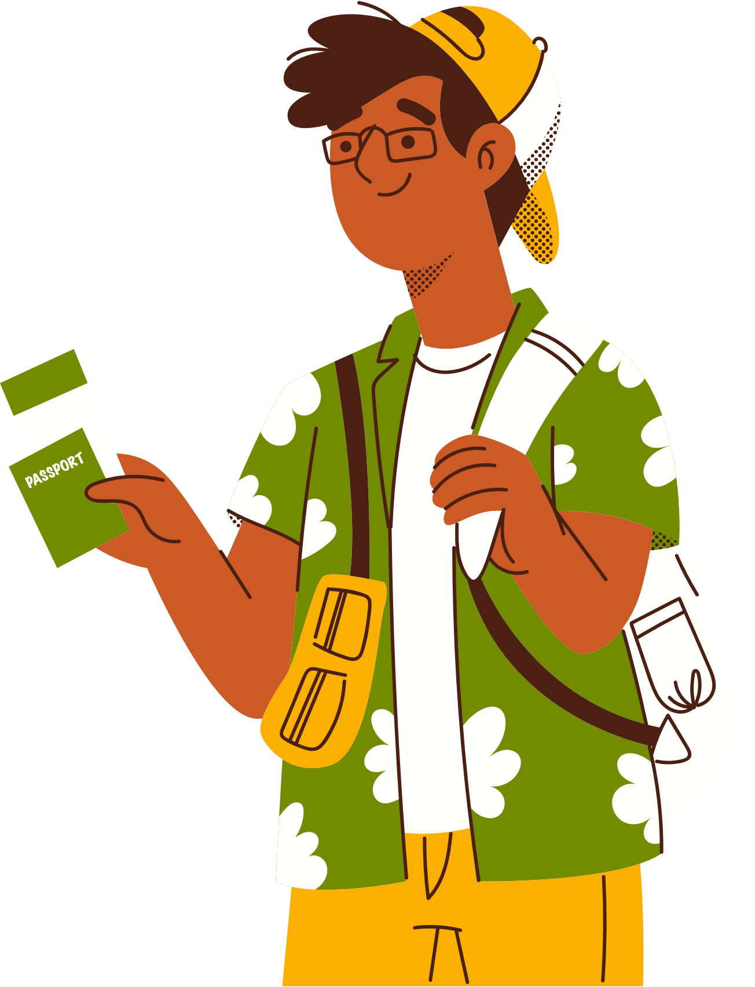
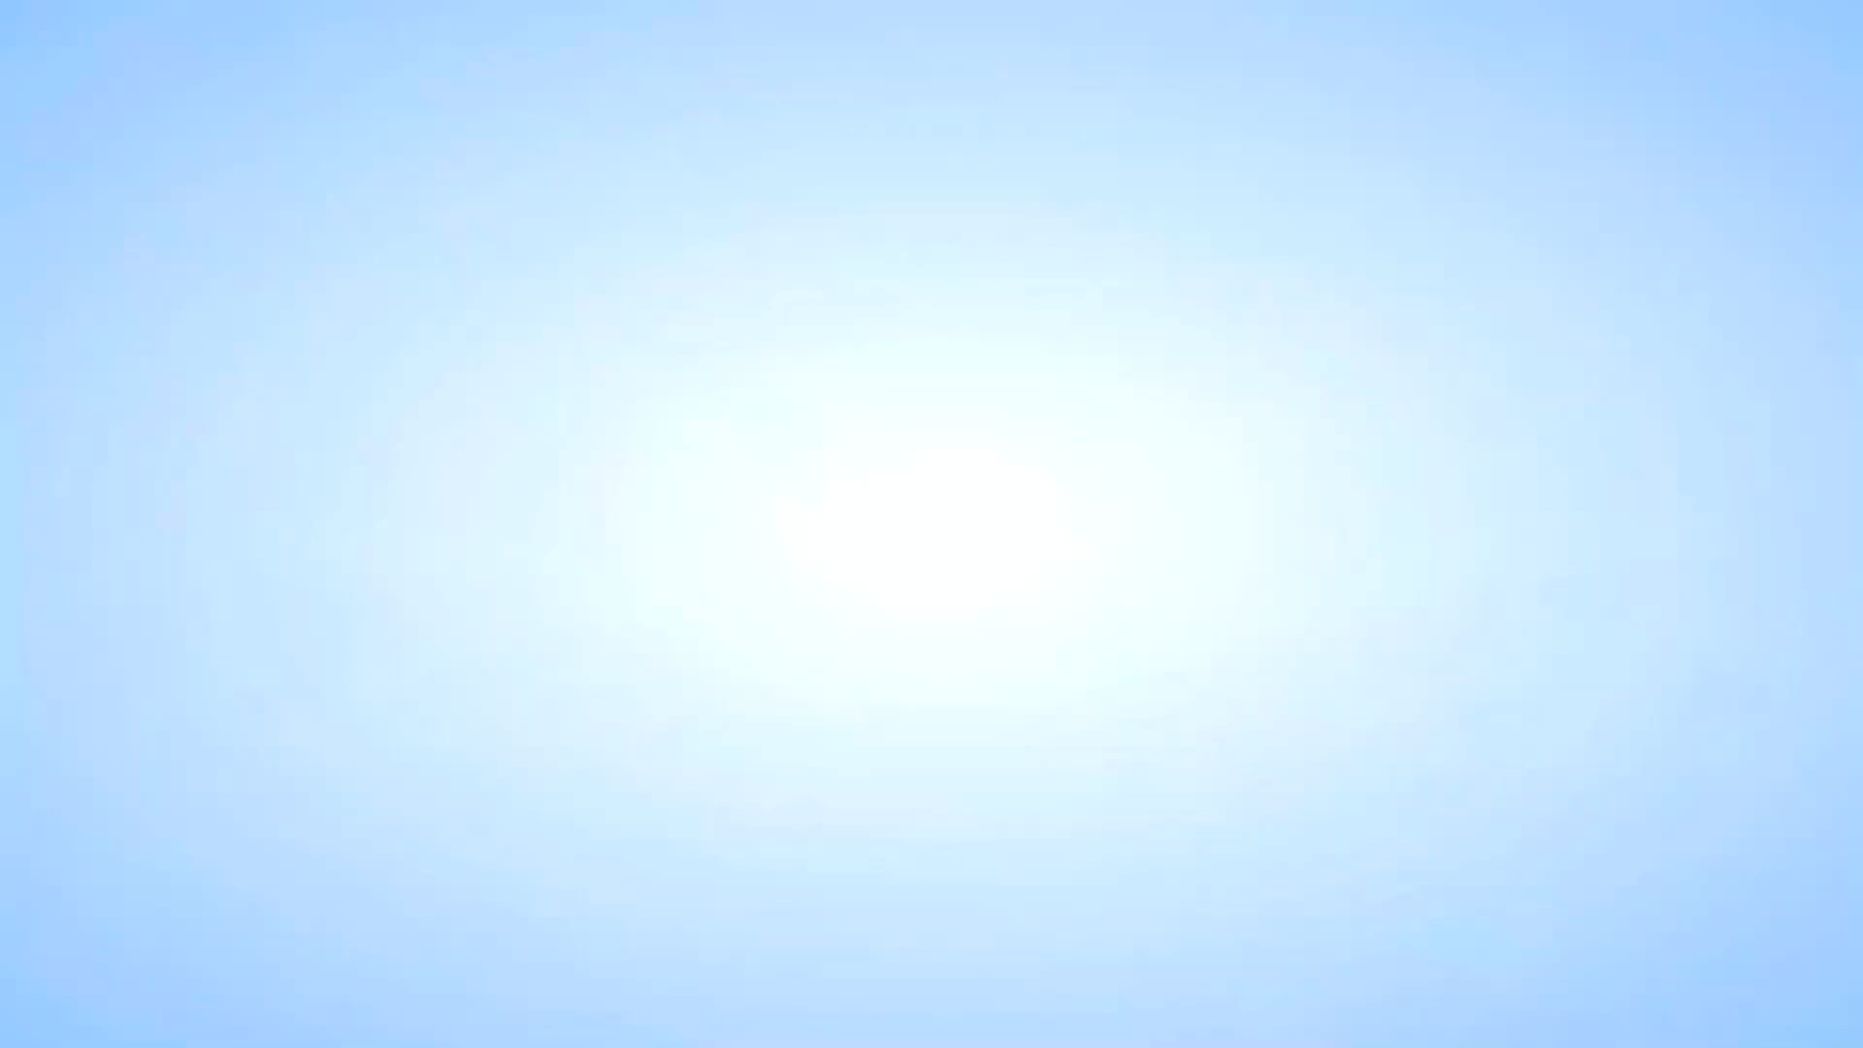


WATCHING A VIDEO

Slide 3
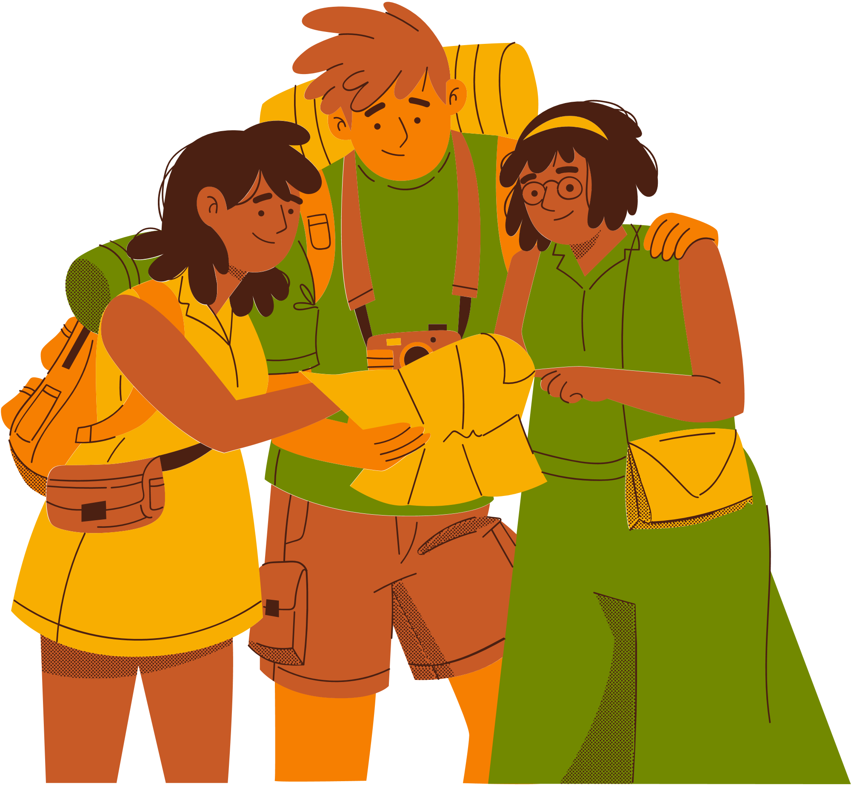
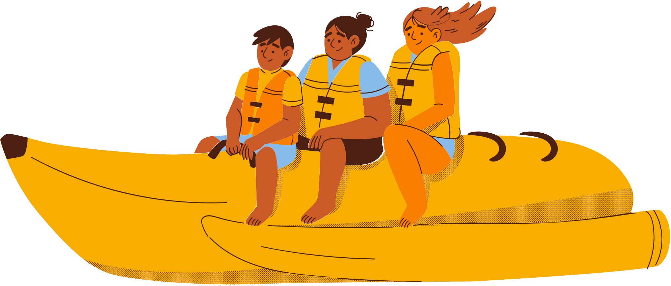
UNIT 7:
NATURAL WONDERS OF THE WORLD
Lesson 1: Getting Started

Slide 4

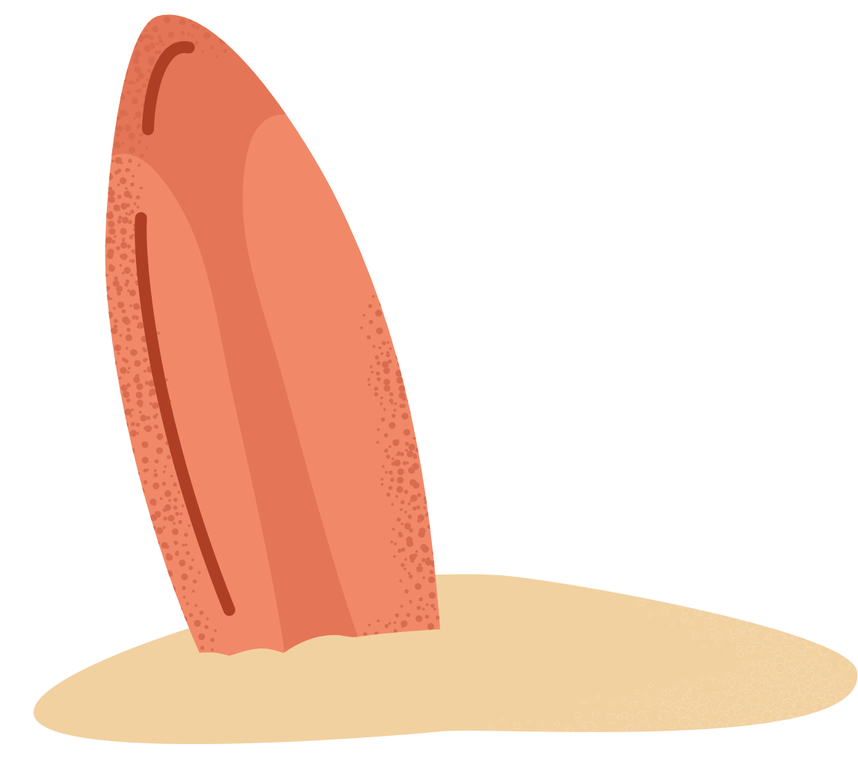
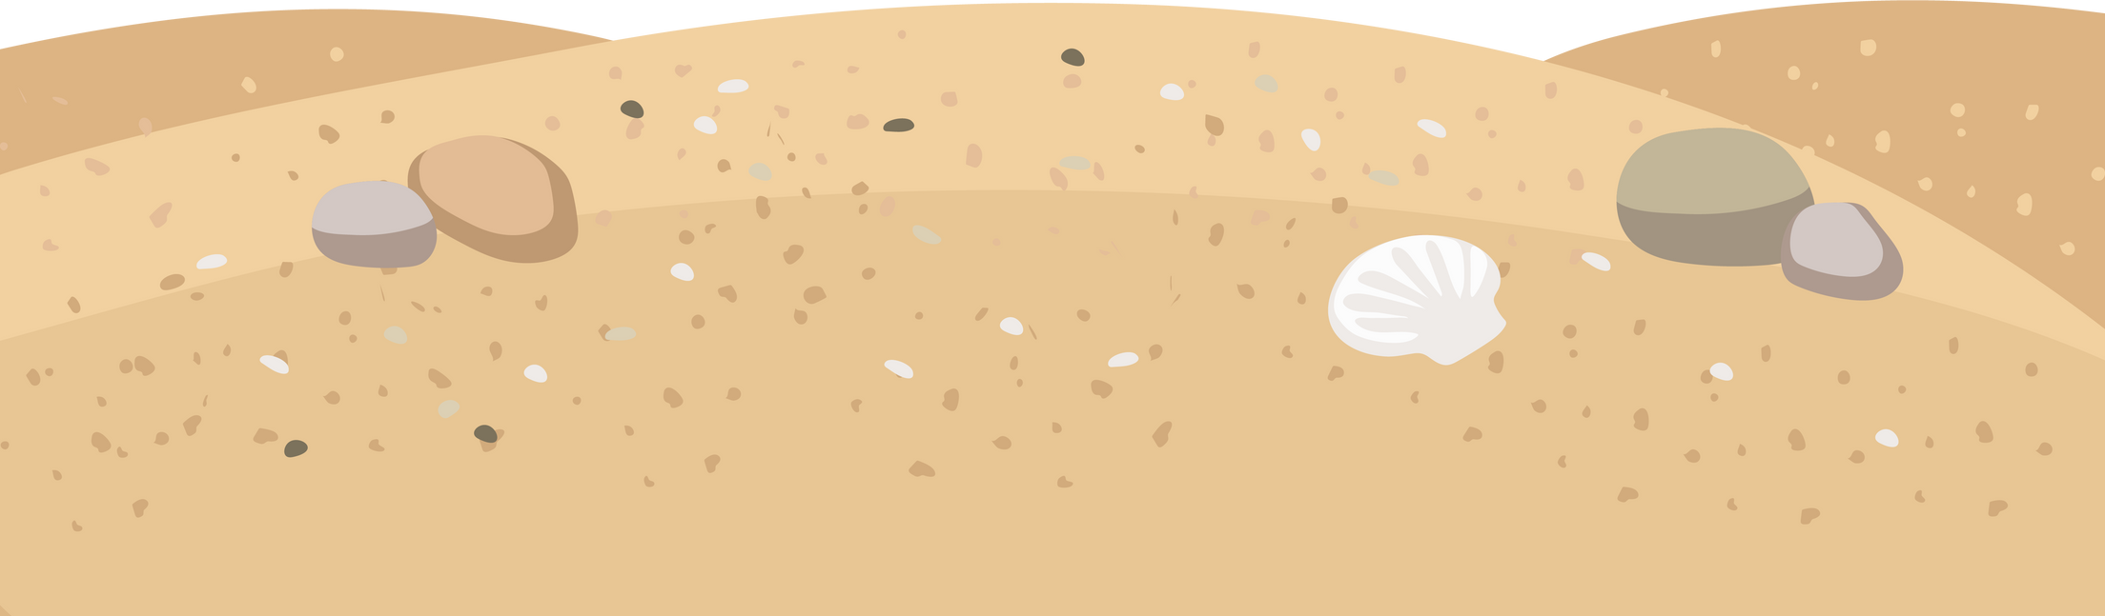
OBJECTIVES
By the end of the lesson, students will be able to:
Use the words related to natural wonders of the world
Gain vocabulary to talk about natural wonders of the world

Slide 5

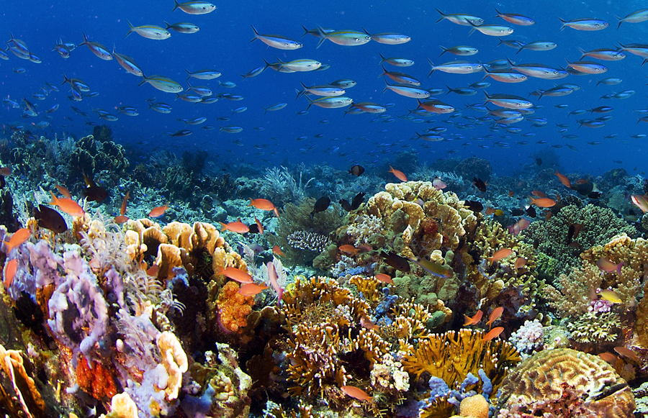
VOCABULARY
crazy (adj) about so/sth
like so/sth very much
Ex: I was crazy about baseball when I was seven.
/ˈkreɪzi/
thích mê

Slide 6
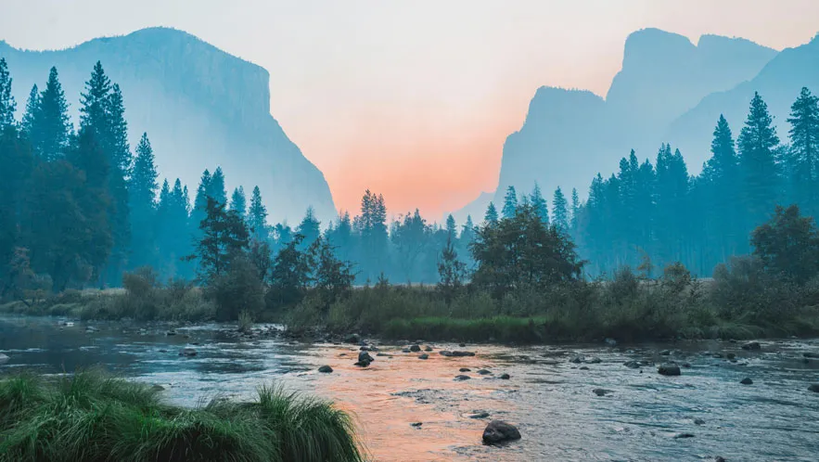
VOCABULARY
a substance like rock, formed in the sea by groups of particular types of small animal, often used in jewelry.
coral (n,adj)
/ˈkɒrəl/
san hô

Slide 7
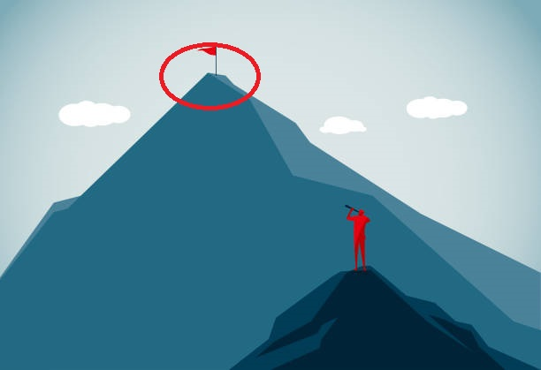
VOCABULARY
landscape (n)
a view or picture of the countryside, or the art of making such pictures.
/ˈlænd.skeɪp/
phong cảnh

Slide 8
VOCABULARY
peak (n)
the highest point
/piːk/
đỉnh, đỉnh núi

Slide 9
VOCABULARY
charming (adj)
pleasant and attractive
/ˈtʃɑː.mɪŋ/
Ex: What a charming street this is.
đẹp

Slide 10

VOCABULARY
sustainable (adj)
able to be maintained or continued
Ex: The website encourages sustainable fashion through swapping.
/səˈsteɪnəbl/
đẹp

Slide 11
VOCABULARY
a place or position
location (n)
/ləʊˈkeɪʃn/
địa điểm, nơi chốn

Slide 12
VOCABULARY
possess (v)
to have or own sth
Ex: I don't possess a single DVD (= I don't have even one DVD).
/pəˈzes/
có, sở hữu

Slide 13
VOCABULARY
1. crazy (adj) about so/sth | /ˈkreɪzi/ | thích mê
2. coral (n,adj) | /ˈkɒrəl/ | san hô
3. landscape (n) | /ˈlænd.skeɪp/ | phong cảnh
4. peak (n) | /piːk/ | đỉnh, đỉnh núi

Slide 14
VOCABULARY
5. charming (adj) | /ˈtʃɑː.mɪŋ/ | đẹp
6. sustainable (adj) | /səˈsteɪnəbl/ | bền vững
7. location (n) | /ləʊˈkeɪʃn/ | địa điểm, nơi chốn
8. possess (v) | /pəˈzes/ | có, sở hữu

Slide 15

LAN
Look and answer
TOM

Slide 16

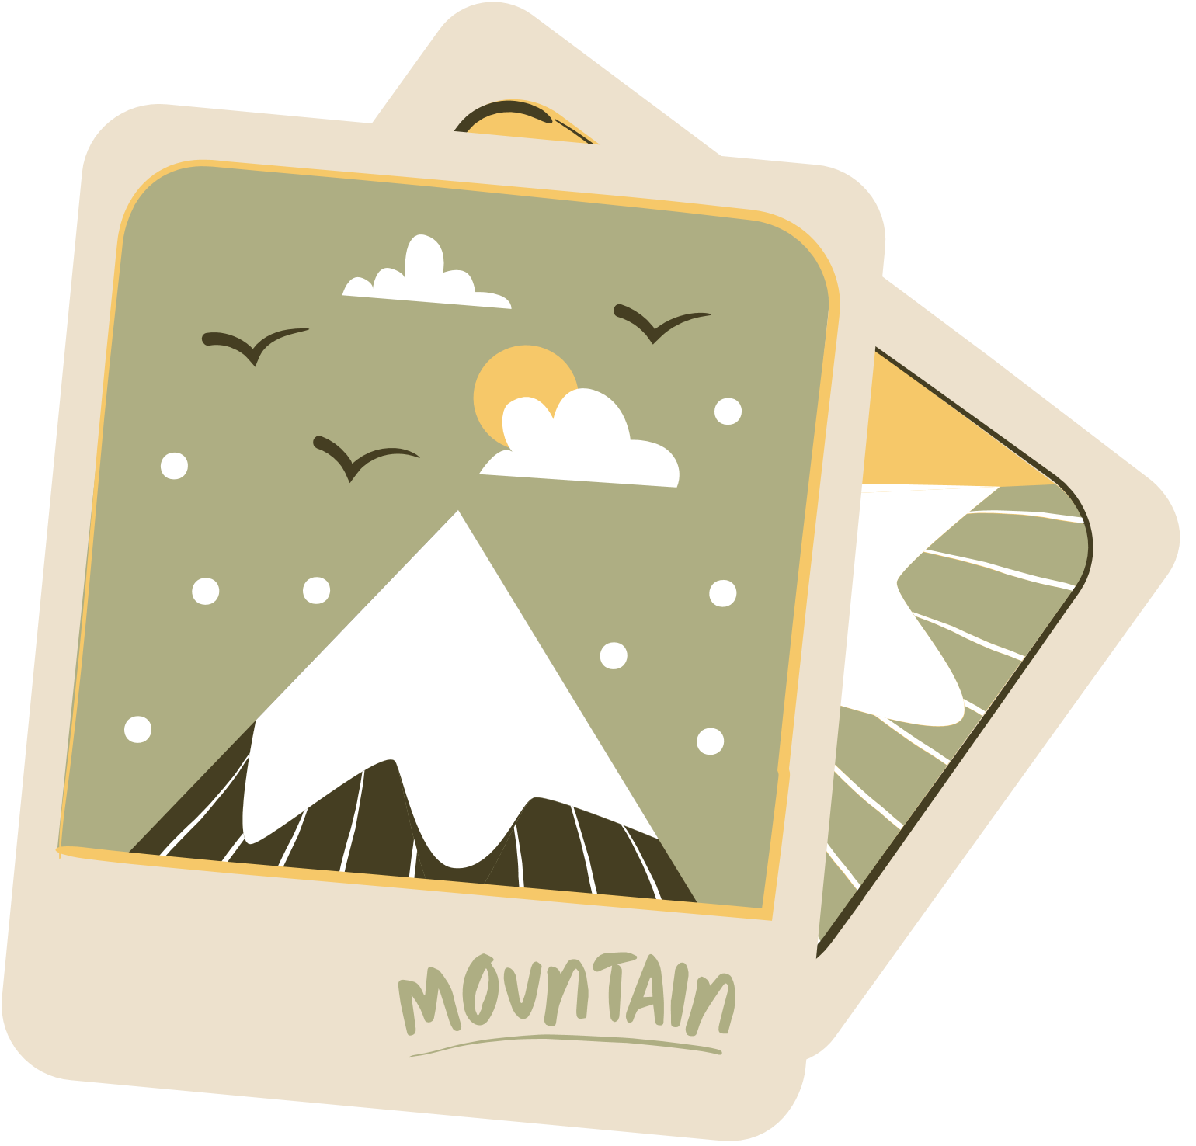
Read and answer the questions
1. Which prize did Tom win?
2. Which natural wonders did Tom talk about?
3. Which risks did Tom mention?
4. Where will Tom visit?
 | T | F
1. Tom took part in the Natural Wonders Contest.
2. Lan is not keen on natural wonders.
3. Tom suggested ways to preserve natural wonders.
4. Tom asked the host if he wanted to go to Ha Long Bay.

Slide 17
Meeting on the corridor
Lan: Hi, Tom. I hear that you’ve won second prize in the Natural Wonders Contest. Congratulations!
Tom: Thanks, Lan. I like exploring the wonders of nature. I’m crazy about them.
Lan: What did you talk about in the contest?
Tom: I talked about some natural wonders like Mount Everest, the Great Barrier Reef, and the Dead Sea.
Lan: Wonderful! I’m interested in them too.
Tom: Well, you know our planet has so many beautiful landscapes, from snow-covered peaks to charming rivers, lakes, and other natural places that we can’t help admiring. So that’s what I talked about.
Lan: Oh yeah … And what else did you mention?
Tom: Well, I mentioned the risk of us, humans, destroying natural wonders,
and I suggested ways to preserve them and support sustainable development.
Lan: Sounds interesting. Do you want to visit any of these places?
Tom: The host also asked me if I wanted to visit those places, and I answered that I wanted to see two of them: the Grand Canyon and Ha Long Bay.
Lan: I’d love to visit them too.

Slide 18
Read and answer the questions
1. Which prize did Tom win?
2. Which natural wonders did Tom talk about?
3. Which risks did Tom mention?
4. Where will Tom visit?
The second prize in the Natural Wonders Contest
Mount Everest, the Great Barrier Reef, and the Dead Sea
Humans, destroying natural wonders.
The Grand Canyon and Ha Long Bay.
 | T | F
1. Tom took part in the Natural Wonders Contest.
2. Lan is not keen on natural wonders.
3. Tom suggested ways to preserve natural wonders.
4. Tom asked the host if he wanted to go to Ha Long Bay.

Slide 19
2. Read the conversation again and tick (√) T (True) of F (False) for each sentence.
 | T | F
1. Tom took part in the Natural Wonders Contest.
2. Lan is not keen on natural wonders.
3. Tom suggested ways to preserve natural wonders.
4. Tom asked the host if he wanted to go to Ha Long Bay.

Slide 20

Check your answer
1. Tom took part in the Natural Wonders Contest.
TRUE
Lan: Hi, Tom. I hear that you’ve won second prize in the Natural Wonders Contest. Congratulations!

Slide 21
Check your answer
2. Lan is not keen on natural wonders.
FALSE
Tom: I talked about some natural wonders like Mount Everest, the Great Barrier Reef, and the Dead Sea.
Lan: Wonderful! I’m interested in them too.

Slide 22
Check your answer
3. Tom suggested ways to preserve natural wonders.
TRUE
Tom: Well, I mentioned the risk of us, humans, destroying natural wonders,
and I suggested ways to preserve them and support sustainable development.

Slide 23
Check your answer
4. Tom asked the host if he wanted to go to Ha Long Bay.
FALSE
Tom: The host also asked me if I wanted to visit those places, and I answered that I wanted to see two of them: the Grand Canyon and Ha Long Bay.

Slide 24
2. Read the conversation again and tick (√) T (True) of F (False) for each sentence.
 | T | F
1. Tom took part in the Natural Wonders Contest. | T
2. Lan is not keen on natural wonders. |  | F
3. Tom suggested ways to preserve natural wonders. | T
4. Tom asked the host if he wanted to go to Ha Long Bay. |  | F

Slide 25


3. Complete the sentences with the words from the box.
explore
couldn’t help
landscape
support
development
1. A _____________________ is everything you can see in a large area of land, especially in the countryside.
2. It was risky for him to climb the peak, but we ______________ admiring his courage.
3. The best way to _____________ the Trang An Landscape Complex is by boat.
4. Environmentalists strongly ______________ measures to save these heritage trees.
5. Sustainable ________________ goals will guide us to create a more sustainable future for all.

Slide 26
4. Underline the correct answer to complete each sentence.
1. Charles is crazy / interested about football. He follows all the World Cup matches.
2. When you go to Mui Ne, you can see the unique location / landscape of a desert.
3. The children were very eager to explore/ possess the surrounding countryside.
4. Can you suggest / discover ways of boosting our local tourism?
5. Tourism develops / contributes millions of dollars to our country’s economy.

Slide 27
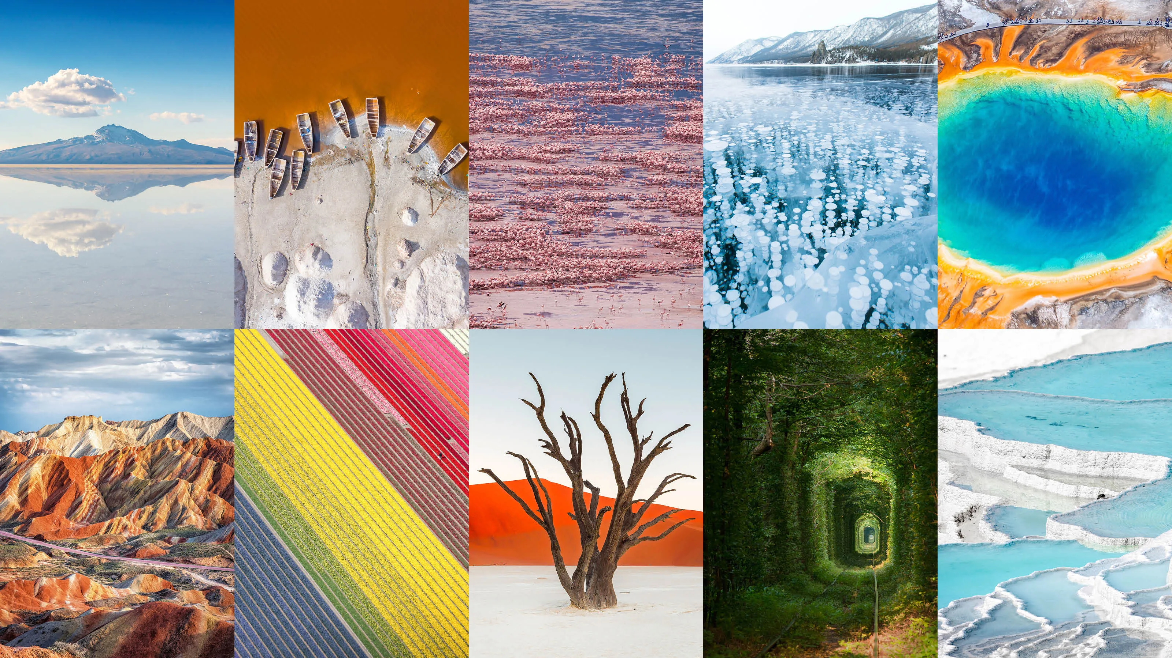
Work in groups. List some natural wonders and say where they are located. The group that has the most correct answers wins.
NATURAL WONDERS KNOWLEDGE
- The Grand Canyon, USA
- The Great Barrier Reef, Australia….

Slide 28
HOMEWORK
Learn by heart vocabulary
Do exercises in the workbook
Prepare: A Closer Look 1
Prepare: Project

Slide 29
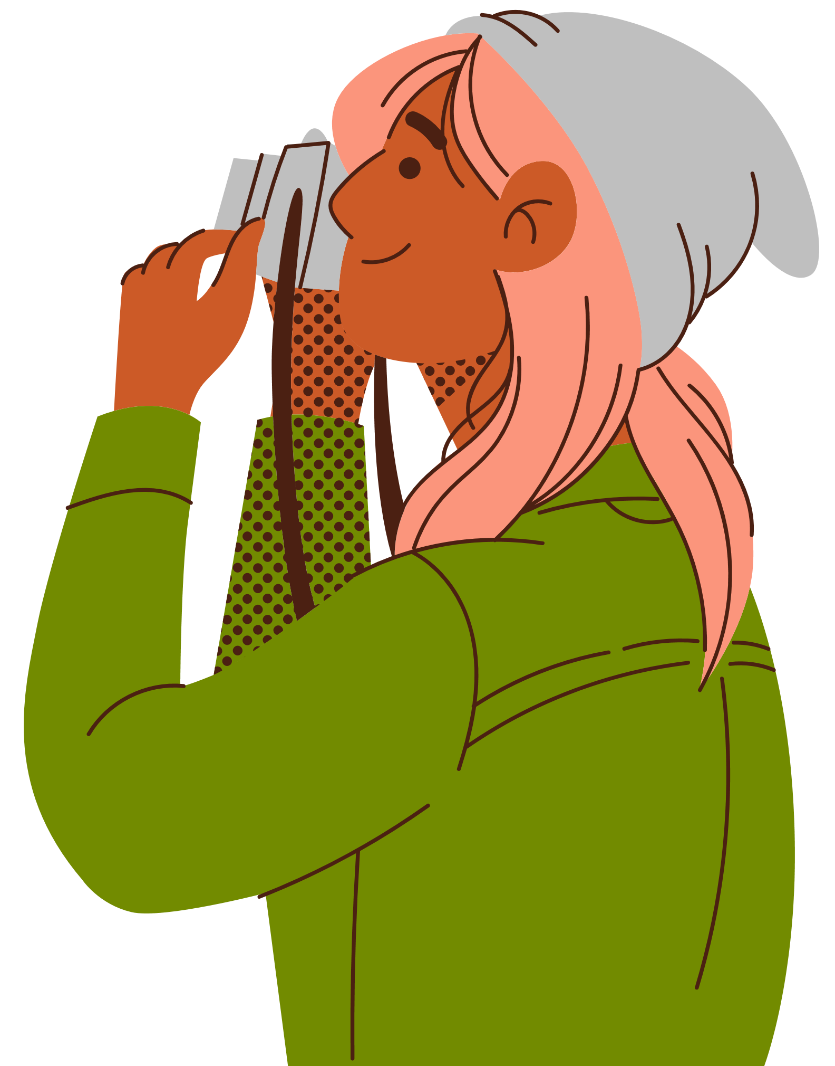
Thank You

