Slide 1

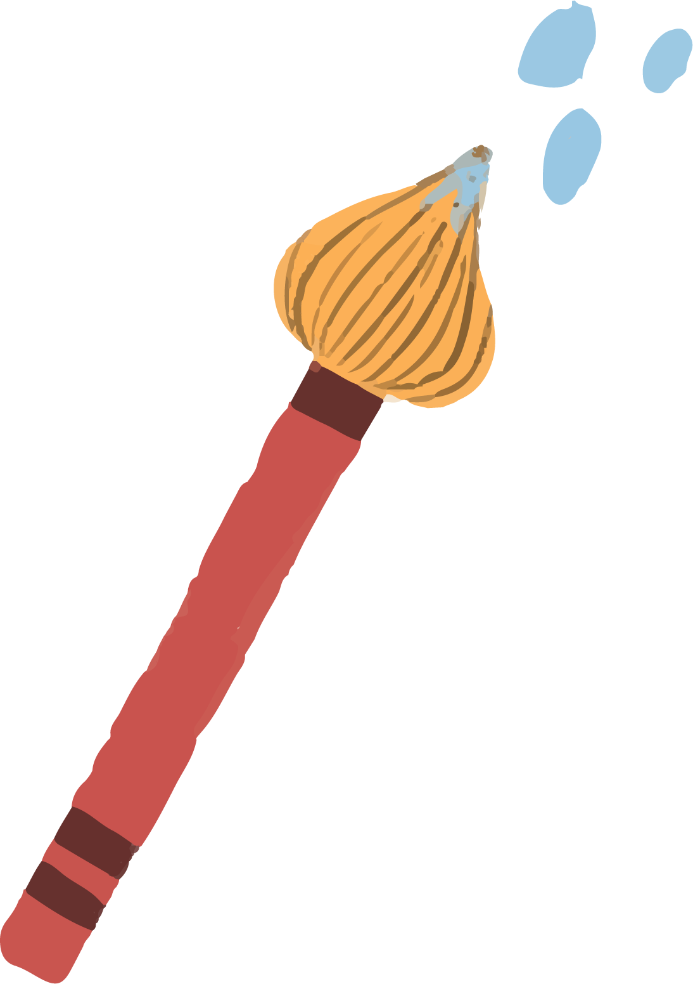




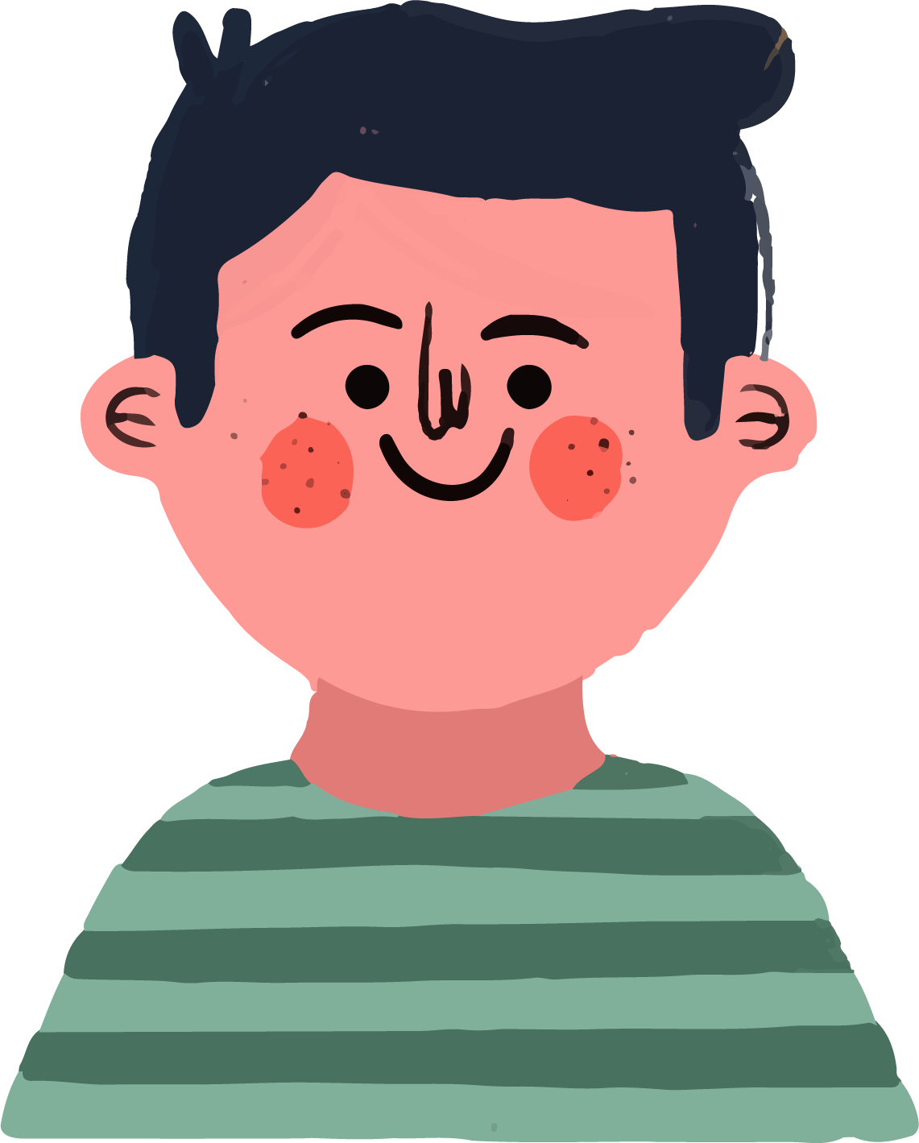
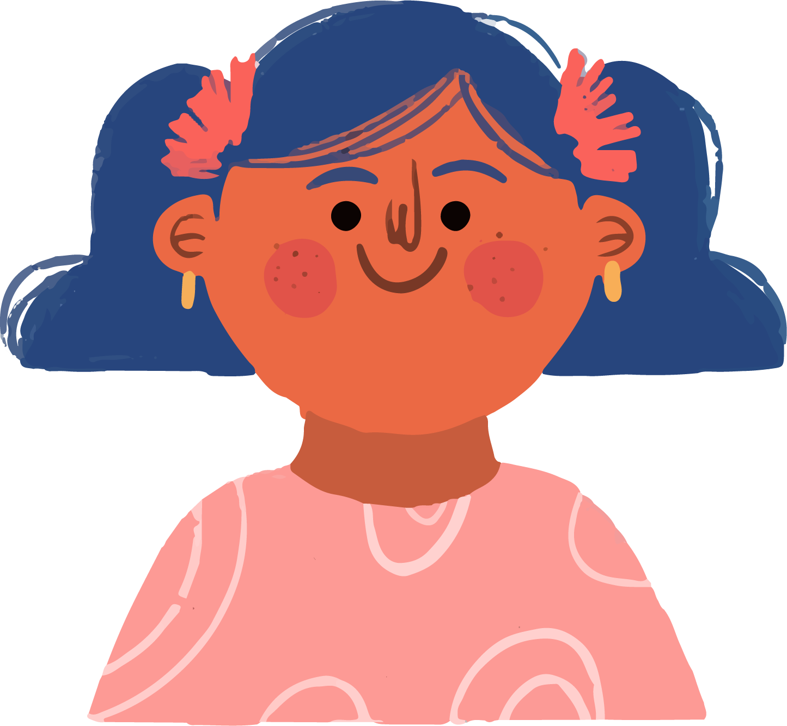

English 8
Unit 10 Communication
in the future
Lesson 5. Skills 1
Notes:
"Let's play an emoji challenge! I will show you 11 emoji sets. Each set shows a way of communicate.”
1. Stand at your place and face the board.
2. 1 player from each group to join each round. (Take turns!)
3. Look at the emoji set on the screen for 5 seconds.
4. Ring the bell as fast as you can
5. Say your answer quickly.
6. 1 point for per correct answer
7. Pass the turn to a new player in the next round.
8. Play for 11 rounds.

Slide 2


Emoji Challenge
✍️✉️📝
Writing letters
Notes:
"Let's play an emoji challenge! I will show you 11 emoji sets. Each set shows a way of communicate.”
1. Stand at your place and face the board.
2. 1 player from each group to join each round. (Take turns!)
3. Look at the emoji set on the screen for 5 seconds.
4. Ring the bell as fast as you can
5. Say your answer quickly.
6. 1 point for per correct answer
7. Pass the turn to a new player in the next round.
8. Play for 11 rounds.

Slide 3
Emoji Challenge
🐦📜
✉️📮
🧑‍🤝‍🧑💬
Carrier pigeon
Sending letters
Talking
face-to-face

Slide 4
Emoji Challenge
📱💬👆
📞👂
💻🧑‍💻📞
Text message
Phone call
Video call

Slide 5
Emoji Challenge
🎙️🗣️
📱🌐
📧📤
Voice message
Social network
Sending emails

Slide 6
Emoji Challenge
🤖📞
🧠🔁🧠
Robot communication
Telepathy
Notes:
37-42
Great job, everyone! You guessed many different ways of communication – some we use today, and some might happen in the future.”
“Now, we’re going to read about one very special way of communication – it’s called telepathy.”
“Before we read, let’s learn some new words that will help you understand the text better.”

Slide 7



🧠🔁🧠
1. Telepathy (n)
/təˈlepəθi/
thought-to-thought, without talking
Notes:
42-47
"Now let's learn a new word that's very important for today's lesson." (point to the slide) "This word is telepathy everyone says it with me: telepathy."
"Telepathy means sending thoughts to another person without speaking. It's like 'thought-to-thought' communication."
"Look at the picture — we see two brains and a symbol in the middle. This means the thoughts are going from one mind to another."
"Can we use telepathy now?" (pause for students to answer likely 'No') "Maybe not now... but in the future? Maybe yes! That's what we'll read about today."

Slide 8
2. Keep in contact (phr)
= keep in touch (with SB)
/ˈkɒntækt/
to talk to someone very often
Notes:
"Let's look at another phrase we often use in daily life: keep in contact.
Say it with me: keep in contact."
"It means to talk to someone very often, so you don't lose your relationship.”
"We also say: keep in touch. These two phrases mean the same."
Gesture example: I keep in contact with my grandma by calling her every week."
Think about who you message often!"

Slide 9
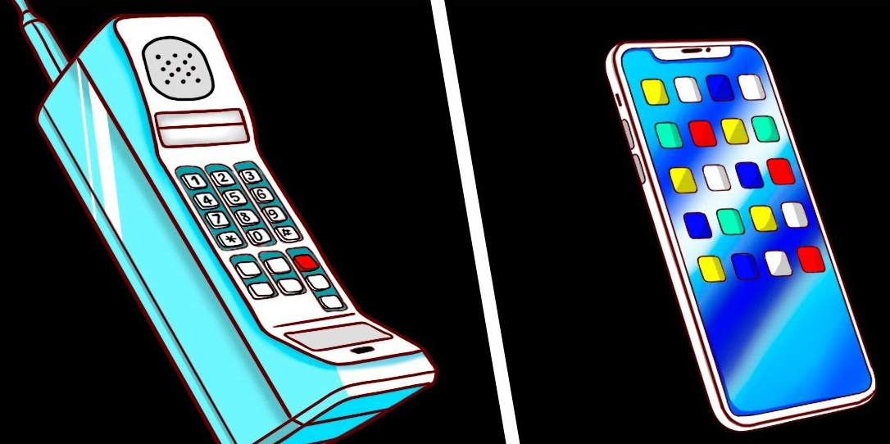
3. advanced (adj)
/ədˈvɑːnst/
more developed or modern
Notes:
Say it with me: advanced /ad'va:nst/.
"It means something that is more developed or more modern than before."
• Point to the images:
"Look here — the first phone is old. The second one is a smartphone.
Smartphones are more advanced than the old phones.”
• Give an example: give me some advanced technology we use every day: smartwatches, online learning, and even robots!"

Slide 10

4. Catch one’s thought (phr)
/kætʃ wʌnz θɔːt/
understand or read what SB is thinking
Notes:
Say it with me:
Catch someone's thoughts /katf wanz Ooits/."
(Point to the image)
"Imagine two people... and one of them can understand what the other person is thinking without talking any words
"This phrase means to read or understand what someone is thinking — with your mind, not your ears.”
For example: "In the future, a telepathy device may catch your thoughts and send them to your friend.”
• "Do you talk with your mouth when you catch someone's thoughts?" → No
• "Do you need a phone?" → No
• "Do you use your mind?" → Yes

Slide 11


5. Take advantage of (adj)
/teɪk ədˈvɑːntɪdʒ ɒv/
to make good or bad use of ST
Notes:
42-47
Say it with me: take advantage of /terk ad'vantid 3 lov/."
Point to the images:
"Look at the first picture — a hacker is using the internet in a bad way."
"Now look at the second picture students are using the internet in a good way to learn better.”
"This phrase means to make use of something — sometimes to help yourself, but sometimes in a negative way.”
If we use st in a good way, so Vnese meaning is Tận dung.
If we use st in a bad way, so Vnese meaning is Lợi dung.

Slide 12
Activity 2
Work individually.
Read the interview.
Tick the speaker of each sentence.
Notes:
47-55
"Now that we've learned some important words
let's see how these words are used in real conversation.”

Slide 13
Activity 2. Who says that …?
MC: Hi everyone. Today, I'll ask some members of the Technology Club to predict how people will communicate in the future. Let's meet Minh and Tom.
Minh & Tom: Hi everyone.
MC: Minh and Tom, how do you and your friends keep in contact?
Minh: Well, we mostly text each other.
We also send voice messages.
Tom: I often see my friends in person, but sometimes we call via the Internet.
MC: Do you think these ways of communication will still be popular in 50 years?
Tom: Not really. We'll use more advanced ways, like telepathy. We'll pass our thoughts to another person without talking and ...
1
2
1
1
3
2
Notes:
47-55
"You're going to read an interview about future communication with two students, Minh and Tom
1. Number the arrangement of the interview.
2. You match the ideas to the correct speaker to complete the table in Activity 2.
3.

Slide 14
Activity 2. Who says that …?
MC: Hold on. I think only a very few people may have this ability.
Minh: Yes, but in the future, everyone will be able to use telepathy. We'll wear a tiny device to catch our thoughts and send them to other people.
MC: Cool! But will there be any problems with telepathy?
Tom: Hmm, telepathy devices can "read" one’s mind, so bad people might take advantage of it to control someone else.
MC: Besides that, some people will be too lazy to even talk anymore.
4
2
5
3
6
Notes:
"Now that we've learned some important words
let's see how these words are used in real conversation.”
"You're going to read an interview about future communication with two students, Minh and Tom
1. Number the arrangement of the interview.
2. You match the ideas to the correct speaker to complete the table in Activity 2.
3.

Slide 15
Activity 2. Who says that …?
MC: Hi everyone. Today, I'll ask some members of the Technology Club to predict how people will communicate in the future. Let's meet Minh and Tom.
Minh & Tom: Hi everyone.
MC: Minh and Tom, how do you and your friends keep in contact?
Minh: Well, we mostly text each other.
We also send voice messages.
Tom: I often see my friends in person, but sometimes we call via the Internet.
MC: Do you think these ways of communication will still be popular in 50 years?
Tom: Not really. We'll use more advanced ways, like telepathy. We'll pass our thoughts to another person without talking and ...
1
0. He sends voice messages to friends
→ Minh 1
1. He calls friends by using the Internet
2
2. Not many people can use telepathy
1
3. Everyone can do telepathy in the future
1
4. We need a small device for telepathy
3
5. Bad people can make use of telepathy
to harm others
6. Some people won't want to talk anymore
2
Notes:
ForeẽampleKẺBẢNG trênbảng đen
0. Keywords
I find keywords in the interview
It is in Minh 1
Tick in MINH column
Evidence MINH 1
2. Now underline keywords for each statement
3. Read the interview, match the ideas to the correct speaker to complete the table in 2 ms
4. share ur answer with your partner

Slide 16
Activity 2. Who says that …?
MC: Hi everyone. Today, I'll ask some members of the Technology Club to predict how people will communicate in the future. Let's meet Minh and Tom.
Minh & Tom: Hi everyone.
MC: Minh and Tom, how do you and your friends keep in contact?
Minh: Well, we mostly text each other.
We also send voice messages.
Tom: I often see my friends in person, but sometimes we call via the Internet.
MC: Do you think these ways of communication will still be popular in 50 years?
Tom: Not really. We'll use more advanced ways, like telepathy. We'll pass our thoughts to another person without talking and ...
1
0. He sends voice messages to friends
→ Minh 1
1. He calls friends by using the Internet
2
2. Not many people can use telepathy
1
3. Everyone can do telepathy in the future
1
4. We need a small device for telepathy
3
5. Bad people can make use of telepathy
to harm others
6. Some people won't want to talk anymore
2
Notes:
ForeẽampleKẺBẢNG trênbảng đen
0. Keywords
I find keywords in the interview
It is in Minh 1
Tick in MINH column
Evidence MINH 1
2. Now underline keywords for each statement
3. Read the interview, match the ideas to the correct speaker to complete the table in 2 ms
4. share ur answer with your partner

Slide 17
Activity 2. Who says that …?
MC: Hi everyone. Today, I'll ask some members of the Technology Club to predict how people will communicate in the future. Let's meet Minh and Tom.
Minh & Tom: Hi everyone.
MC: Minh and Tom, how do you and your friends keep in contact?
Minh: Well, we mostly text each other.
We also send voice messages.
Tom: I often see my friends in person, but sometimes we call via the Internet.
MC: Do you think these ways of communication will still be popular in 50 years?
Tom: Not really. We'll use more advanced ways, like telepathy. We'll pass our thoughts to another person without talking and ...
1
0. He sends voice messages to friends
→ Minh 1
1. He calls friends by using the Internet
→ Tom 1
2
1
1
3
2
Notes:
47-55
"Now that we've learned some important words
let's see how these words are used in real conversation.”
"You're going to read an interview about future communication with two students, Minh and Tom
1. Number the arrangement of the interview.
2. Now underline keywords for each statement
3. Read the interview, match the ideas to the correct speaker to complete the table in 2 ms
4. share ur answer with your partner

Slide 18
Activity 2. Who says that …?
MC: Hold on. I think only a very few people may have this ability.
Minh: Yes, but in the future, everyone will be able to use telepathy. We'll wear a tiny device to catch our thoughts and send them to other people.
MC: Cool! But will there be any problems with telepathy?
Tom: Hmm, telepathy devices can "read" one’s mind, so bad people might take advantage of it to control someone else.
MC: Besides that, some people will be too lazy to even talk anymore.
2. Not many people can use telepathy
4
→ MC 4
2
3. Everyone can do telepathy in the future
→ Minh 2
4. We need a small device for telepathy
5
→ Minh 2
5. Bad people can make use of telepathy
to harm others
3
→ Tom 3
6. Some people won't want to talk anymore
6
→ MC 6
Notes:
"Now that we've learned some important words
let's see how these words are used in real conversation.”
"You're going to read an interview about future communication with two students, Minh and Tom
1. Number the arrangement of the interview.
2. You match the ideas to the correct speaker to complete the table in Activity 2.
3.

Slide 19
Activity 3
Work individually.
Read the interview again.
Choose the correct answer A, B, or C.
Notes:
55-14.00
Great job matching the ideas to the correct speaker!"
"Now, let's check your understanding of the interview more deeply."
"You're going to answer some multiple-choice questions
Now, to scan the information easier, underline keywords for each question and 3 options if needed

Slide 20
Activity 3. A, B or C?
MC: Hi everyone. Today, I'll ask some members of the Technology Club to predict how people will communicate in the future. Let's meet Minh and Tom.
Minh & Tom: Hi everyone.
MC: Minh and Tom, how do you and your friends keep in contact?
Minh: Well, we mostly text each other.
We also send voice messages.
Tom: I often see my friends in person, but sometimes we call via the Internet.
MC: Do you think these ways of communication will still be popular in 50 years?
Tom: Not really. We'll use more advanced ways, like telepathy. We'll pass our thoughts to another person without talking and ...
1
1. What is the interview
mainly about?
A. One way of future communication
B. Voice chats and online calls
C. Problems of telepathy
2. Which way of communication below is NOT mentioned in the interview?
A. Meeting face to face
B. Writing an email
C. Telepathy
3. According to Tom, telepathy means ....
A. making phone calls via the Internet
B. talking on tiny devices
C. communicating by thoughts
2
1
1
3
2
Notes:
55-14.00
Great job matching the ideas to the correct speaker!"
"Now, let's check your understanding of the interview more deeply."
"You're going to answer some multiple-choice questions
Now, to scan the information easier, underline keywords for each question and 3 options if needed

Slide 21
Activity 3. A, B or C?
Tom: Not really. We'll use more advanced ways, like telepathy. We'll pass our thoughts to another person without talking and ...
MC: Hold on. I think only a very few people may have this ability.
Minh: Yes, but in the future, everyone will be able to use telepathy. We'll wear a tiny device to catch our thoughts and send them to other people.
MC: Cool! But will there be any problems with telepathy?
Tom: Hmm, telepathy devices can "read" one’s mind, so bad people might take advantage of it to control someone else.
2
4. The word “advanced” in Tom (2)
is CLOSEST in meaning to ...
A. tiny
B. lazy
C. Modern
5. The word “it” in Tom (3) refers
to ...
A. telepathy
B. people
C. mind
4
2
5
3
Notes:
"Great job matching the ideas to the correct speaker!"
"Now, let's check your understanding of the interview more deeply."
"You're going to answer some multiple-choice questions
Now, to scan the information easier, underline keywords for each question and 3 options if needed
choose the best answer: A, B, or C. Use what you remember from the reading — and look back at the text if you need to!”
"Let's start with question 1 together."

Slide 22
Activity 3. A, B or C?
MC: Hi everyone. Today, I'll ask some members of the Technology Club to predict how people will communicate in the future. Let's meet Minh and Tom.
Minh & Tom: Hi everyone.
MC: Minh and Tom, how do you and your friends keep in contact?
Minh: Well, we mostly text each other.
We also send voice messages.
Tom: I often see my friends in person, but sometimes we call via the Internet.
MC: Do you think these ways of communication will still be popular in 50 years?
Tom: Not really. We'll use more advanced ways, like telepathy. We'll pass our thoughts to another person without talking and ...
1
1. What is the interview
mainly about?
A. One way of future communication
B. Voice chats and online calls
C. Problems of telepathy
2
1
1
→ Evidence: MC 1
3
2
Notes:
"Let's start with question 1 together."
If the keyword is maily about, you need to skim to find main idea
And main ideas usually appear in the beginning

Slide 23
Activity 3. A, B or C?
MC: Hi everyone. Today, I'll ask some members of the Technology Club to predict how people will communicate in the future. Let's meet Minh and Tom.
Minh & Tom: Hi everyone.
MC: Minh and Tom, how do you and your friends keep in contact?
Minh: Well, we mostly text each other.
We also send voice messages.
Tom: I often see my friends in person, but sometimes we call via the Internet.
MC: Do you think these ways of communication will still be popular in 50 years?
Tom: Not really. We'll use more advanced ways, like telepathy. We'll pass our thoughts to another person without talking and ...
1
2
2. Which way of communication below is NOT mentioned in the interview?
A. Meeting face to face
B. Writing an email
C. Telepathy
1
→ Tom 1
→ Topic of the interview
1
3
2

Slide 24
Activity 3. A, B or C?
MC: Hi everyone. Today, I'll ask some members of the Technology Club to predict how people will communicate in the future. Let's meet Minh and Tom.
Minh & Tom: Hi everyone.
MC: Minh and Tom, how do you and your friends keep in contact?
Minh: Well, we mostly text each other.
We also send voice messages.
Tom: I often see my friends in person, but sometimes we call via the Internet.
MC: Do you think these ways of communication will still be popular in 50 years?
Tom: Not really. We'll use more advanced ways, like telepathy. We'll pass our thoughts to another person without talking and ...
1
2
3. According to Tom, telepathy means ....
A. making phone calls via the Internet
B. talking on tiny devices
C. communicating by thoughts
1
1
3
→ Evidence: Tom 2
2

Slide 25
Activity 3. A, B or C?
Tom: Not really. We'll use more advanced ways, like telepathy. We'll pass our thoughts to another person without talking and ...
MC: Hold on. I think only a very few people may have this ability.
Minh: Yes, but in the future, everyone will be able to use telepathy. We'll wear a tiny device to catch our thoughts and send them to other people.
MC: Cool! But will there be any problems with telepathy?
Tom: Hmm, telepathy devices can "read" one’s mind, so bad people might take advantage of it to control someone else.
2
4. The word “advanced” in Tom (2)
is CLOSEST in meaning to ...
A. tiny
B. lazy
C. modern
5. The word “it” in Tom (3) refers
to ...
A. telepathy
B. people
C. mind
4
2
5
3
Notes:
55-14.00

Slide 26
Activity 4
Work in pairs.
Read the following ideas about online calls.
Put the ideas in the correct column.
Notes:
14.00-05
Let's move on to Activity 4,
"You'll read some ideas of online calls and decide: are there advantages or disadvantages?

Slide 27


Activity 4
The ideas about “Online calls”
a. They are cheap or even free.
b. There must be an Internet connection.
c. You can talk to people from distant places.
d. You may receive unwanted calls.
e. You can make group calls.
f. You need a smart device.
Advantages
Disadvantages
Notes:
Read a—f ideas and Underline keywords
Now work in pairs to decide: each idea is an advantage or a disadvantage.
Write each letter (a-f) into the correct column in the table.

Slide 28





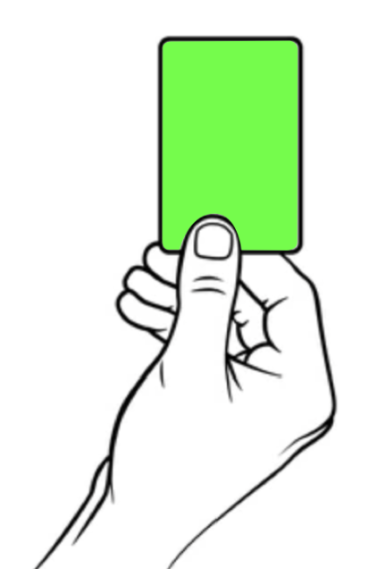




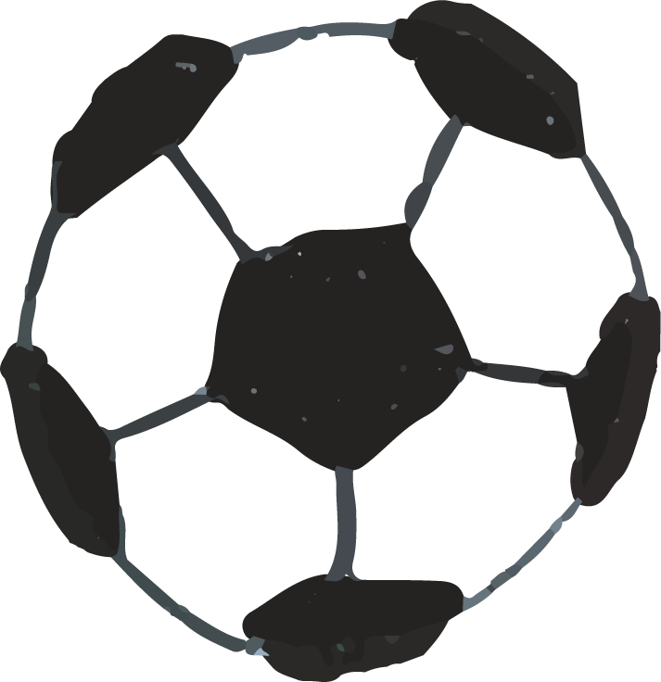

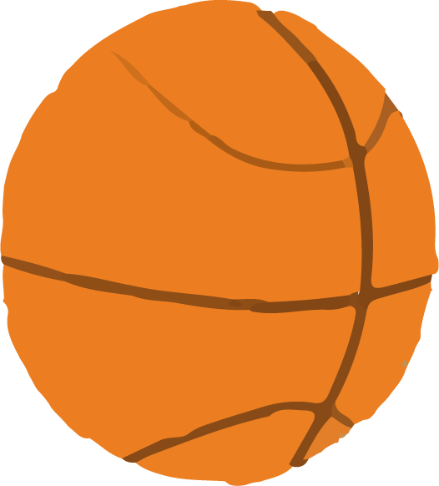

02
Segunda opción
→ Advantages
→ Disadvantages
Notes:
Now we check
Each pair has 2 cards: green and red
Raise green card for advan
Raise red card for disad
When you hear the ring, raise your card

Slide 29
Activity 4
The ideas about “Online calls”
a. They are cheap or even free.
b. There must be an Internet connection.
c. You can talk to people from distant places.
d. You may receive unwanted calls.
e. You can make group calls.
f. You need a smart device.
Advantages
a
c
e
Disadvantages
b
d
f
Notes:
14.00-05

Slide 30
“Online calls”
- cheap or even free
- distant places
- group calls
- Internet connection
- a smart device
- unwanted calls
“Telepathy”
- just thinking
- no internet connection
- not many people
- control one’s mind
- lazy to talk
Notes:
05-20
Great work thinking about the good and bad sides of online calls.”
"Before moving to the speaking task, let's think again about telepathy.
"We already read about it in the interview earlier. Can you remember — what are the advantages of telepathy?"
"How about the disadvantages?"

Slide 31
“Online calls”
Useful expressions
- cheap or even free
- distant places
- group calls
• One advantage/benefit is ...
→ One advantage of online calls is free.
• Another good thing is …
→ Another good thing is that we can understand somebody without talking.
- Internet connection
- a smart device
- unwanted calls
“Telepathy”
• One disadvantage/drawback is ...
→ One drawback of online calls is unwanted calls.
• Another bad thing is …
→ Another bad thing is that people don’t want to talk anymore.
- just thinking
- no internet connection
- not many people
- control one’s mind
- lazy to talk
Notes:
You have the idea of online calls and telepathy.
Ideá are what to say
And how to say clearly, we need expressions and structure
To talk about advan, we use .... Repeat after me
To talk about dis, we use .... Repeat after me

Slide 32
“Online calls”
Useful expressions
- cheap or even free
- distant places
- group calls
• One advantage/benefit is ...
→ One advantage of online calls is free.
• Another good thing is …
→ Another good thing is that we can understand somebody without talking.
- Internet connection
- a smart device
- unwanted calls
“Telepathy”
• One disadvantage/drawback is ...
→ One drawback of online calls is unwanted calls.
• Another bad thing is …
→ Another bad thing is that people don’t want to talk anymore.
- just thinking
- no internet connection
- not many people
- control one’s mind
- lazy to talk
Notes:
You have the idea of online calls and telepathy. use your ideas to talk more in groups.”
To speak clearly, we will use some useful sentence structures."

Slide 33
02
Segunda opción
→I think there are both advantages and disadvantages of __. One advantage/benefit is __ . Another good thing is __ . However, one disadvantage is __. Another drawback is __. In my opinion, ___ is ___.

Slide 34
Activity 5
Work in groups.
Choose one: Telepathy or Online calls?
Discuss its advantages and disadvantages.
Report your answers.
Notes:
You have the idea of online calls and telepathy. use your ideas to talk more in groups.”
Also have expressions and structures to talk about ad and dis
"You'll choose one way of communication and discuss its advantages and disadvantages together."

