Slide 1




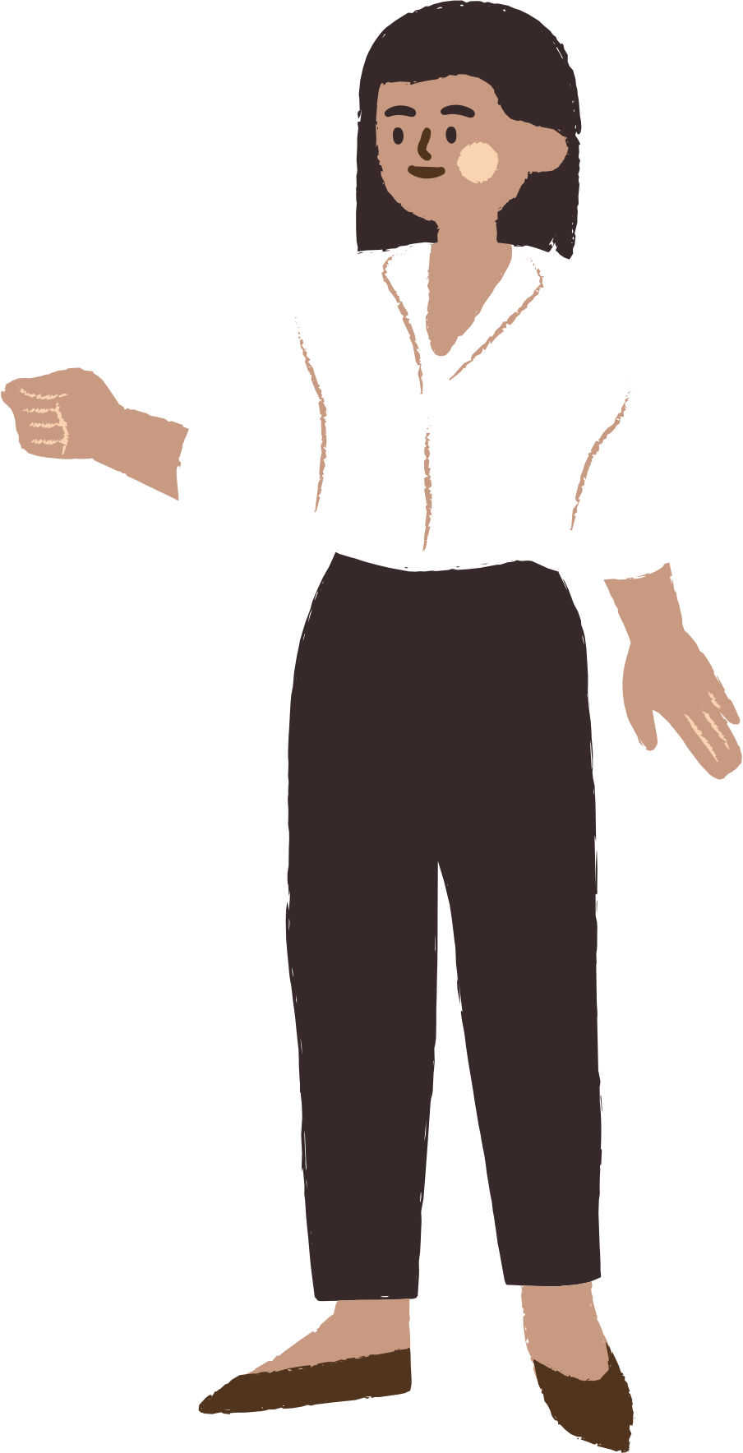
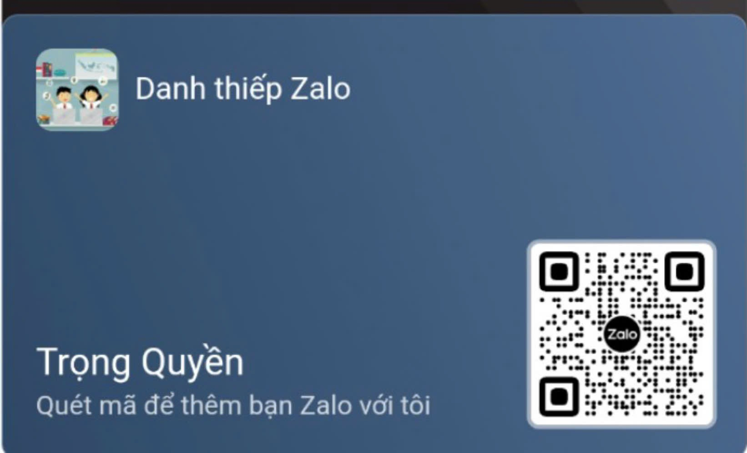




UNIT 9
World Englishes
LESSON 3: A CLOSER LOOK 2
Nguyễn Thị Mai
Notes:
TRUY CẬP MÃ QR ĐỂ NHẬN QUÀ TẶNG
https://facebook.com/groups/853679022766648/

Slide 2






CONTENT
WARM-UP
VOCABULARY
PRACTICE
GAMES

Slide 3

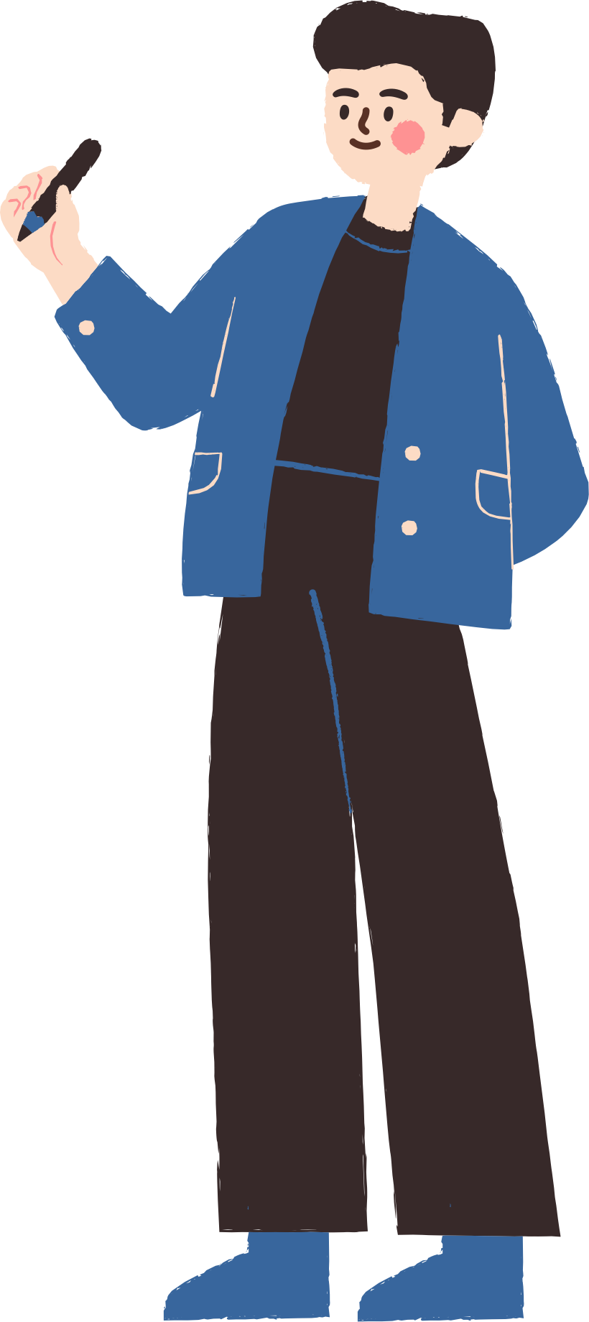



WARM-UP

Slide 4

WARM-UP
OPTION 1
- Look at the board and tell me the use of:
who
which
whose
: refer people. Ex: The teacher, who always wears a bowtie, is my favorite.
: refer things or animals.
Ex: The book, which I borrowed from the library, is fascinating.
: indicate possession for people or things.
Ex: My friend Sarah, whose birthday is next week, is throwing a party.

Slide 5

WARM-UP
OPTION 1
- There is part of this sentence and you need to complete it:
English is the language which ____________________________
is spoken by the most people in the world
=> which is spoken by the most people in the world: defining relative clause.

Slide 6
VOCABULARY

Slide 7










32. common language
/ˈkɒmənˈlæŋɡwɪdʒ/ (n) ngôn ngữ chung
English serves as a common language for students from different countries in our international club.(Tiếng Anh đóng vai trò là ngôn ngữ chung cho học sinh từ các quốc gia khác nhau trong câu lạc bộ quốc
tế của chúng tôi.)

Slide 8

33. effectively /ɪˈfektɪvli/ (adv) hiệu quả
Learning to communicate effectively in English can help us make friends from around the world.(Học cách giao tiếp hiệu quả bằng tiếng Anh có thể giúp chúng ta kết bạn từ khắp nơi trên thế giới.)

Slide 9
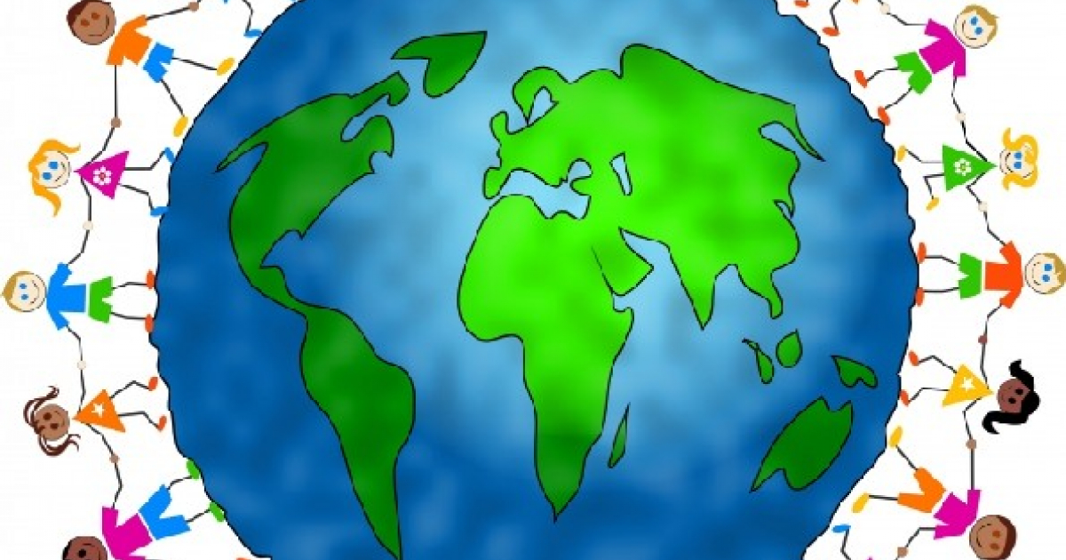
34. global language /ˈɡloʊbl ˈlæŋɡwɪdʒ/ (n) ngôn ngữ toàn cầu
English is considered a global language due to its widespread use in international communication.(Tiếng Anh được coi là một ngôn ngữ toàn cầu do việc sử dụng rộng rãi trong giao tiếp quốc tế.)

Slide 10
VOCABULARY
Words | Pronunciation | Meanings
common language | /ˈkɒmənˈlæŋɡwɪdʒ/ | (n) ngôn ngữ chung
effectively | /ɪˈfektɪvli/ | (adv) hiệu quả
global language | /ˈɡloʊbl ˈlæŋɡwɪdʒ/ | (n) ngôn ngữ toàn cầu

Slide 11
PRACTICE

Slide 12
Grammar
Defining relative clauses
1. Choose the correct answer A, B, C, or D to complete each sentence.
1. English is the language _______ is known as a global language.
A. who
B. which
C. whose
D. what
Notes:
TRUY CẬP MÃ QR ĐỂ NHẬN QUÀ TẶNG
https://facebook.com/groups/853679022766648/

Slide 13
Grammar
Defining relative clauses
1. Choose the correct answer A, B, C, or D to complete each sentence.
2. People _______ speak English well can find jobs in international companies more easily.
A. Who
B. which
C. whose
D. why
Notes:
TRUY CẬP MÃ QR ĐỂ NHẬN QUÀ TẶNG
https://facebook.com/groups/853679022766648/

Slide 14

Grammar
Defining relative clauses
1. Choose the correct answer A, B, C, or D to complete each sentence.
3. People from countries _______ do not share a common language use English to work together effectively.
A. Who
B. which
C. whose
D. where
Notes:
TRUY CẬP MÃ QR ĐỂ NHẬN QUÀ TẶNG
https://facebook.com/groups/853679022766648/

Slide 15
Grammar
Defining relative clauses
1. Choose the correct answer A, B, C, or D to complete each sentence.
4. The woman _______ son won the English speaking contest felt very proud.
A. Who
B. which
C. whose
D. When
Notes:
TRUY CẬP MÃ QR ĐỂ NHẬN QUÀ TẶNG
https://facebook.com/groups/853679022766648/

Slide 16
Grammar
Defining relative clauses
1. Choose the correct answer A, B, C, or D to complete each sentence.
5. I met a man _______ first language is Arabic at the conference.
A. Who
B. which
C. what
D. Whose
Notes:
TRUY CẬP MÃ QR ĐỂ NHẬN QUÀ TẶNG
https://facebook.com/groups/853679022766648/

Slide 17
2. Underline the relative clause in each sentence. Decide if the relative pronoun is the subject (S) or object (O) of the relative clause and if we can or cannot omit it.
1. The new vocabulary items which we learnt yesterday are difficult to remember.
2. I don't like the grammar exercises which ara in this book .
3. The man who translated this novel into Vietnamese must be proficient in English.
4. The students who love languages can join our Reading Club.
5. The teacher who we admire can speak three languages.
Notes:
TRUY CẬP MÃ QR ĐỂ NHẬN QUÀ TẶNG
https://facebook.com/groups/853679022766648/

Slide 18
3. Are these sentences right or wrong? Correct them if necessary.
1. My sister doesn't like films have unhappy endings.
→My sister doesn't like films which have unhappy endings
2. What is the name of the man who is the director of the language centre?
3. One of the four official languages people use in Singapore is English.
→One of the four official languages which people use in Singapore is English.
4. I like the English lesson which Ms Oanh taught yesterday.
5. Students who grades are high can compete in this contest.
→Students whose grades are high can compete in this contest.
F
T
F
T
F
Notes:
TRUY CẬP MÃ QR ĐỂ NHẬN QUÀ TẶNG
https://facebook.com/groups/853679022766648/

Slide 19
4. Combine the two sentences into one, using a relative pronoun.
1. I met a woman. Her husband is a famous linguist.
→ I met a woman whose husband is a famous linguist.
2. My friend's father gave us the tickets. He owns a travel agency.
My friend's father, who owns a travel agency, gave us the tickets.
3. The grammar exercise was very complicated. Nobody could do it.
→The grammar exercise which nobody could do was very complicated.
4. I study English in a language school. It is in the centre of the city.
I study English in a language school which is in the center of the city.
5. The student completed the quiz the fastest. The teacher praised him.
→The student who the teacher praised completed the quiz the fastest.
Notes:
TRUY CẬP MÃ QR ĐỂ NHẬN QUÀ TẶNG
https://facebook.com/groups/853679022766648/

Slide 20
5. GAME. Clues for you
1.
A: This is an object which we use to cut paper.
B: Are they scissors?
A: Correct!
2.
A: This is a place where we can borrow books.
B: Is it a library?
A: That's right!
3.
B: This is a person who is bilingual in Vietnamese and Korean in our class.
A: Is it Lan?
B: Correct!
4.
B: This is someone in our class who won the chess competition.
A: Is it Nam?
B: Yes, that’s right!
Work in two teams. A student from each team gives clues about an object or a person in class, using a relative clause. Students from the other team guess which object or person it is.
Example:
-This is something which we write with.
- Is it a pen?
- Yes, it is.
Notes:
TRUY CẬP MÃ QR ĐỂ NHẬN QUÀ TẶNG
https://facebook.com/groups/853679022766648/

Slide 21
GAMES

Slide 22
GAMETIME!

Slide 23
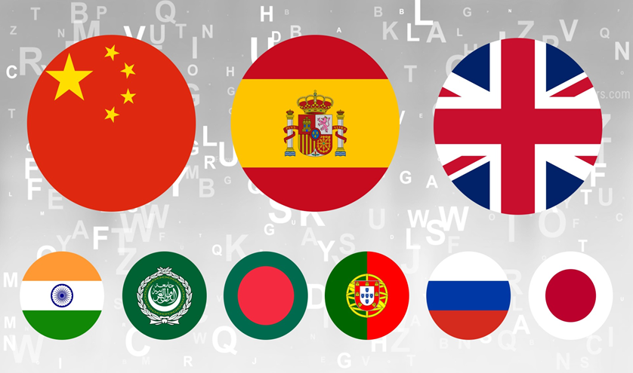
effectively
common language
global language
2

Slide 24

effectively
common language
global language
3

Slide 25

global language
effectively
common language
3

Slide 26





Slide 27

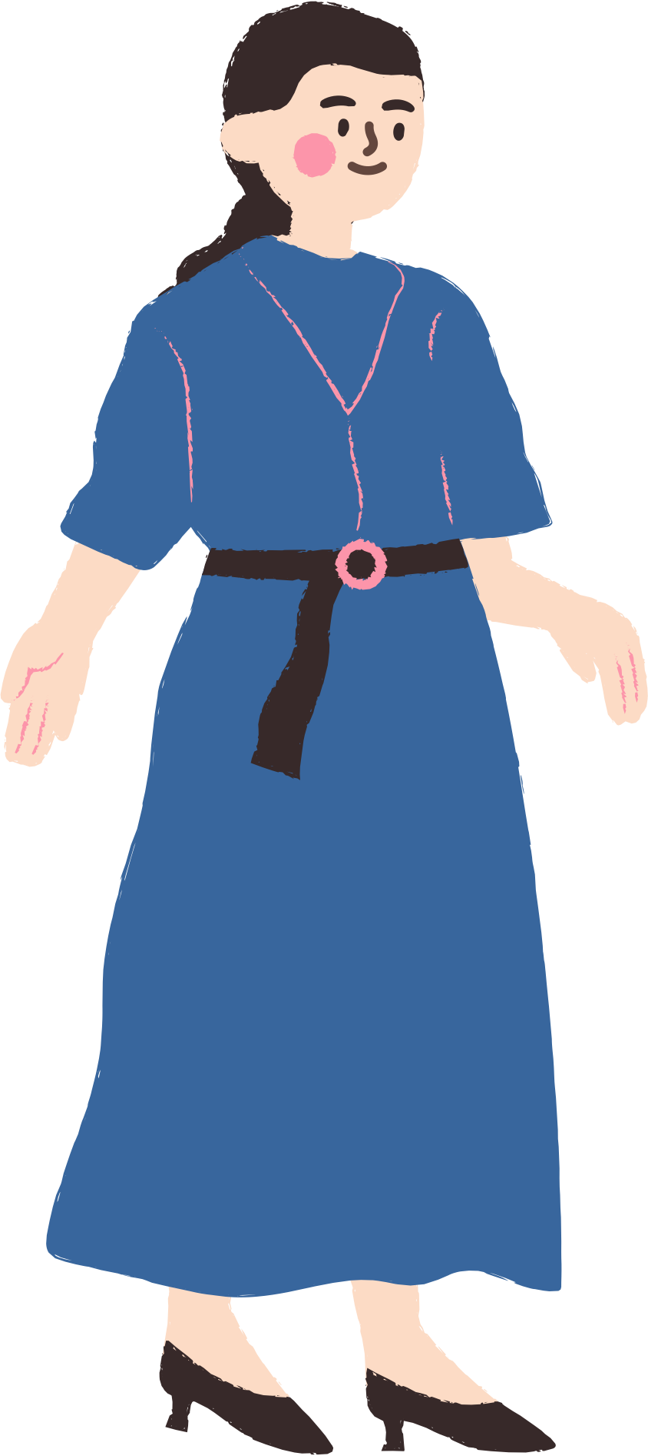

THANK YOU
See you gain!
Notes:
TRUY CẬP MÃ QR ĐỂ NHẬN QUÀ TẶNG
https://facebook.com/groups/853679022766648/

