Slide 1


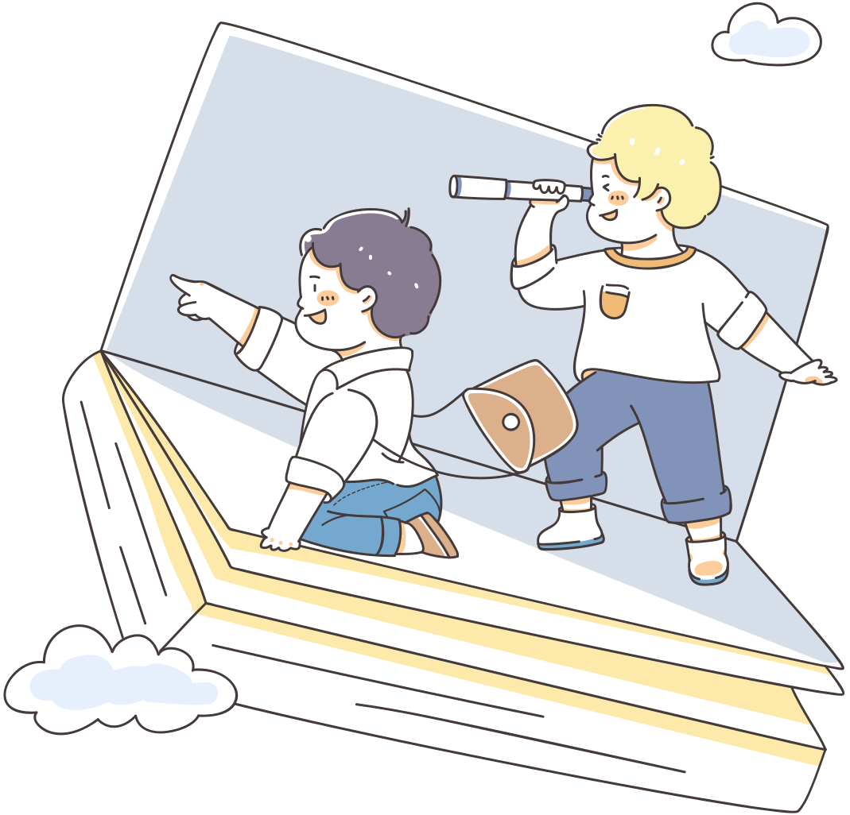
Unit 8: Sports and games
Lesson 5: Skills 1
By teacher Ha

Slide 2

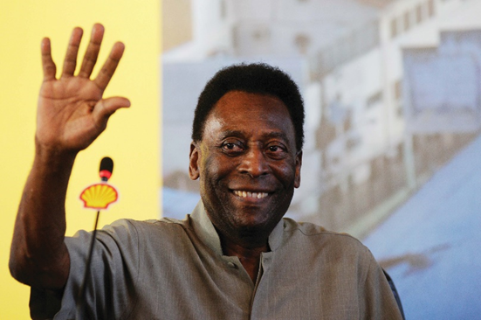

I. Reading
Ex1: Work in pairs. Discuss the questions.
  What do you know about Pelé?
2. What is special about him?
=> Best footballer
=> King of football
=> From Brazil

Slide 3
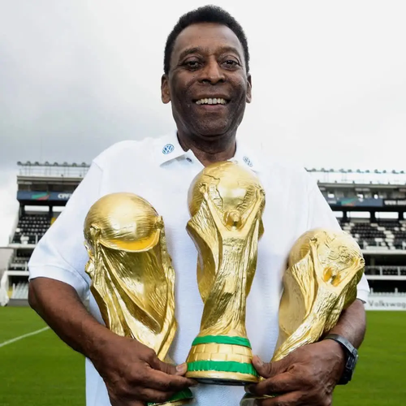
Ex2: Read the dialogue quickly to check your ideas in 1.
The PE teacher is talking to her students about Pelé.
Teacher: Today we’re going to talk about Pelé. Do you know him?
Nick: Yes, I think he’s the best footballer of all time.
Teacher: Right. He was born in 1940 in Brazil. His father taught him to play football at a very young age.
Susan: Oh. When did he begin his career in football?
Teacher: At 15, when he started playing for Santos Football Club. In 1958, he won his first World Cup.
Nick: How many goals did he score in his career?
Teacher: 1,281 goals in total, I think.
Nick and Susan: Wow! Amazing!
Teacher: And he became “Football Player of the Century” in 1999.
Michael: Surely Pelé’s a national hero in Brazil.
Teacher: Yes, and he’s known around the world as “The King of Football”.

Slide 4
Ex3: Read the text again and answer the questions.
  When was Pelé born?
=> Pelé was born in 1940.
2. Who first taught him to play football?
=> His father did.
3. How many goals did he score in total?
=> He scored 1,281 goals in total.
4. When did he become “Football Player of the Century”?
=> In 1999.
5. What do people call him?
=> They call him “The King of Football”.

Slide 5
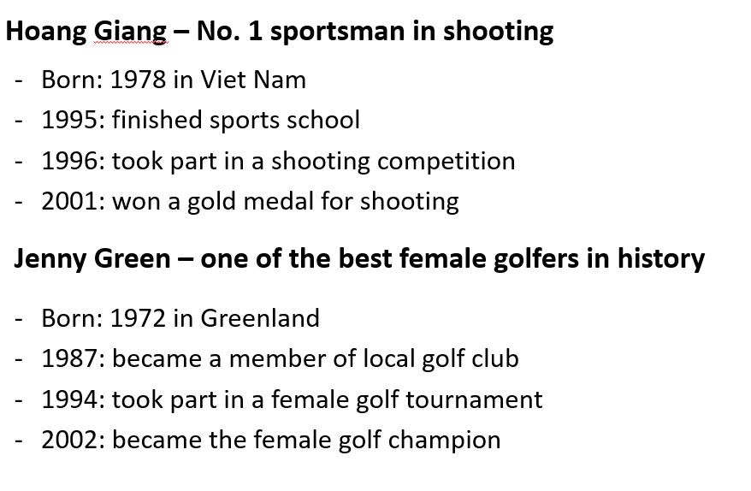


II. Speaking
Ex 4: Read the following facts about two famous sportspeople.

Slide 6

II. Speaking
Ex 5: Choose one sportsperson in 4. Talk about him / her. Use the following cues.
His name is Hoang Giang, he was born in 1978 in Viet Nam. He plays shooting. He is famous for being No.1 sportsman in shooting. In 1996, he took part in a shooting competition. In 2001, he won a medal for shooting. I like him very much because he’s talented.
Xem thêm tại: -His / Her name
-The sport he / she plays
-Why he / she is famous
-You like him / her or not
Explain why
-His / Her name
-The sport he / she plays
-Why he / she is famous
-You like him / her or not
Explain why

Slide 7
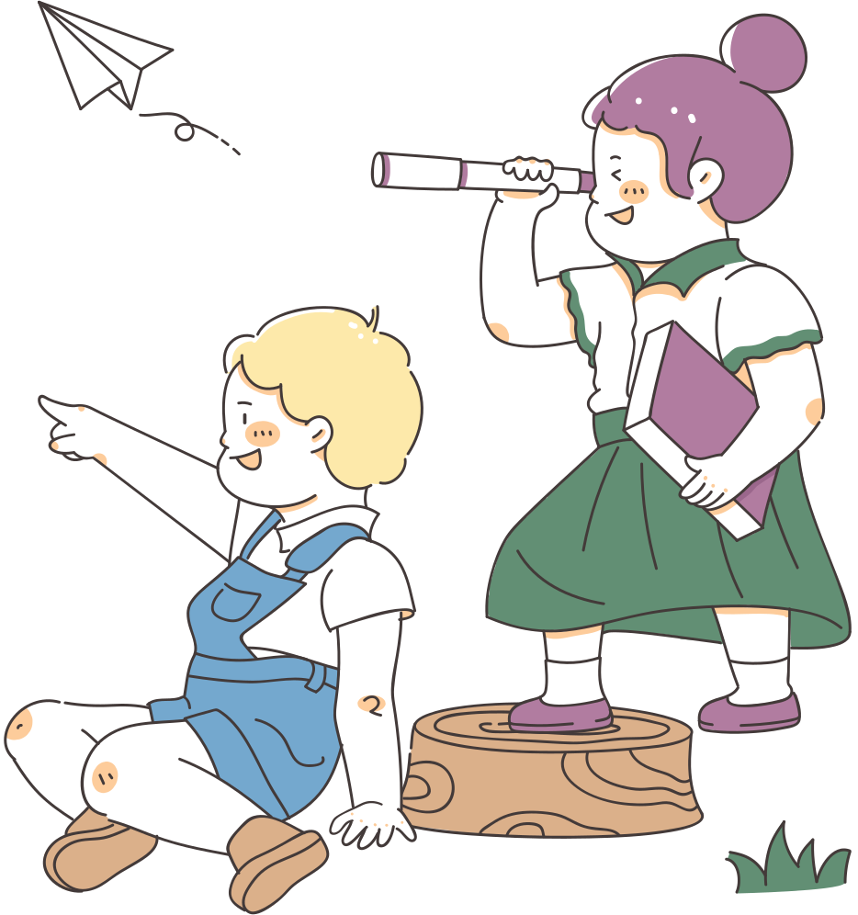
What have you learnt today?

Slide 8
Homework
-Do ex5 in the course book
-Prepare Unit 8: lesson 6: Skills 2

Slide 9
Add zalo: 0866631300 ( Nhị Hà)
Nhận soạn bài giảng điện tử theo yêu cầu hoặc bán trọn gói Powerpoint theo từng Unit, từng kì học.
Thanks!

