Slide 1
GAMES
Start!

Slide 2
REVIEW GAMES
ENGLISH
MATH
SCIENCE
ART
10 points
20 points
30 points
40 points
10 points
20 points
30 points
40 points
10 points
20 points
30 points
40 points
10 points
20 points
30 points
40 points
This is an interactive template: each button is linked to a different slide.
Please modify these links accordingly when you’re done editing this presentation.

Slide 3
ENGLISH
A-B-C-D-E… English!
1
2
3
4

Slide 4
ENGLISH
1
A-B-C-D-E… English!
2
3
4

Slide 5

1. COMPLETE THE SENTENCE
The boy is _ _ _ _ _ _ _ in the kitchen

Slide 6
cooking
If your answer is correct, you win 10 points!

Slide 7
1. COMPLETE THE SENTENCE
The honey is produced by _ _ _ _

Slide 8
Bees
If your answer is correct, you win 10 points!

Slide 9
2. WHERE IS SHE?
She went to a place to have fun with her friends. It had plenty of lights, songs, games and people having fun. There were bumper cars, donuts and cotton candy.

Slide 10
At the fairground
If your answer is correct, you win 20 points!

Slide 11
2. WHICH ANIMAL IS IT?
It is the main character of many cartoons, it is a very curious and quite interesting animal. Its characteristic black spot on its face makes it have a reputation as a very particular petty thief.

Slide 12
Raccoon!!!
If your answer is correct, you win 20 points!

Slide 13
3. WHAT IS THIS?
Novel
A piece of short fiction with different characters. Its plot is simple and entertaining.
Tale
Poem
A
B
C

Slide 14
It’s a tale!!!
If your answer is correct, you win 30 points!

Slide 15
3. CHOOSE THE CORRECT ICON
Book

Slide 16
It’s a book!!!
If your answer is correct, you win 30 points!

Slide 17
4. WHO IS THE WRITER?
Romeo & Juliet
Hamlet
Macbeth
Othello
A Midsummer’s Night Dream

Slide 18
William Shakespeare
If your answer is correct, you win 40 points!

Slide 19
4. SELECT THE CORRECT ANSWER
Venus
Jupiter
Mars
Saturn
Which one of the following planets is red? Put a check mark on the correct box
Venus has a beautiful name, but it’s very hot
Jupiter It’s the biggest planet in the Solar System
Despite being red, Mars is a cold place, not hot
Saturn is the ringed planet and a gas giant

Slide 20
It’s Mars!!!
If your answer is correct, you win 40 points!

Slide 21
MATH
Numbers and more!
1
2
3
4

Slide 22
MATH
Numbers and more!
1
2
3
4

Slide 23

1. CHOOSE THE CORRECT ONE
It tells you how many times a number is contained in another
+
-
x
:
%
√

Slide 24
Division
(:) or (/)
If your answer is correct, you win 10 points!

Slide 25
SOLVE THE EXERCISES
4 + 5=
7 + 7=
?
?
6 + 2=
4 + 6=
?
?
8 + 9=
9 + 3=
?
?

Slide 26
4 + 5=9
6 + 2=8
8 + 9=17
7 + 7=14
4 + 6=10
9 + 3=12
If your answer is correct, you win 10 points!

Slide 27
2. CAN YOU SOLVE THIS?
2 0
x 5

Slide 28
100!
If your answer is correct, you win 20 points!

Slide 29
2. NUMERICAL CHALLENGE
First stage
Second stage
Third stage
23 + 7
?? x 5
?? / 3
The result

Slide 30
50!
If your answer is correct, you win 20 points!

Slide 31
3. READ THIS NUMBER
914
2
3
,
,
5
7

Slide 32
Nine Hundred Fourteen
If your answer is correct, you win 30 points!

Slide 33
CAN YOU READ THIS NUMBER?
58,300
Take your time to do it properly!

Slide 34
Fifty-eight thousand three hundred
If your answer is correct, you win 30 points!

Slide 35
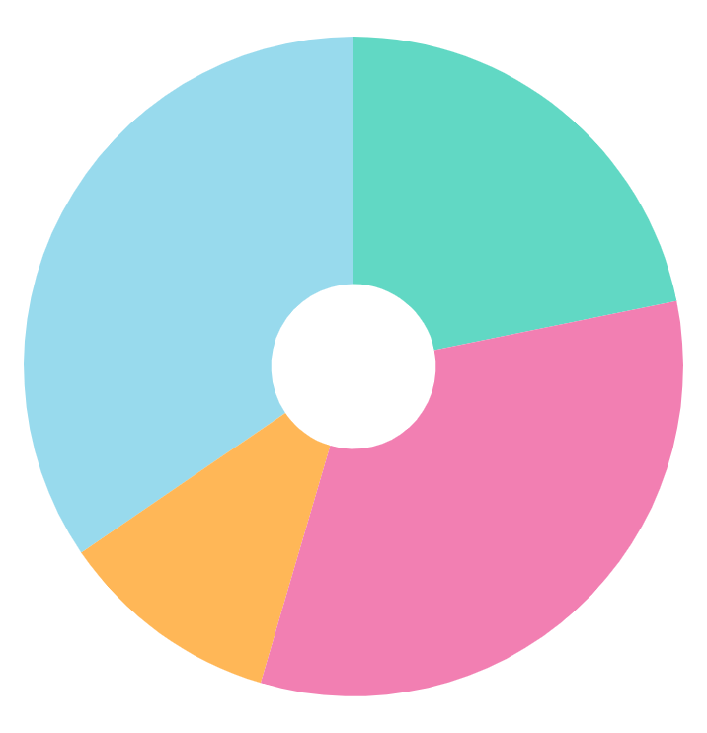
4. WHICH HOBBY IS MORE POPULAR?
Games (34.5%)
Music (21.8%)
Books (10.9%)
Art (32.8%)

Slide 36
Games!
If your answer is correct, you win 40 points!

Slide 37
4. WHICH HOBBY IS MORE POPULAR?
33.4%
54%
12.6%
Mercury is the closest planet to the Sun
Despite being red, is actually a cold place
Jupiter is the biggest in the Solar System

Slide 38
Listen to music!!!
If your answer is correct, you win 40 points!

Slide 39
SCIENCE
Learn about nature!
1
2
3
4

Slide 40
SCIENCE
Learn about nature!
1
2
3
4

Slide 41

1. WHAT ARE THEY DOING?

Slide 42
A campfire
If you answer correctly, you win 10 points!

Slide 43
TRUE OR FALSE?
Is the law of gravity important when skating?
T
Yes
F
No

Slide 44
True!!!!
If you answer correctly, you win 10 points!

Slide 45
2. WHAT DO YOU NEED?
To go on a trip I need...
A map
A ruler

Slide 46
I need a map
If your answer is correct, you win 20 points!

Slide 47
2. SELECT THE CORRECT
Place the correct icon inside the box
Lion
Tulip

Slide 48
They are
If your answer is correct, you win 20 points!

Slide 49
3. WHERE DO GIRAFFES LIVE?
America
Europe
Asia
Africa
Oceania

Slide 50
We live in Africa
If your answer is correct, you win 30 points!

Slide 51
3. THE 4 COLDEST COUNTRIES
Mercury
Saturn
Mercury is the closest planet to the Sun
It is composed of hydrogen and helium
Jupiter
Mars
It’s the biggest planet in the Solar System
Mars is actually a very cold place

Slide 52
Antartida
Rusia
Canada
Estonia
You win 10 points for each correct answer!

Slide 53
4. WHAT IS THIS?
It is a process used by plants and other organisms to convert light energy into food for them. It gives plants and trees their green color.

Slide 54
Photo-
synthesis
If your answer is correct, you win 40 points!

Slide 55
4. TRUE OR FALSE?
Uncolor the incorrect one on each sentence by clicking on the option fill color
T
1. The heart beats approximately 100,000 times a day
F
T
2. A python can swallow a deer whole
F
T
3. Polar bears under their abundant fur have pinkish skin
F
4. Between 60,000 and 100,000 dead cells are shed from
our skin per minute
T
F

Slide 56
True
True
False
False
If your answer is correct, you win 40 points!

Slide 57
ARTS
Art for art’s sake!
1
2
3
4

Slide 58
ARTS
Art for art’s sake!
1
2
3
4

Slide 59

1. WHAT OBJECT DOES SHE USE?
Mary loves to spend the weekend outside taking pictures. She uses something that Mary’s father gave her as a present, although she needs to use the flash option at night!

Slide 60
A photo camera
If your answer is correct, you win 10 points!

Slide 61
ORDER THE LETTERS
Mercury is the closest planet to the Sun
Saturn is a gas giant and has several rings
R
A
C
Y
O
N
S
R
A
T
Jupiter is the biggest planet of them all
Mars is actually a very cold place
R
W
A
D
I
N
G
A
M
C
E
R
A

Slide 62
Crayons
Camera
Art
Drawing
If your answer is correct, you win 10 points!

Slide 63
2. WHICH TYPE OF INSTRUMENT IS IT?
Wind
String
Percussion
A
B
C

Slide 64
String
instrument
If your answer is correct, you win 20 points!

Slide 65
2. WHAT IS YOUR FAVORITE MUSIC STYLE?
50%
25%
60%
Pop
Rock
Ballad
Earth is the third planet from the Sun
Neptune is the farthest planet from the Sun
Despite being red,
Mars is a cold place

Slide 66
Pop!!!!
If your answer is correct, you win 20 points!

Slide 67
3. TRUE OR FALSE?
Dancing improves agility and balance
True
False

Slide 68
True!
If you answer correctly, you win 30 points!

Slide 69
3. MATCH THE NAME WITH ITS ICON
Theatre
Ballet
Music
Despite being red, Mars is actually a cold place
Jupiter is the biggest planet in the entire Solar System
Saturn is composed mostly of hydrogen and helium

Slide 70
Ballet
Music
Theatre
If you answer correctly, you win 30 points!

Slide 71
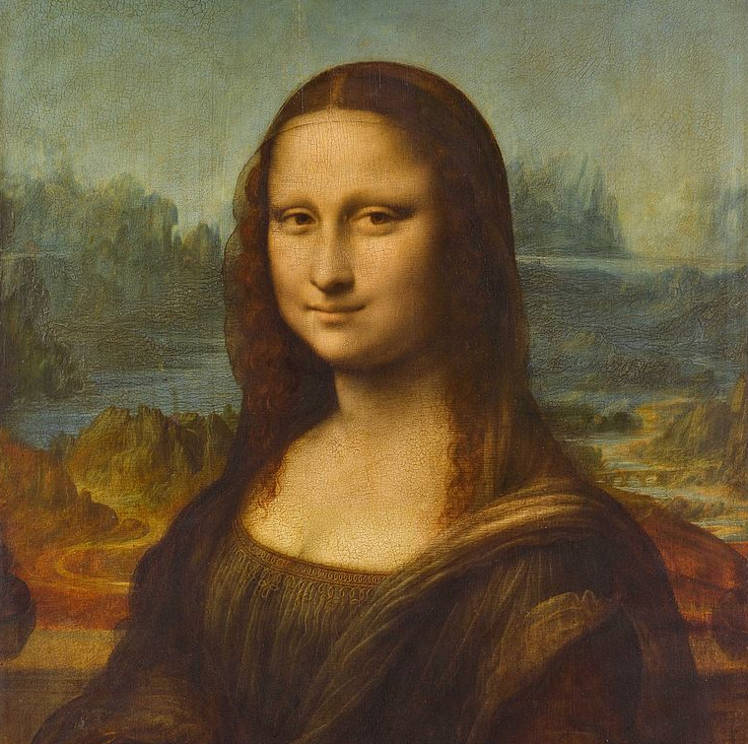
4. WHO IS THE PAINTER?

Slide 72
Leonardo Da Vinci!
If you answer correctly, you win 40 points!

Slide 73
4. SELECT YOUR FAVORITE
Click on the one you prefer
Color pencil
Tempera
Clay
Despite being red, Mars is actually a cold place
Jupiter is the biggest planet in the entire Solar System
Saturn is composed mostly of hydrogen and helium

Slide 74
Tempera!!!
If you answer correctly, you win 40 points!

Slide 75
THANK YOU

