Slide 1

GOOD MORNING
EVERYONE !!!

Slide 2
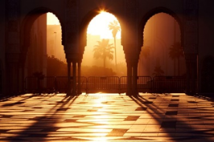
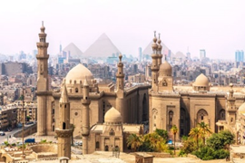
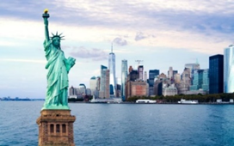
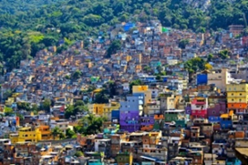
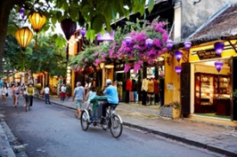

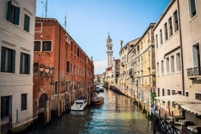
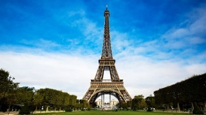
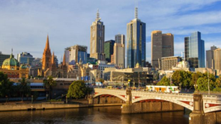
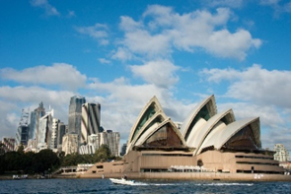
GAME:
Match 10 pictures about cities with the name of the
5 continents.
Casablanca
Cairo
New York
Rio De Janeiro
Europe
Asia
Africa
America
Oceania
Hoi An
Singapore
Venice
Paris
Melbourne
Sydney

Slide 3
Casablanca
Cairo
New York
Rio De Janeiro
Africa
America
Hoi An
Singapore
Asia
Venice
Paris
Melbourne
Sydney
Europe
Oceania

Slide 4




LESSON 1

Slide 5




Listen and read.
What nice photos!
1. What are Mai and Tom doing?
2. What are they looking at?
3. What is the name of the city?
4. What landmark is in the picture?
1. They are talking to/ discussing with each other.
2. They are looking at some photos about places around the world
3. It’s Sydney in Australia.
4. It’s the Opera House.

Slide 6
* Vocabulary
- rainy (adj):
có mưa
- crowded (adj):
đông đúc
- landmark (n) :
địa điểm, công trình thu hút khách du lịch
- interesting (adj):
hấp dẫn, thú vị
- exciting (adj):
thú vị, phấn khích

Slide 7
* Checking vocab
What and Where
beautiful
interesting
crowded
exciting
rainy

Slide 8

STRUCTURES
What is Sydney like?
Mai: What a beautiful place!
What is London like?
Mai: Wonderful. Oh, this is London. Isn't it raining? What bad weather!
What + (a/an) + adj + noun!

Slide 9
1. What do you think Mai and Tom are talking about?
2. What city can you recognize from the photos?
3. What is it famous for?

Slide 10
What nice photos!
Mai: Tom, are these photos from your vacations?
Tom: Yes, they are. This is Sydney, a city in Australia.
Mai: What’s it like?
Tom: It’s exciting with a lot of beaches.
Mai: What a beautiful place!
Tom: Yes, its beaches are very clean.
Mai: Wonderful. Oh, this is London. Isn’t it raining?
What bad weather!
Tom: Yes, it rains all the time. Can you see Big Ben?
Mai: Yeah ... on the River Thames. It’s a landmark of London.
Tom: It is. And this is Times Square in New York, crowded but interesting.
Mai: You’re lucky to visit many places.
Tom: I am. What about your vacations?
Mai: Here are some photos of mine. This is ...

Slide 11


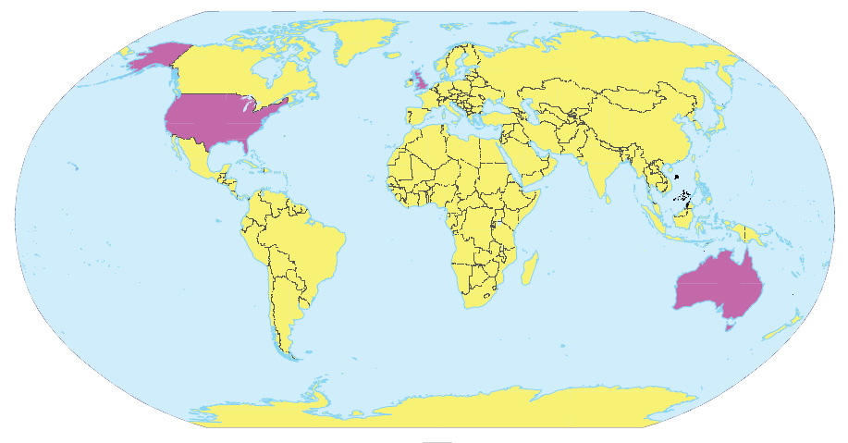
Write the names of the cities in the correct place.
1.
New York
2.
London
Sydney
London
New York
3.
Sydney

Slide 12

3. (p.27) Read the conversation again and match the cities with the adjectives describing them.
Mai: Tom, are these photos from your holidays?
Tom: Yes, they are. This is Sydney, a city in Australia. Mai: What's it like?
Tom: It's exciting with a lot of beaches.
Mai: What a beautiful place!
Tom: Yes, its beaches are very clean.
Mai: Wonderful. Oh, this is London. Isn't it raining? What bad weather!
Tom: Yes, it rains all the time. Can you see Big Ben?
Mai: Yeah... on the River Thames. It's a landmark of London.
Tom: It is. And this is Times Square in New York, crowded but interesting.
Mai: You're lucky to visit many places.
Tom: I am. What about your holiday?
Mai: Here are some photos of mine. This is...
Mai: Tom, are these photos from your holidays?
Tom: Yes, they are. This is Sydney, a city in Australia. Mai: What's it like?
Tom: It's exciting with a lot of beaches.
Mai: What a beautiful place!
Tom: Yes, its beaches are very clean.
Mai: Wonderful. Oh, this is London. Isn't it raining? What bad weather!
Tom: Yes, it rains all the time. Can you see Big Ben?
Mai: Yeah... on the River Thames. It's a landmark of London.
Tom: It is. And this is Times Square in New York, crowded but interesting.
Mai: You're lucky to visit many places.
Tom: I am. What about your holiday?
Mai: Here are some photos of mine. This is...
1. Sydney
a. rainy
2. London
b. crowded
c. exciting
3. New York
d. beautiful
e. interesting

Slide 13
3. (p.27) Read the conversation again and match the cities with the adjectives describing them.
Mai: Tom, are these photos from your holidays?
Tom: Yes, they are. This is Sydney, a city in Australia. Mai: What's it like?
Tom: It's exciting with a lot of beaches.
Mai: What a beautiful place!
Tom: Yes, its beaches are very clean.
Mai: Wonderful. Oh, this is London. Isn't it raining? What bad weather!
Tom: Yes, it rains all the time. Can you see Big Ben?
Mai: Yeah... on the River Thames. It's a landmark of London.
Tom: It is. And this is Times Square in New York, crowded but interesting.
Mai: You're lucky to visit many places.
Tom: I am. What about your holiday?
Mai: Here are some photos of mine. This is...
Mai: Tom, are these photos from your holidays?
Tom: Yes, they are. This is Sydney, a city in Australia. Mai: What's it like?
Tom: It's exciting with a lot of beaches.
Mai: What a beautiful place!
Tom: Yes, its beaches are very clean.
Mai: Wonderful. Oh, this is London. Isn't it raining? What bad weather!
Tom: Yes, it rains all the time. Can you see Big Ben?
Mai: Yeah... on the River Thames. It's a landmark of London.
Tom: It is. And this is Times Square in New York, crowded but interesting.
Mai: You're lucky to visit many places.
Tom: I am. What about your holiday?
Mai: Here are some photos of mine. This is...
1. Sydney
a. rainy
2. London
b. crowded
c. exciting
3. New York
d. beautiful
e. interesting

Slide 14
3. (p.27) Read the conversation again and match the cities with the adjectives describing them.
Mai: Tom, are these photos from your holidays?
Tom: Yes, they are. This is Sydney, a city in Australia.
Mai: What's it like?
Tom: It's exciting with a lot of beaches.
Mai: What a beautiful place!
Tom: Yes, its beaches are very clean.
Mai: Wonderful. Oh, this is London. Isn't it raining? What bad weather!
Tom: Yes, it rains all the time. Can you see Big Ben?
Mai: Yeah... on the River Thames. It's a landmark of London.
Tom: It is. And this is Times Square in New York, crowded but interesting.
Mai: You're lucky to visit many places.
Tom: I am. What about your holiday?
Mai: Here are some photos of mine. This is...
Mai: Tom, are these photos from your holidays?
Tom: Yes, they are. This is Sydney, a city in Australia. Mai: What's it like?
Tom: It's exciting with a lot of beaches.
Mai: What a beautiful place!
Tom: Yes, its beaches are very clean.
Mai: Wonderful. Oh, this is London. Isn't it raining? What bad weather!
Tom: Yes, it rains all the time. Can you see Big Ben?
Mai: Yeah... on the River Thames. It's a landmark of London.
Tom: It is. And this is Times Square in New York, crowded but interesting.
Mai: You're lucky to visit many places.
Tom: I am. What about your holiday?
Mai: Here are some photos of mine. This is...
1. Sydney
a. rainy
2. London
b. crowded
c. exciting
3. New York
d. beautiful
e. interesting

Slide 15
SUGGEST
What nice photos!
Mai: Tom, are these photos from your vacations?
Tom: Yes, they are. This is Sydney, a city in Australia.
Mai: What’s it like?
Tom: It’s exciting with a lot of beaches.
Mai: What a beautiful place!
Tom: Yes, its beaches are very clean.
Mai: Wonderful. Oh, this is London. Isn’t it raining? What bad weather!
Tom: Yes, it rains all the time. Can you see Big Ben?
Mai: Yeah... on the River Thames. It’s a landmark of London.
Tom: It is. And this is Times Square in New York, crowded but interesting.
Mai: You’re lucky to visit many places.
Tom: I am. What about your vacations?
Mai: Here are some photos of mine. This is…

Slide 16
SUGGEST
What nice photos!
Mai: Tom, are these photos from your vacations?
Tom: Yes, they are. This is Sydney, a city in Australia.
Mai: What’s it like?
Tom: It’s exciting with a lot of beaches.
Mai: What a beautiful place!
Tom: Yes, its beaches are very clean.
Mai: Wonderful. Oh, this is London. Isn’t it raining? What bad weather!
Tom: Yes, it rains all the time. Can you see Big Ben?
Mai: Yeah... on the River Thames. It’s a landmark of London.
Tom: It is. And this is Times Square in New York, crowded but interesting.
Mai: You’re lucky to visit many places.
Tom: I am. What about your vacations?
Mai: Here are some photos of mine. This is…

Slide 17
SUGGEST
What nice photos!
Mai: Tom, are these photos from your vacations?
Tom: Yes, they are. This is Sydney, a city in Australia.
Mai: What’s it like?
Tom: It’s exciting with a lot of beaches.
Mai: What a beautiful place!
Tom: Yes, its beaches are very clean.
Mai: Wonderful. Oh, this is London. Isn’t it raining? What bad weather!
Tom: Yes, it rains all the time. Can you see Big Ben?
Mai: Yeah... on the River Thames. It’s a landmark of London.
Tom: It is. And this is Times Square in New York, crowded but interesting.
Mai: You’re lucky to visit many places.
Tom: I am. What about your vacations?
Mai: Here are some photos of mine. This is…

Slide 18

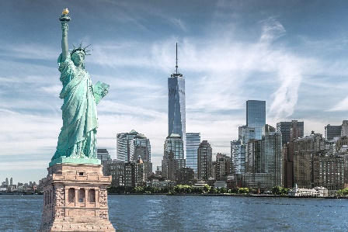
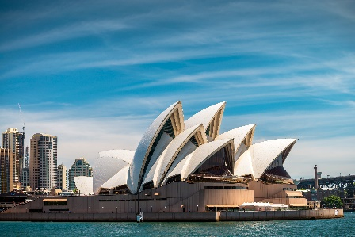
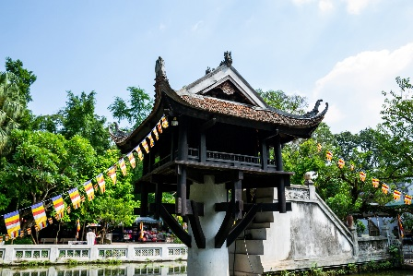
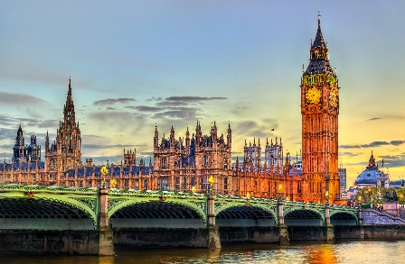
Match the cities with their landmarks.
a
1. Ha Noi
b
2. London
c
3. New York
d
4. Sydney

Slide 19
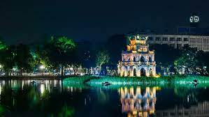
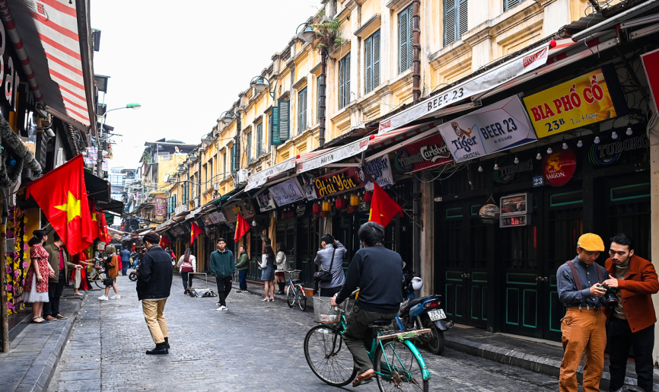
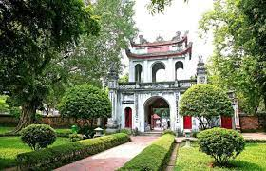
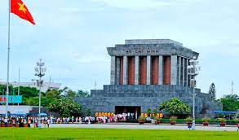
* Choose a landmark or a city to present about it.
EX:
Ha Noi
Hanoi Old Town Quarter
Hoan Kiem Lake
Temple of Literature
Ho Chi Minh Mausoleum

Slide 20
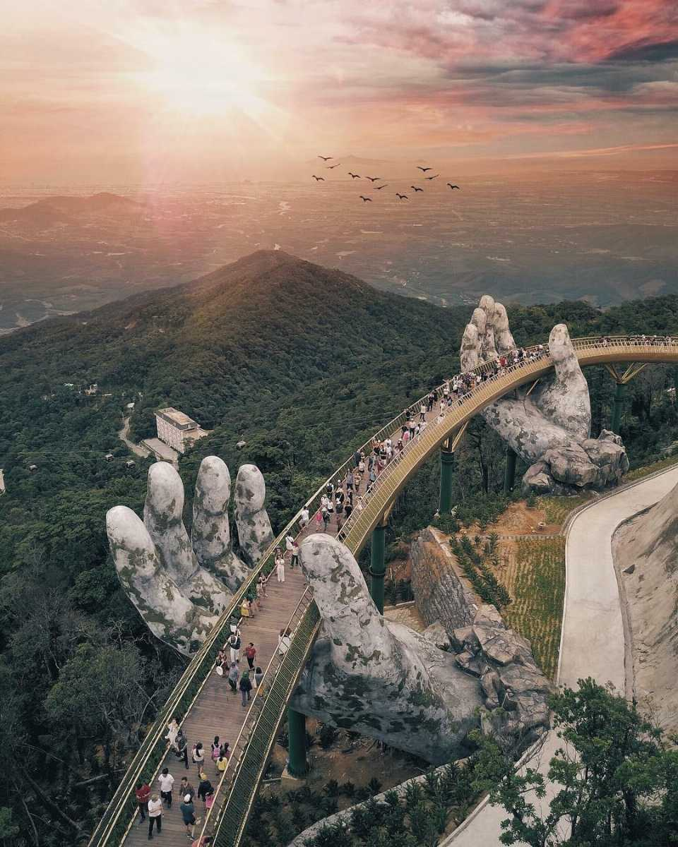
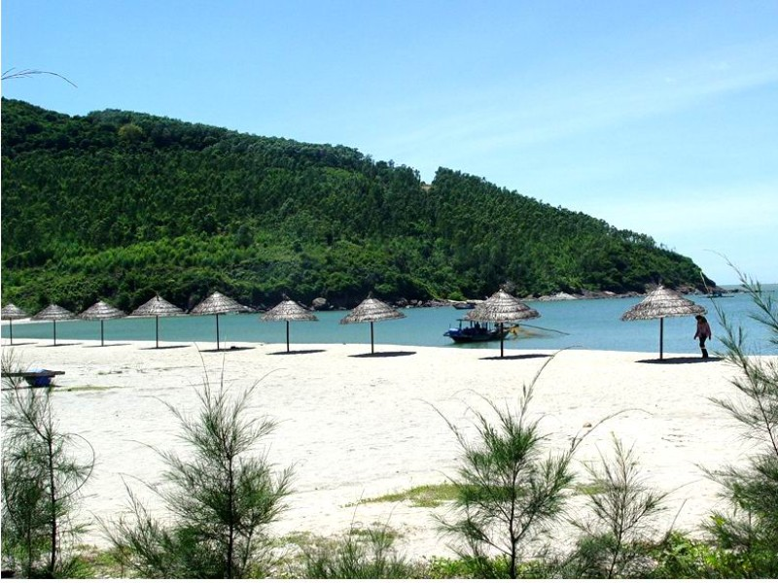
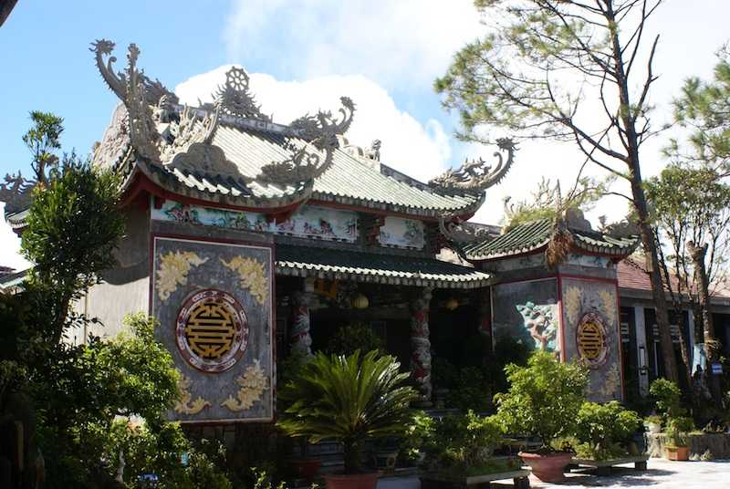
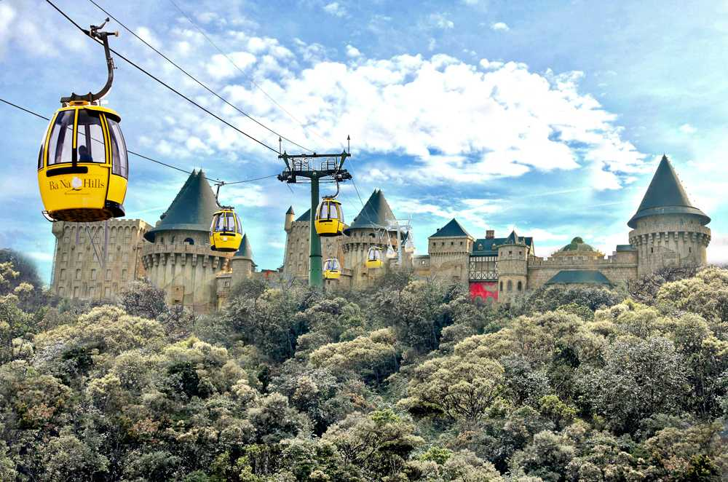
Da Nang
Golden Bridge
My Khe Beach
Linh Ung Pagoda
Ba Na Hills

Slide 21
New York
- Statue of Liberty, Central Park, Empire State Building, Times Square, etc.

Slide 22


What city is it?
Example:
A: What’s it like?
B: It has beautiful beaches.
C: Is it in Australia?
B: Yes, it is.
A: It’s Sydney.
B: Right.

Slide 23

homework
- Learn by heart all the new words.
- Go to the Internet and search for the information on your favourite cities in the world (food, people, weather, etc.)
- Prepare lesson 2 ( A closer look 1).

Slide 24

Goodbye!
See you again
Thank you!
Have a nice day!

