Slide 1


Slide 2
JUMBLED WORDS

Slide 3
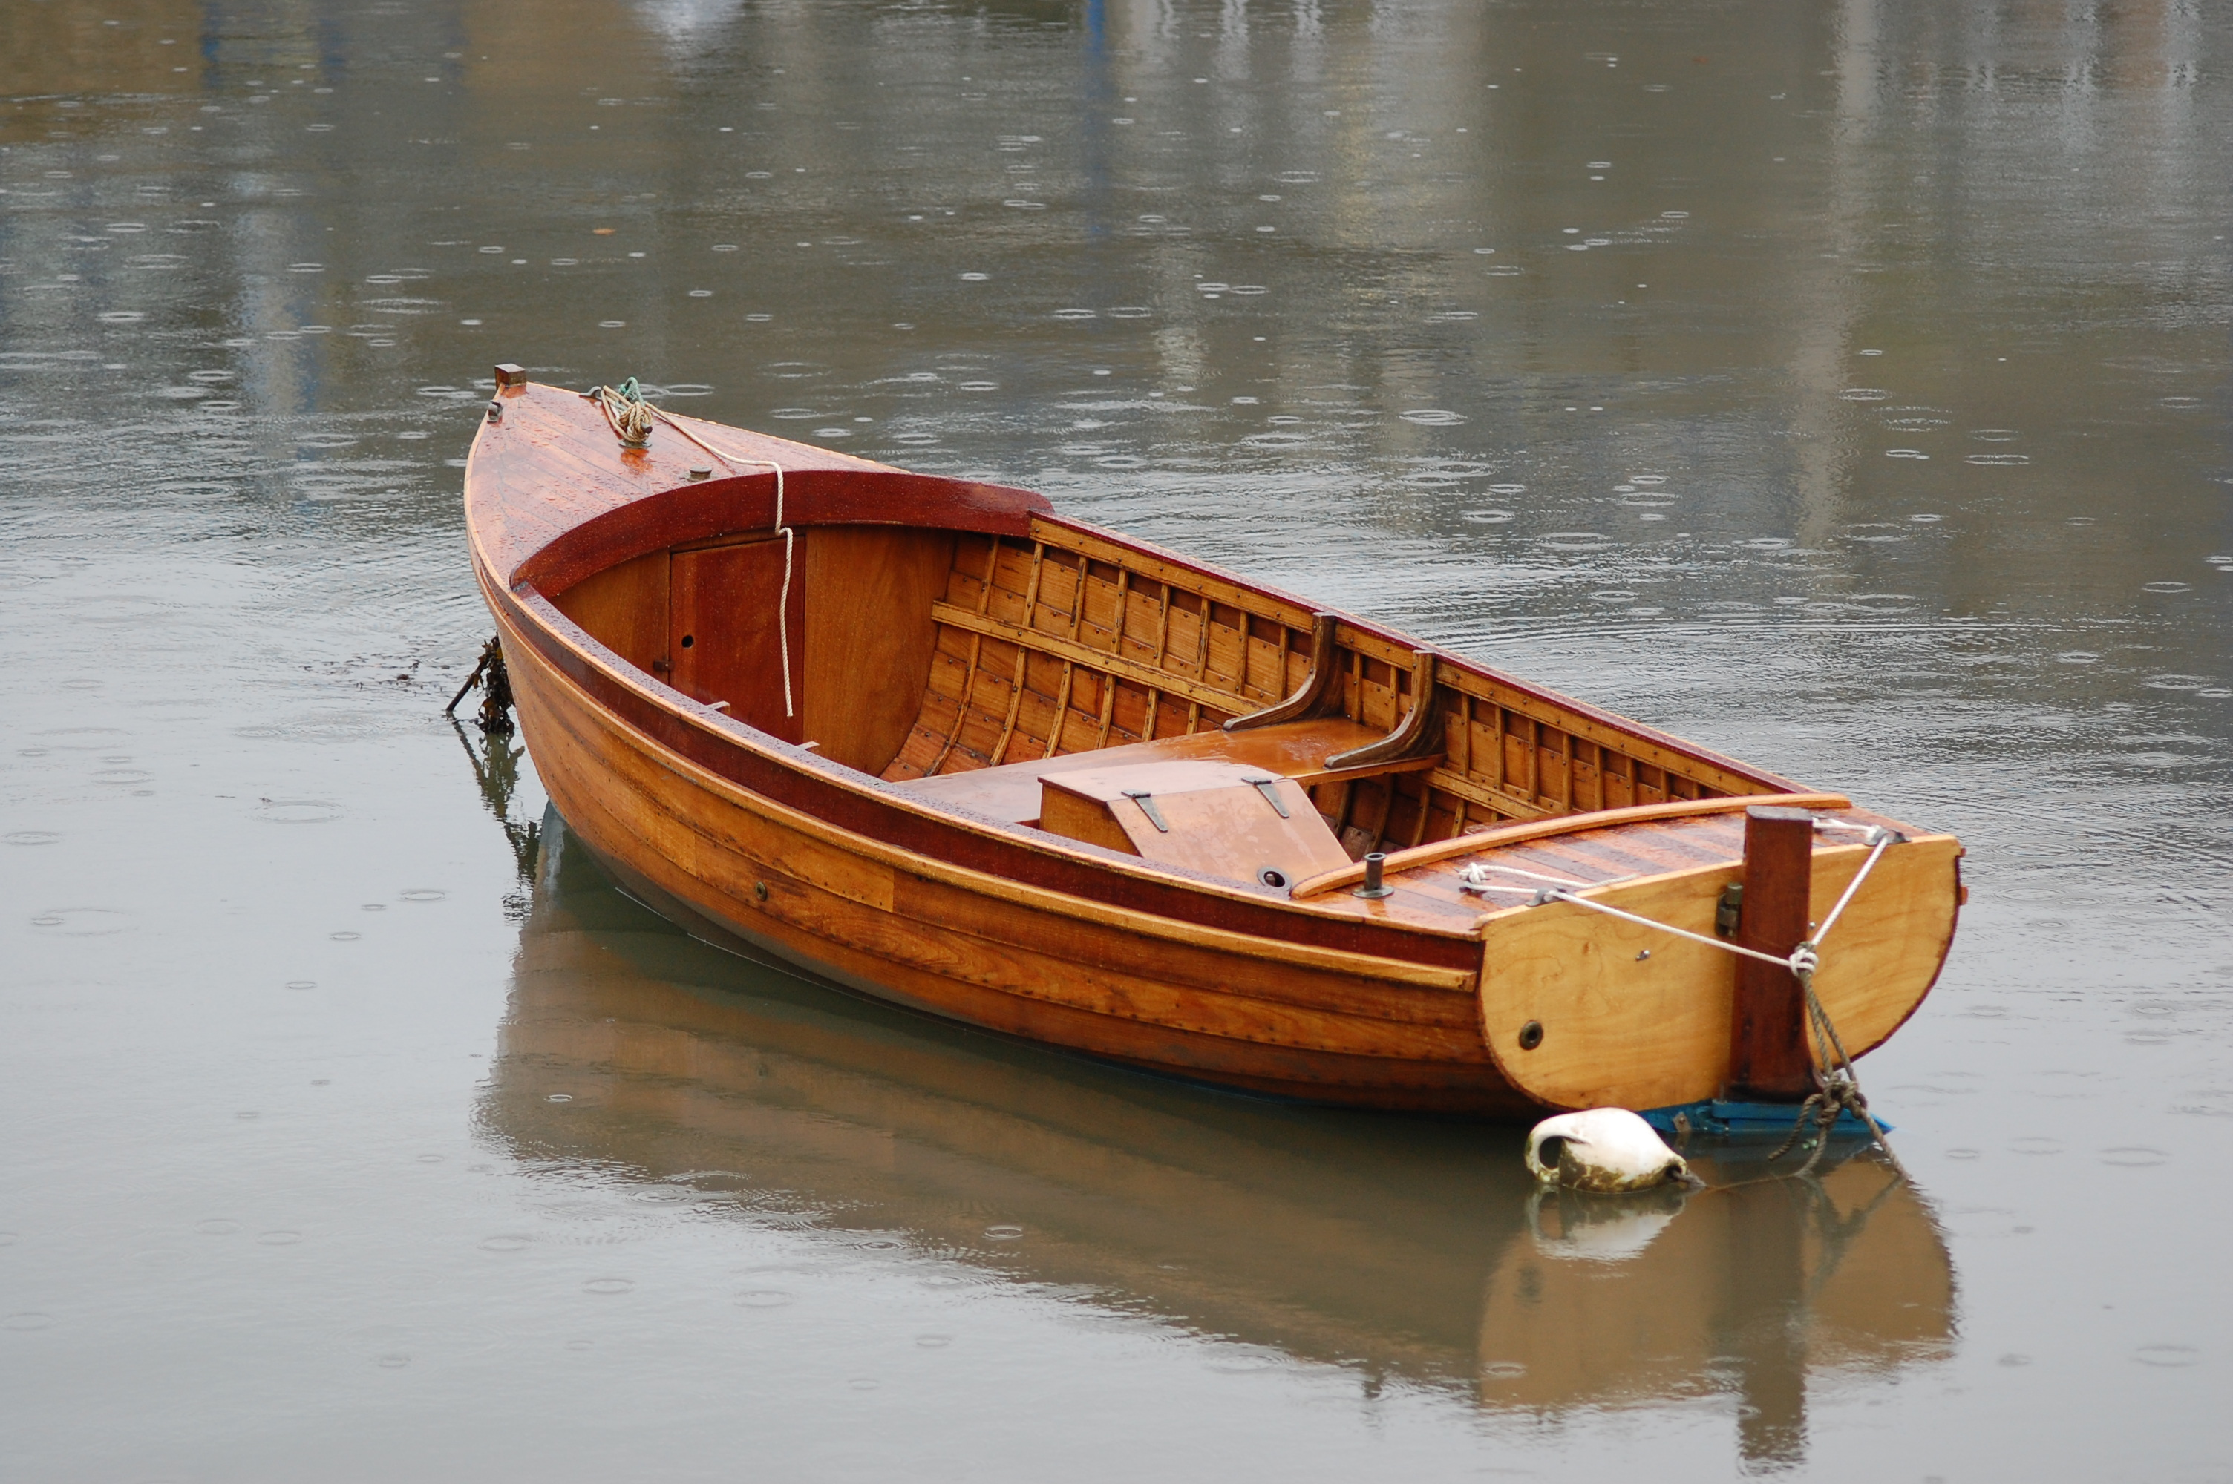
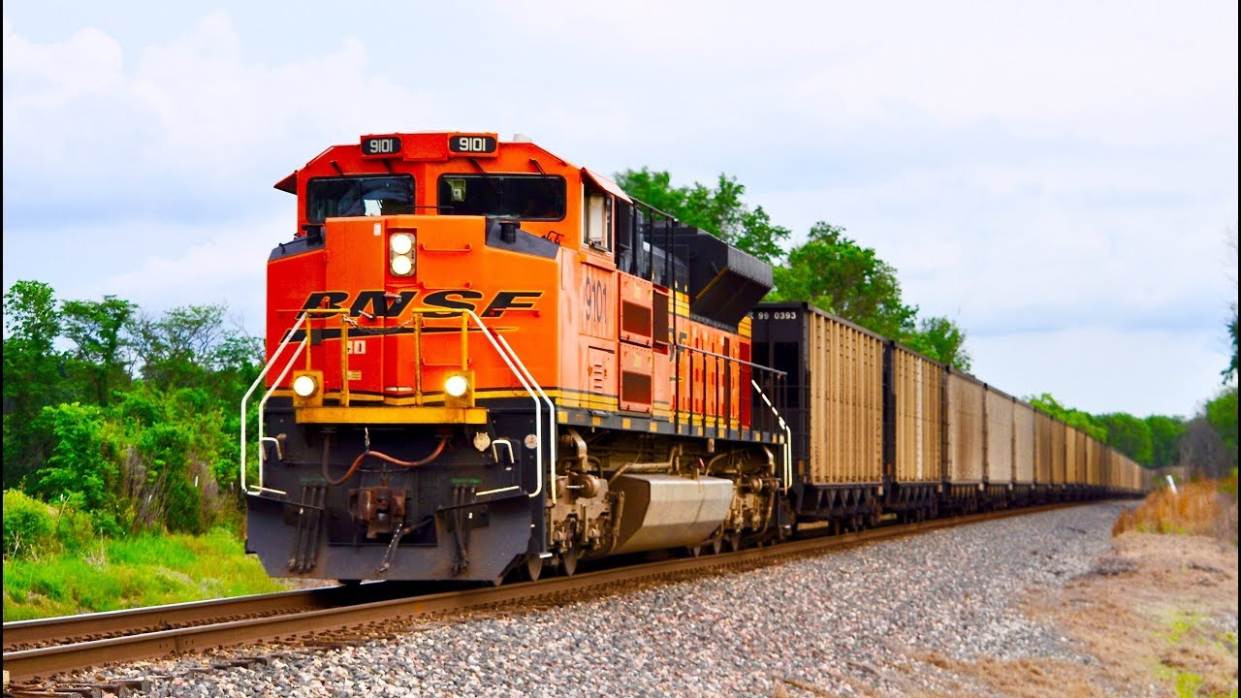
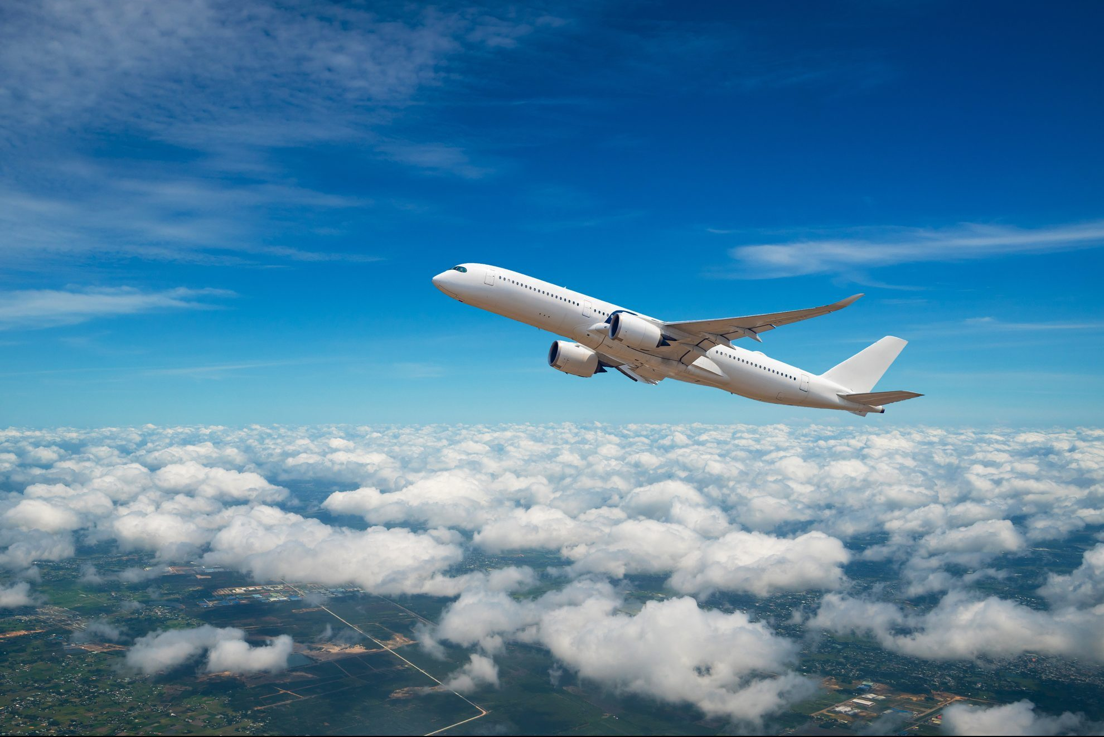
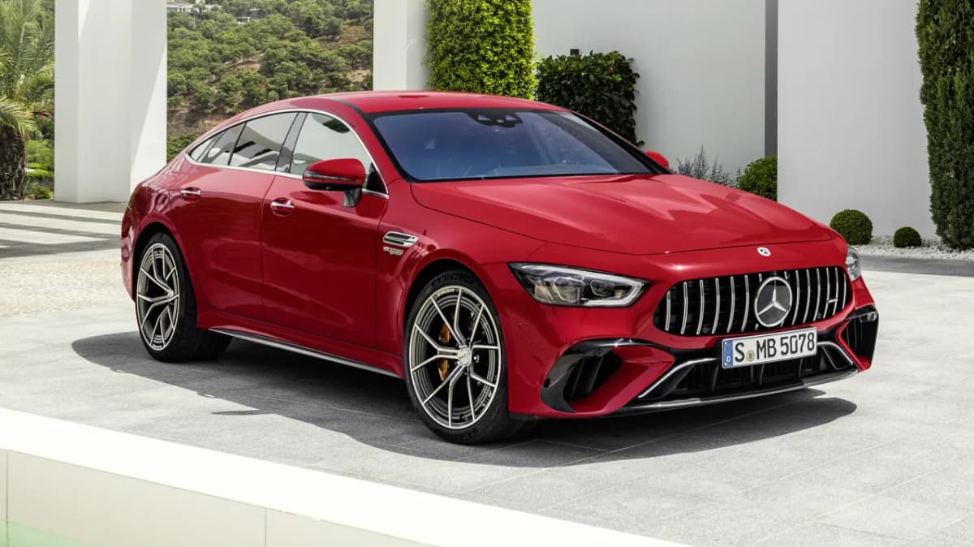
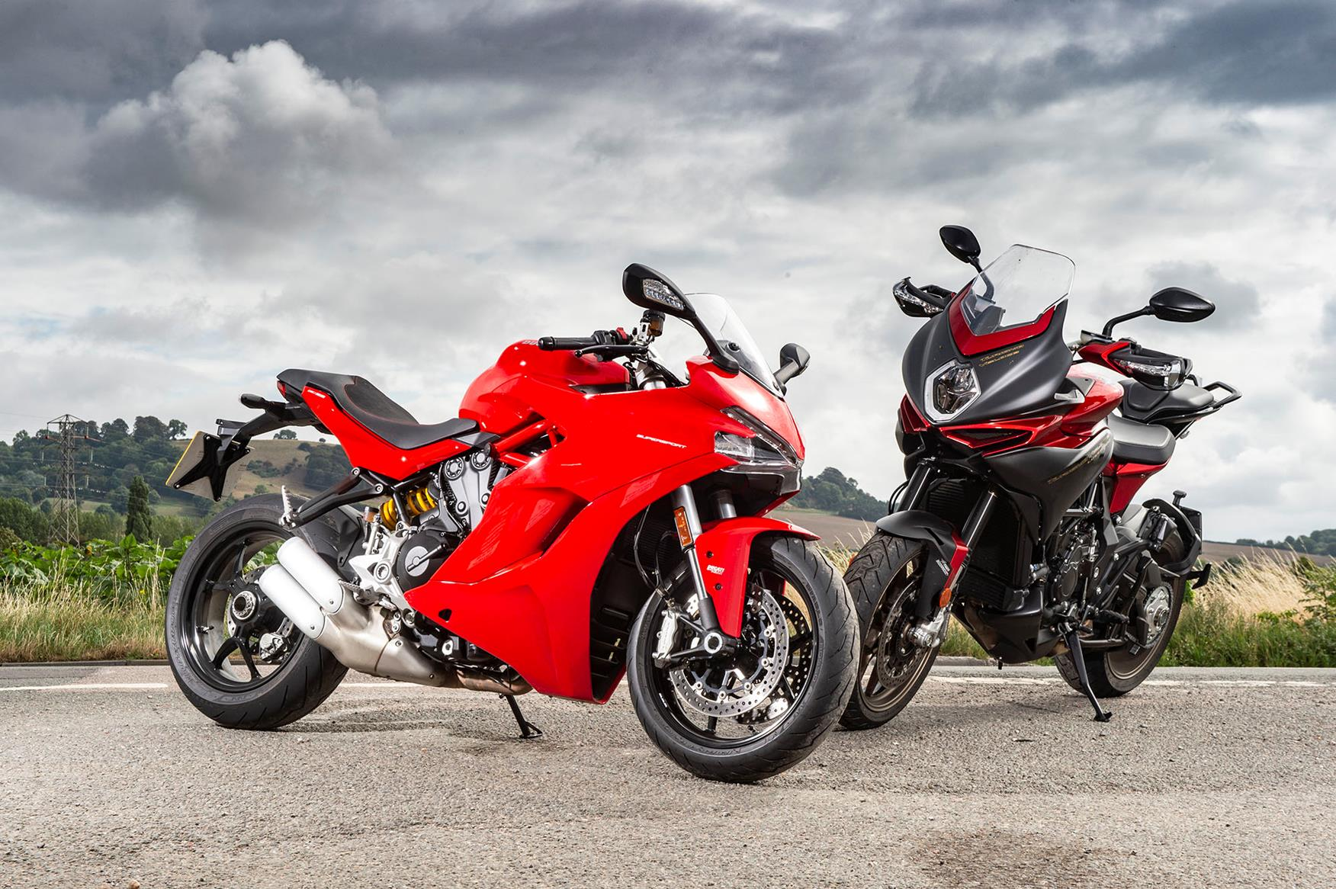
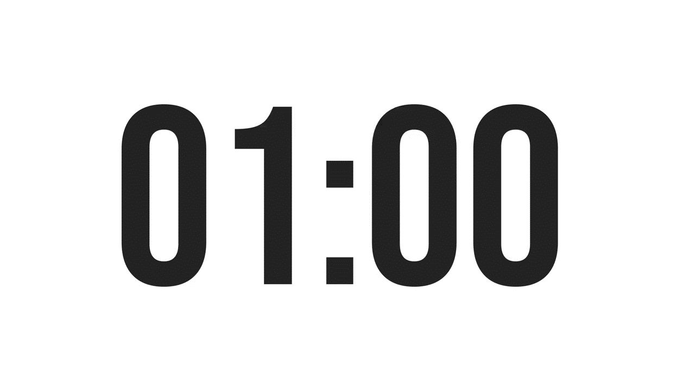
Look and rewrite
OTBA
ITANR
NPEILARA
ARC
OTMIROEKB

Slide 4
MEANS OF TRANSPORT
BOAT
AIRPLANE
OTBA
ITANR
NPEILARA
TRAIN
ARC
CAR
MOTORBIKE
OTMIROEKB

Slide 5
UNIT 7: TRAFFIC
Wednesday, January 4th 2025
LESSON 2:
A CLOSER LOOK 1

Slide 6
Objectives
By the end of the lesson, students will be able to:
VOCABULARY
use the verbs going with means of transport
read the road signs
PRONUNCIATION
pronounce and recognize the sounds /aɪ/ and /eɪ/

Slide 7
1
VOCABULARY

Slide 8

DO YOU SAY?
ride a car?
ride a bicycle?
What about the others?

Slide 9
Ex 1. Match A with B
A
B
1. ride
a. a car
2. drive
b. a boat
3. sail
c. a bike
4. go
d. by air
5. travel
e. on foot

Slide 10
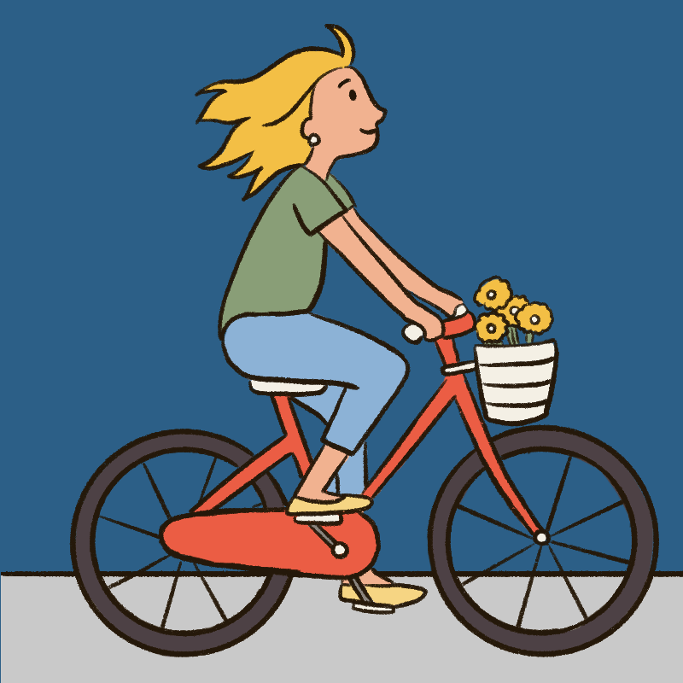
Ex 1. Match A with B
1. ride
c. a bike
ride a bike

Slide 11

Ex 1. Match A with B
2. drive
a. a car
drive a car

Slide 12

Ex 1. Match A with B
3. sail
b. a boat
sail a boat

Slide 13

Ex 1. Match A with B
4. go
e. on foot
go on foot

Slide 14
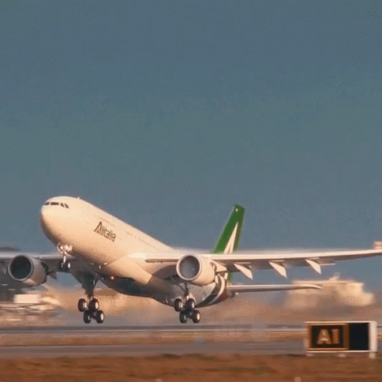
Ex 1. Match A with B
5. travel
d. by air
travel by air

Slide 15
Ex 1. Make your own sentences
Ex 1. Look at the answers again.
My father taught me how to ride a bike.
drive a car
sail a boat
ride a bike
go on foot
travel by air

Slide 16
NEW WORDS

Slide 17
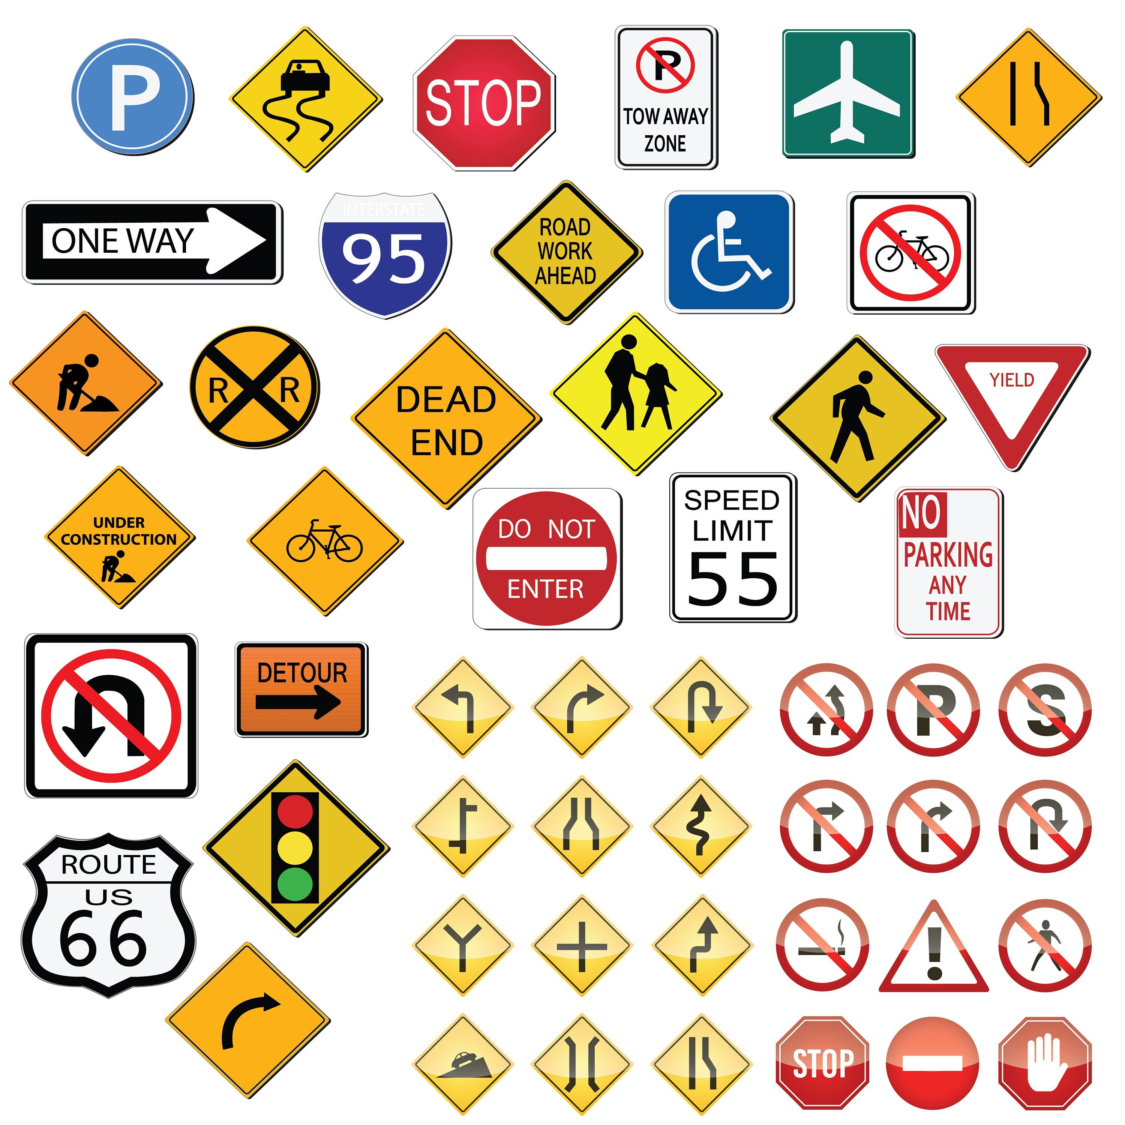

New words
road sign (n)
/ˈrəʊd saɪn/
biển báo giao thông

Slide 18
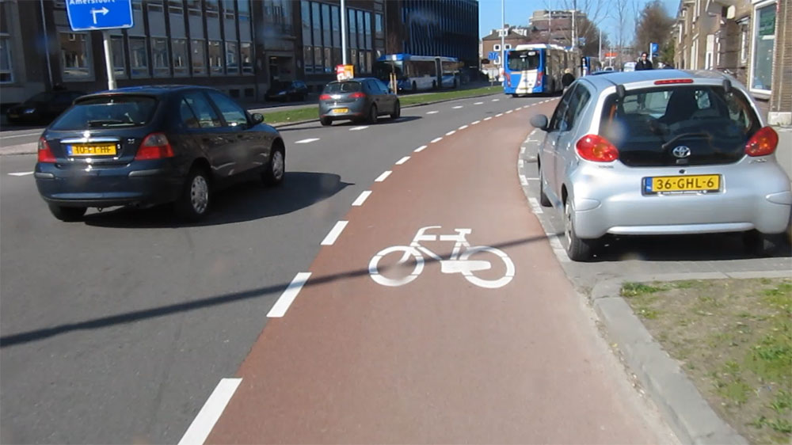
New words
cycle lane (n)
/ˈsaɪkl leɪn/
làn đường
dành riêng cho xe đạp

Slide 19
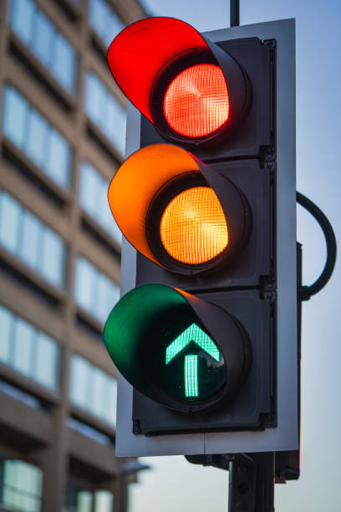
New words
traffic light (n.phr.)
/ˈtræfɪk laɪt/
đèn giao thông

Slide 20
New words
New words | Pronunciation | Meaning
1. road sign (n.phr.) | /ˈrəʊd saɪn/ | biển báo giao thông
2. cycle lane (n.phr.) | /ˈsaɪkl leɪn/ | làn đường dành riêng cho xe đạp
3. traffic light (n.phr.) | /ˈtræfɪk laɪt/ | đèn giao thông

Slide 21

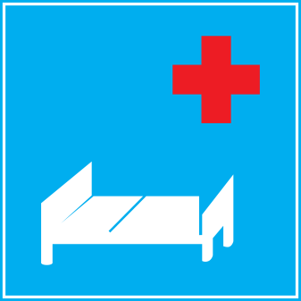



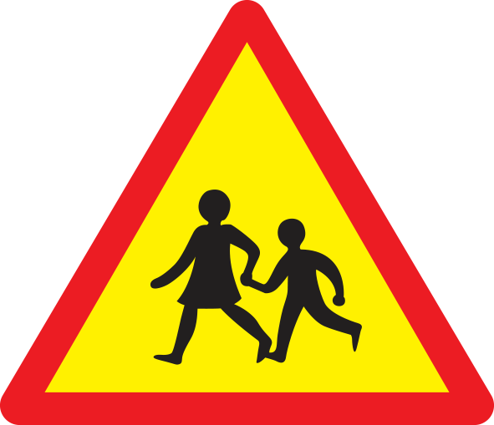
Ex 2. Look and write the correct phrases.
No right turn
Cycle lane
School ahead
Traffic lights
No cycling
Hospital ahead

Slide 22
HIDDEN PICTURE!

Slide 23
What is it?
Cycle lane
SHOW ALL

Slide 24
What is it?
No right turn
SHOW ALL

Slide 25
What is it?
Hospital ahead
SHOW ALL

Slide 26
What is it?
School ahead
SHOW ALL

Slide 27
What is it?
No cycling
SHOW ALL

Slide 28
What is it?
Traffic light
SHOW ALL

Slide 29
Look at the answers again.
Hospital ahead
No right turn
Traffic lights
Cycle lane
School ahead
No cycling

Slide 30


Ex 3. Work in pairs. Take turns to say which of the signs in 2 you see on the way to school.
On my way to school, there is a hospital, so I see a “hospital ahead” sign.
On my way to school, there is a hospital, so I see a “hospital ahead” sign.
On the way to school, there are crossroads, so I see several traffic lights.
On the way to school, there are crossroads, so I see several traffic lights.

Slide 31
Suggested answer:
On the way to school, there are many bicycles on the roads, so I see a “Cycle lane” sign.
On the way to school, I see a “school ahead” sign.
On the way to school, there is no bicycle on the road, so I see a “No cycling” sign.
On the way to school, I see in a traffic light a “not turn right” sign.

Slide 32
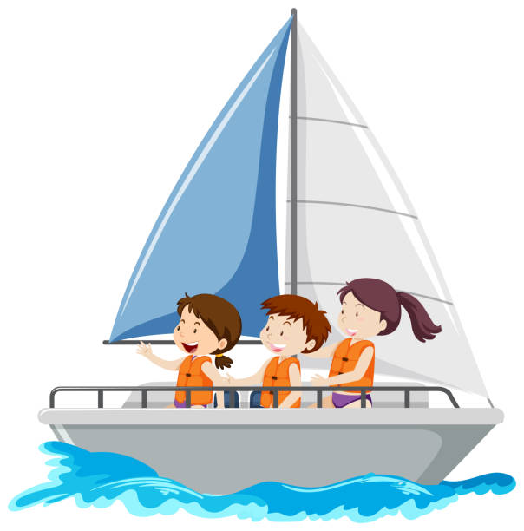
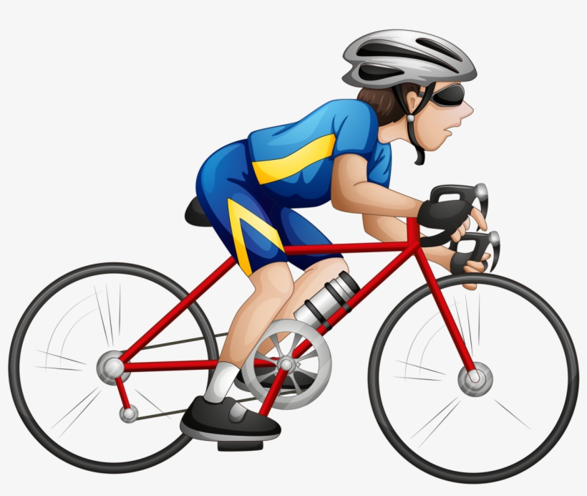
Guess the words
y
s_ _l
c_cle
a
i
/aɪ/
/eɪ/

Slide 33
2
PRONUNCIATION
/aɪ/
/eɪ/

Slide 34

Watch and repeat

Slide 35
Ex 4. Listen and repeat. Pay attention to the sounds /aɪ/ and /eɪ/.
/aɪ/ | /eɪ/
cycle | sail
fly | train
fine | plane
sign | station
motorbike | pavement

Slide 36
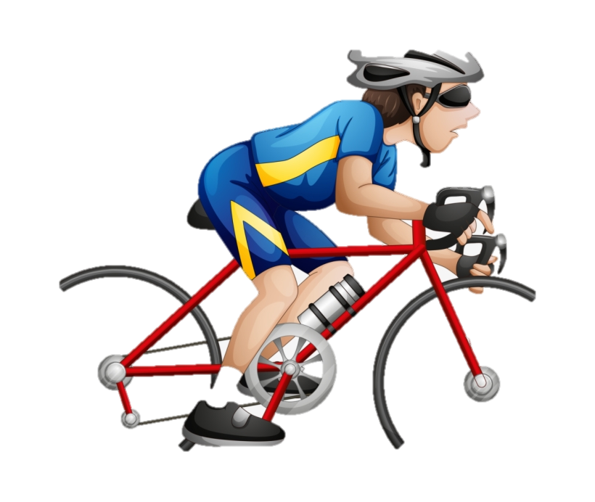
Ex 5. Underline the words with the sound /aɪ/ and circle the words with the sound /eɪ/.
1. The bus station is far from my house.
2. Remember to ride your bike carefully.
3. We must obey traffic rules for our safety.
4. You have to get there in time for the train.
5. Don’t ride on the pavement.

Slide 37
Ex 5. Listen, check and repeat.
1. The bus station is far from my house.
2. Remember to ride your bike carefully.
3. We must obey traffic rules for our safety.
4. You have to get there in time for the train.
5. Don’t ride on the pavement.

Slide 38
RECAP
01
My house is far from school, so I have to ___ a bike to school.
A. drive B. sail C. ride
02
What is the sign?
Hospital ahead
No right turn
No cycling
03
Choose the word pronounced different.
A. ride B. bike C. city
04
You should look right and left when you go ……………. the road.
A. up B. across C. down

Slide 39
HOMEWORK
Learn by heart vocabulary
Find other sign on the road.
Prepare: Unit 7: A Closer Look 2

Slide 40
THANKS!

