Slide 1









Unit 7
TELEVISION
Lesson 3: A closer look 2

Slide 2

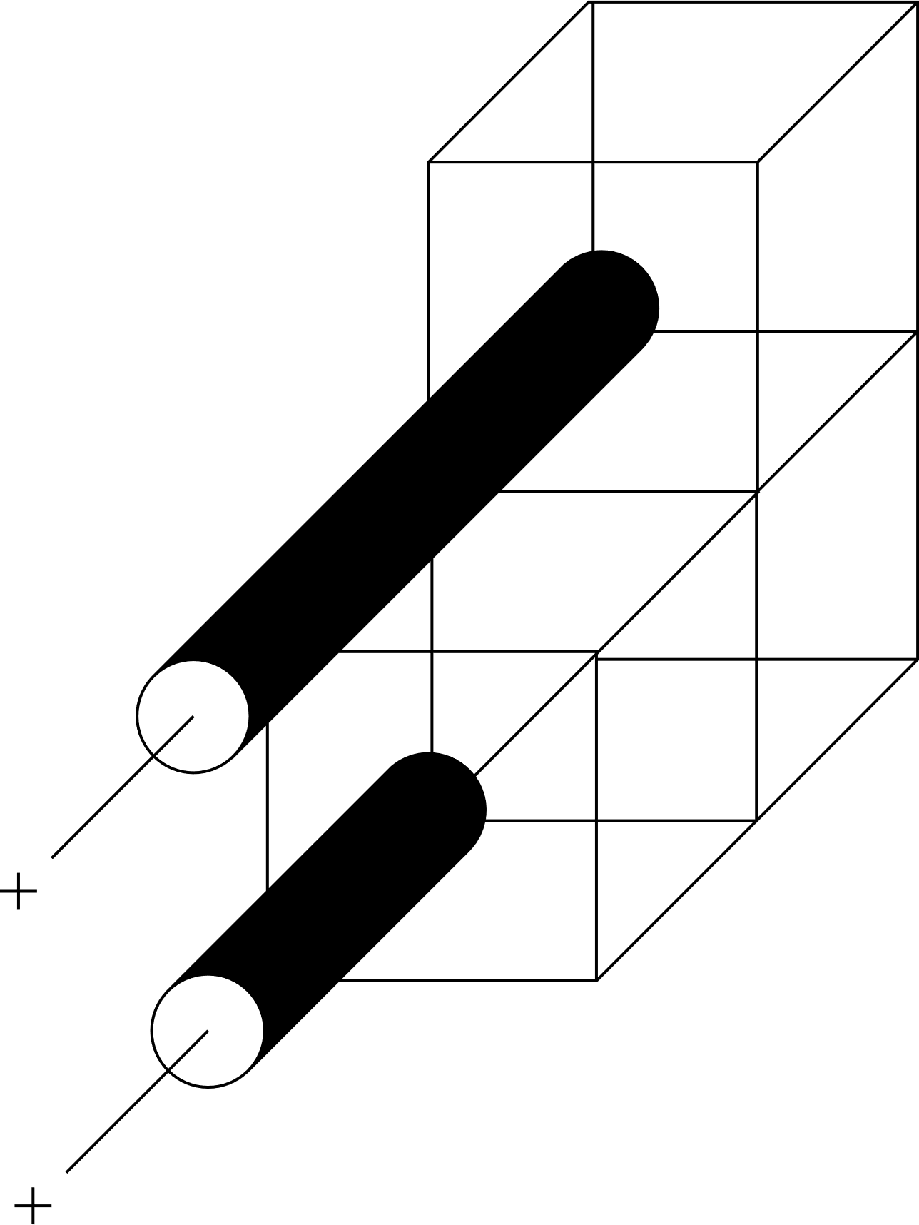


Warm-up
Watch a video
List all questions words

Slide 3

Watch and list

Slide 4




Objectives
By the end of the lesson, students will be able to:
Use Wh-questions and conjunctions in compound sentences: and, but, so correctly.

Slide 5




01.
WH-Questions

Slide 6

1. Read and underline WH-questions (P.9)
Hi, Phong. What are you doing tomorrow?
I’m going to a book exhibition.
I’m going to a book exhibition.
ask about things
Where is it?
It’s in Van Ho Street.
ask about place
It’s in Van Ho Street.
How long is it on?
From the 4th to the 7th January.
From the 4th to the 7th January.
ask about the length of time

Slide 7
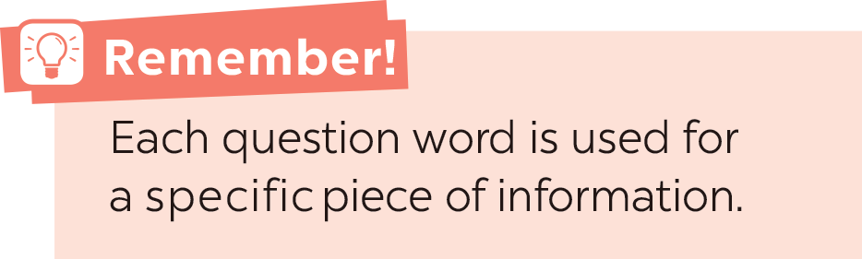
WH-QUESTIONS
2. Match each question word with the information it needs.
When
thing
How many
time
How often
people
What
reason
Where
repetition
Who
number
Why
place

Slide 8
3. Fill in the blanks. Use the questions words in the box.
Conversation 1
A: ____________ do you watch TV?
B: Not very often. Two or three times a week.
A: ____________ do you watch?
B: It depends. But I like talent shows the most.
Conversation 2
A: ____________ do you like the most in Doraemon?
B: Nobita. He's so funny.
Conversation 3
A: ____________ do you play football?
B: Usually on Saturday or Sunda.
A: ____________ do you play?
B: In the yard.
How often
When
Two or three times a week.
(repetition)
What
Who
It depends.
talent shows
(things)
What
Who
Where
Nobita.
(people)
How often
When
on Saturday or Sunday.
(time)
Where
In the yard.
(place)

Slide 9
Combine 2 sentences into 1?
1. I like watching cartoons. My brother likes watching sports.
I like watching cartoons, but brother likes watching sports.
CONJUNCTION
2. I enjoy sports. I spend a lot of time outdoors.
I enjoy sports, so I spend a lot of time outdoors.
CONJUNCTION
We use conjunctions to combine two clauses into a compound sentence.

Slide 10

02. CONJUNCTIONS

Slide 11
Conjunctions in compound sentences
and
(và)
but
(nhưng)
CONJUNCTIONS
(liên từ trong câu ghép)
so
(vì vậy)

Slide 12
4. Match the beginnings with the endings
Beginnings
1. I like animal programmes, 2. I’ll get up early tomorrow, 3. Sometimes we read books, 4. My little brother can colour pictures, 5. We love outdoor activities,
Endings
a. so I can be at the stadium on time. b. but he can’t draw. c. and my brother likes them, too d. so we spend every Saturday playing sports e. and sometimes we play sports.
c
a
e
b
d

Slide 13

4. Use and, but or so to complete the sentences.
1. I'm tired, _______ I'll go to bed early.
2. My sister is good at school, _______ I'm not.
3. We trained hard, _______ we won the game.
4. The programme is interesting, _______ it's too long.
5. I'll write him some instructions, _______ I hope he'll follow them.
so
but
so
but
and

Slide 14



Game: Finding your group
3 teams
beginning
conjunction
ending
- Each person from each team writes their own part on the paper.
- 2 minutes
- Choose 2 friends from other teams, match your parts to make a sentence.

Slide 15






- _______ do you play football with?
- My friends.
What
Who
Whose
RECAP
He’s tired, _____ he’ll take a rest.
and
so
but

Slide 16

Homework
Do exercises in workbook
Prepare for the next lesson

Slide 17
Thank you
See you next time!

