Slide 1




WELCOME TO OUR CLASS
Presented by: …..

Slide 2

Do the quiz

Slide 3

Unit 7:
NATURAL WONDERS OF THE WORLD
Lesson 3: A Closer Look 2

Slide 4



OBJECTIVES
By the end of the lesson, students will be able to:
Change Yes / No questions into reported speech

Slide 5

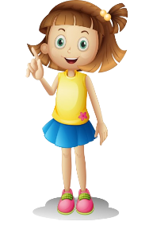

Reported speech: Yes/No question
Do you plan to climb any mountains this summer, Joe?
Anna asked Joe if/whether he planned to climb any mountains that summer?
Anna

Slide 6

Reported Speech: Yes/No question

Slide 7

In reporting Yes / No questions, we often use the verb ask or want to know; we use the word order of statements.
In reporting Yes / No questions, we normally use if / whether + clause.
S
asked
wanted to know
+
if
whether
+
S
+
V2/ed
+

Slide 8

1. Choose the correct answer A, B, C, or D to complete each question
1. “Will pollution endanger the wildlife here?” Kate asked.
→ Kate ______ if pollution would endanger the wildlife there.
A. told me B. said to me
C. wanted to know D. questions me
2. “Are you enjoying your flight?” the stewardess asked me.
→ The stewardess asked me if I ______my flight.
A. am enjoying B. was enjoying
C. enjoyed D. would enjoy
3. “Is Ganh Da Dia in Phu Yen Province, Phong?”
→ She asked Phong ______ in Phu Yen Province.
A. was Ganh Da Dia B. if Ganh Da Dia is
C. whether Ganh Da Dia was D. if it is Ganh Da Dia

Slide 9
1. Choose the correct answer A, B, C, or D to complete each question
4. “Can I take a photo inside the cave?” he said to the guide.
→ He ______ the guide if he could take a photo inside the cave.
A. asked B. said
C. advised D. ordered
5. “Is the weather good in Sa Pa in the winter?”
→ She wanted to know_____________________
A. was the weather good in Sa Pa in the winter?
B. if the weather is good in Sa Pa in the winter.
C. whether was the weather good in Sa Pa in the winter.
D. if the weather was good in Sa Pa in the winter.

Slide 10

2. Complete the following reported questions.
1. “Are you excited about your upcoming trip to Mui Ne?”
He asked the children if they were _______________________.
2. “Do you often meet Angela at school?”
She asked us whether we ______________________________.
3. “Will you visit Giang Dien Waterfall next week?”
She wanted to know if Mark____________________________.
4. “Is Con Dao National Park rich in flora and fauna?”
I asked the teacher ___________________________________.
5. “Can we go to the campsite by bike?”
Arthur wanted to know ________________________________.

Slide 11



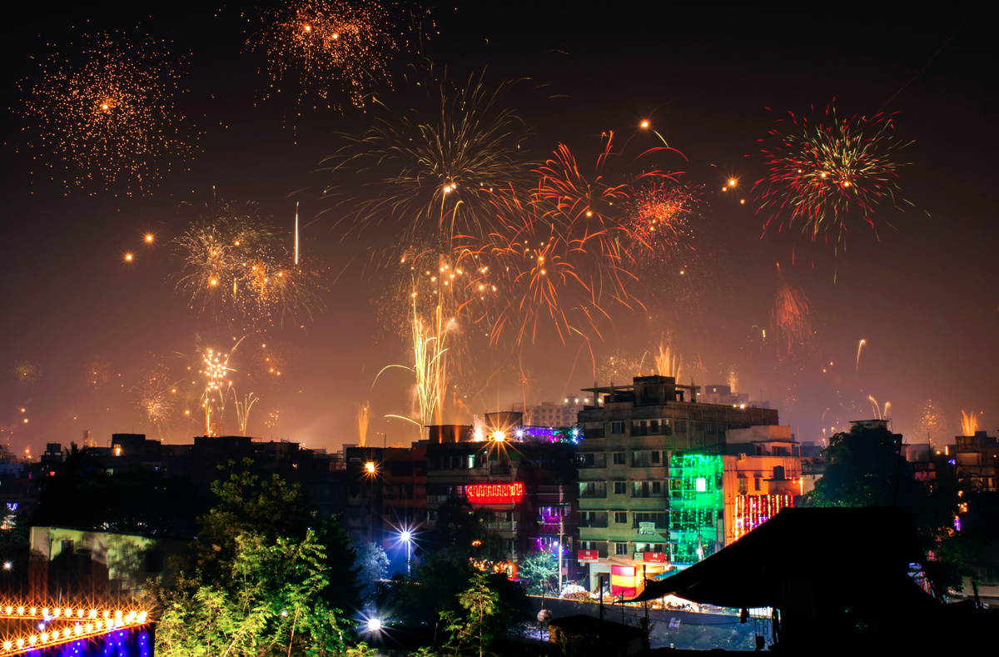
Check your answer
1. “Are you excited about your upcoming trip to Mui Ne?”
He asked the children if they were
excited about their upcoming trip to Mui Ne.

Slide 12
Check your answer
2. “Do you often meet Angela at school?”
She asked us whether we
often met Angela at school.

Slide 13
Check your answer
3. “Will you visit Giang Dien Waterfall next week?”
She wanted to know if Mark
would visit Giang Dien Waterfall the next week?

Slide 14
Check your answer
4. “Is Con Dao National Park rich in flora and fauna?”
I asked the teacher
if Con Dao National Park rich in flora and fauna.

Slide 15
Check your answer
5. “Can we go to the campsite by bike?”
Arthur wanted to know
if they could go to the campsite by bike.

Slide 16

3. Rewrite the sentences in reported questions.
1. “Are you still working from home?” I asked my dad.
I asked my dad if / whether he was still working from home.
2. “Do you have to pack your suitcase, Anne?” said Mark.
Mark asked Anne if / whether she had to pack her suitcase.
3. Lan: “Are you interested in visiting Phu Quoc Island, Tom?”.
Lan asked / wanted to know if / whether Tom was interested
in visiting Phu Quoc Island.
4. “Can we afford to go to Niagara Falls, Mum?” said Kay.
Kay asked her mum if / whether they could afford to
go to Niagara Falls.
5. “Will they visit Sa Pa and climb Mount Fansipan this summer?”
I asked / wanted to know if/ whether they would visit Sa Pa
and climb Fansipan that summer.

Slide 17
Read the passage
Underline the Yes/No question
A tour guide is taking a group of tourists to visit Tonle Sap Lake in Cambodia. The guide said to them: “Is it your first time here?” Some said yes and some said no. Olivia asked the guide: “Do the people live on fishing?” He said most of them did. Then Mark said: “Do their children go to school on land?” “Yes, they do,” said the guide. ...
Write them in reported questions

Slide 18

Write them in reported questions.
1. The guide said to them: “Is it your first time here?”
The guide asked them / wanted to know
if / whether it was their first time there.
2. Olivia asked the guide: “Do the people live on fishing?”
Olivia asked / wanted to know
if / whether the people there lived on fishing.
3. Mark said: “Do their children go to school on land?”
Mark asked / wanted to know
if / whether their children went to school on land.
3. Mark said: “Do their children go to school on land?”

Slide 19
5. Work in two groups. Take turns to give and change the Yes/No questions into reported speech.
Group A:
“Is the Atacama Desert in Chile?”
Group B:
She asked if the Atacama Desert was in Chile.

Slide 20
WRAP-UP
What have we learnt in this lesson?
Change Yes / No questions into reported speech

Slide 21
HOMEWORK
- Do exercises in the workbook.
- Make 5 sentences by using Yes/No questions in Reported Speech
- Prepare: Communication

Slide 22

Thank you!

Slide 23


Resource
Page
Use these design resources in your Canva Presentation. Happy designing!
Don't forget to delete or hide this page before presenting.

Slide 24





Resource
Page
Use these design resources in your Canva Presentation. Happy designing!
Don't forget to delete or hide this page before presenting.

