Slide 1



WELCOME TO OUR CLASS

Slide 2
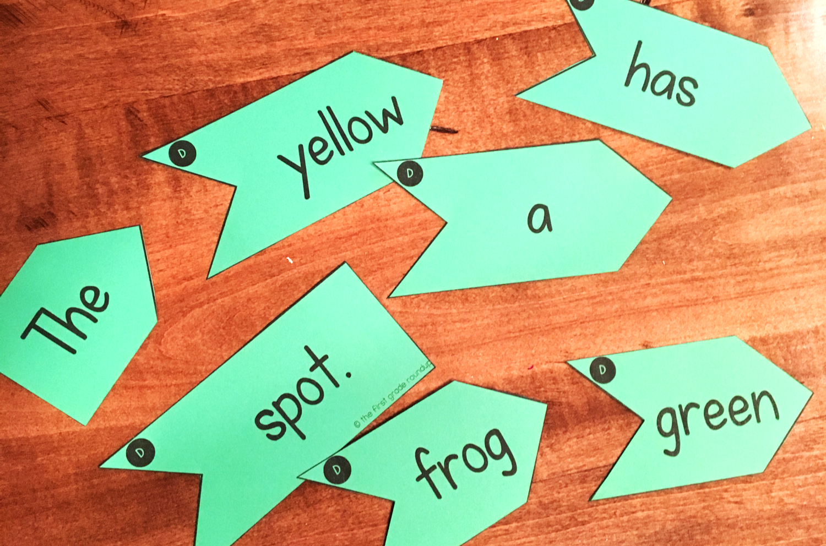
SENTENCE PUZZLES
Work in groups
Reorder the words to
make complete sentences
The
green
frog
has
a
yellow
spot.

Slide 3
1
use
will
My house
energy.
solar
2
bus.
school
She
goes to
by
3
will
twenty
have
robots.
It
4
help
housework.
I
to do
my mom

Slide 4
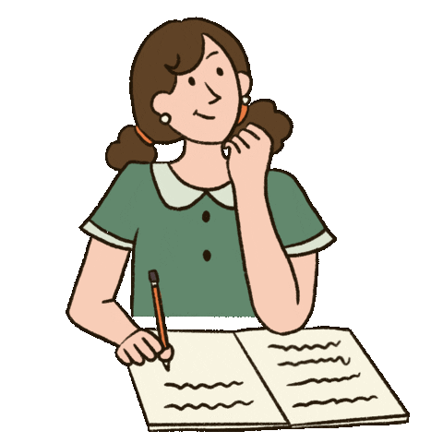
4
16
9
15
7
30
29
28
27
26
25
24
23
22
21
20
19
18
17
16
15
14
13
12
11
10
9
8
7
6
5
4
3
2
1
1
2
20
3
0
5
27
22
17
18
12
6
24
11
10
8
13
14
29
19
21
23
26
25
30
28
1
use
will
My house
energy.
solar
2
bus.
school
She
goes to
by
3
will
twenty
have
robots.
It
4
help
housework.
I
to do
my mom

Slide 5
1
My house
will
use
solar
energy.
Future simple
2
She
goes to
school
by
bus.
3
It
will
have
twenty
robots.
4
I
help
my mom
to do
housework.

Slide 6

UNIT 10
Our houses
in the future
LESSON 3: A CLOSER LOOK 2

Slide 7

TENSES
PAST SIMPLE
PRESENT SIMPLE
FUTURE
SIMPLE
Actions happened in the past
Habits, and daily routines
happen every day
Actions happen in the future
Notes:
NGANG

Slide 8

FUTURE SIMPLE
Affirmative (+)
We
will
live
in the city next year.
She
will
learn
English this afternoon.
…
S
+
will
+
Vbare infinitive
+
*will = ‘ll
Notes:
Thêm 1 câu ví dụ chủ từ khác we., lấy vu trong sách,

Slide 9
FUTURE SIMPLE
Negative (-)
Sam
will not
finish
his work.
…
S
will not/
won’t
+
+
+
Vbare infinitive
*will not = won’t

Slide 10
FUTURE SIMPLE
Interrogative (?)
Will
you
meet
him tomorrow?
Will
+
S
+
Vbare infinitive
+
…
    Yes, S + will.
No, S + won’t.

Slide 11
We use the futre simple to talk ab;out an action that happens in the future.
FUTURE SIMPLE
*Usage:
We use the future simple to talk about an action that happens in the future.
*Future expressions:
Tomorrow, tonight
In the future
This morning/afternoon/…
Next week/month…
I think / I'm sure …

Slide 12

Fill in the blanks with will (‘ll) or won’t to make the sentences true for you.
TASK 1

Slide 13
Fill in the blanks with will (‘ll) or won’t to make the sentences true for you.
1
Example:
I think I’ll listen to music in the afternoon.
will/won’t
1.
I think I ___________ stay at home tonight.
will/won’t
2.
My friends _____________ go to the library this afternoon.
will/won’t
3.
My mum ___________ make a cake today.
will/won’t
4.
I ____________ have an English test tomorrow.
will/won’t
5.
Our family __________ move to the new house next week.

Slide 14
Complete the conversation with will (‘ll) or won’t.
TASK 2

Slide 15
2
Complete the conversation with will (‘ll) or won’t.
A: Oh, no. The dog ran away again!
B: Don’t worry – he (1)
A: Are you sure he (2)
B: OK, he might not come back today. But I’m sure he (3)
come back tomorrow.
A: I don’t believe you! He (4)
never see him again. I’m sure.
B: Oh, look ... Here he is!
will / 'll come back.
_______ come back.
will ?
_______?
will / 'll
_______
will / 'll
won’t come back. We (5)
_______ come back. We (5) _______
_______

Slide 16
Write sentences using will (‘ll) or won’t and the words given.
TASK 3

Slide 17
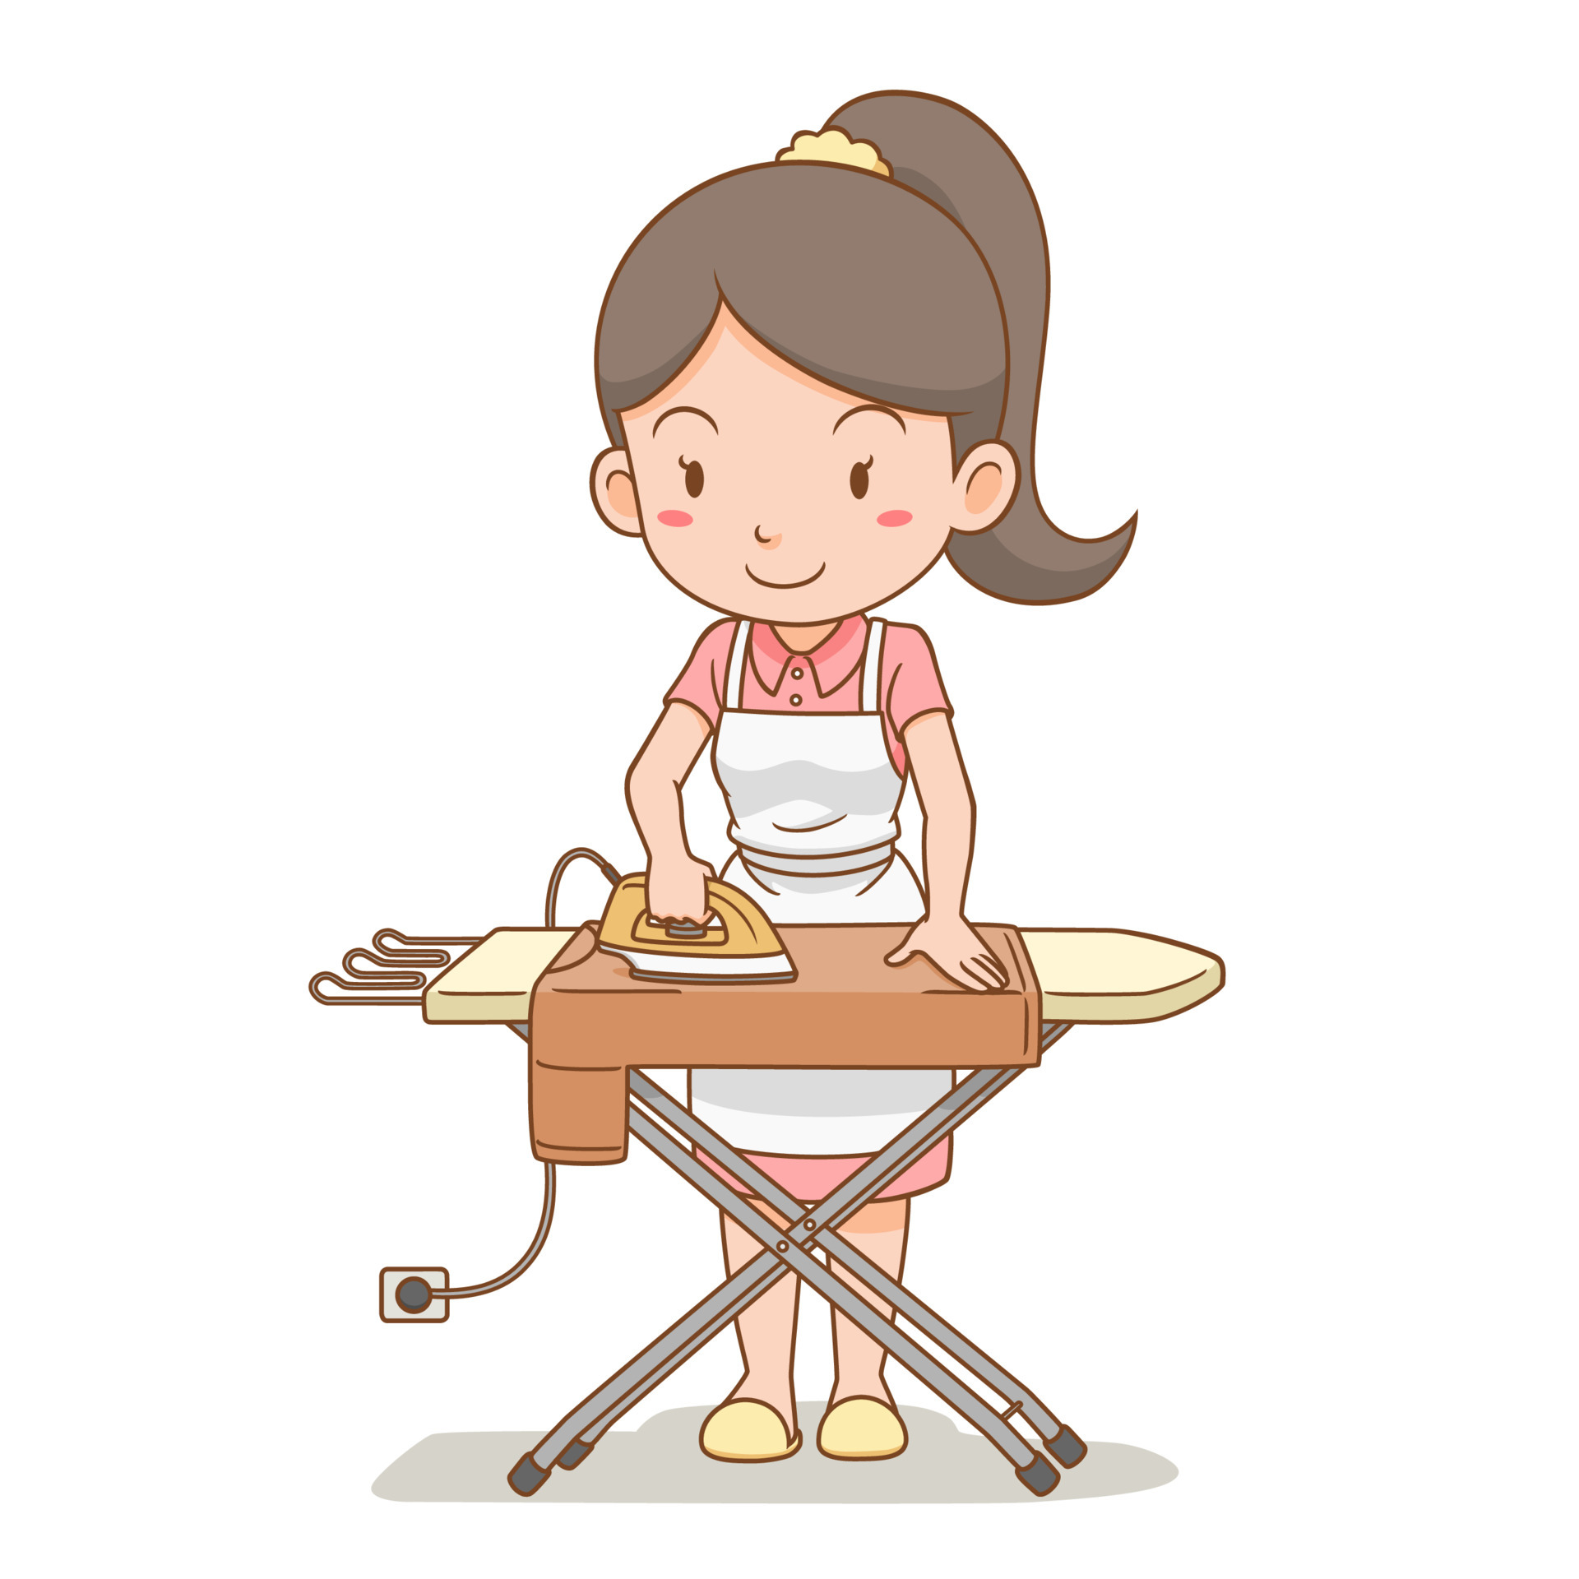
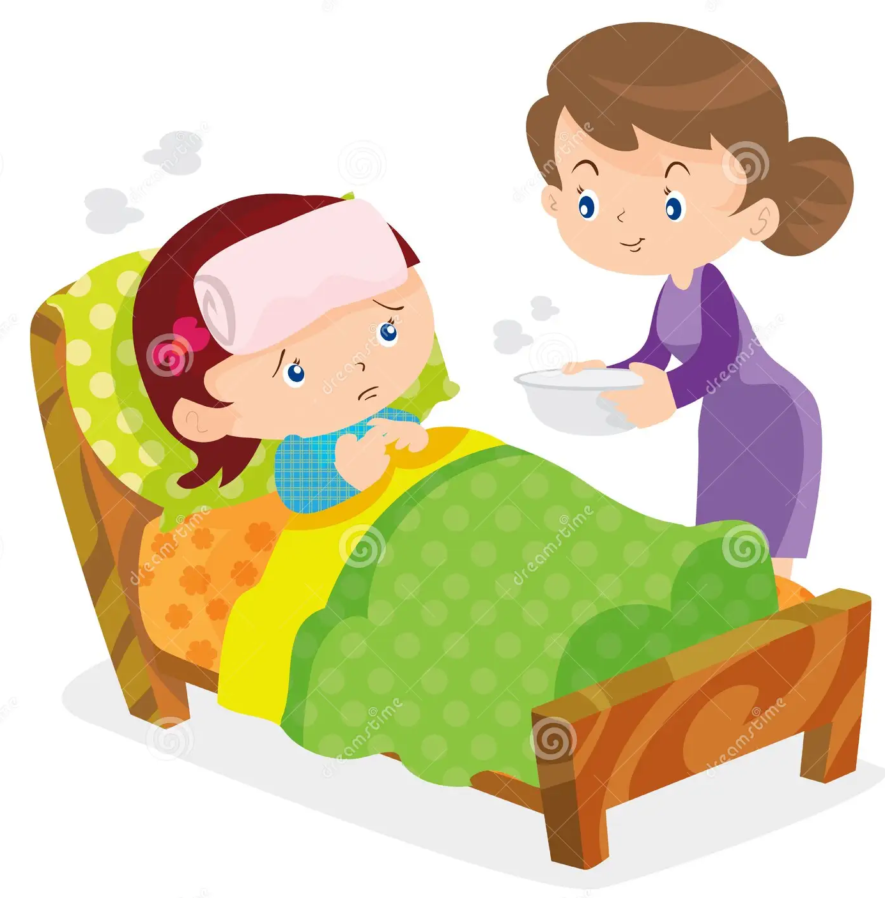
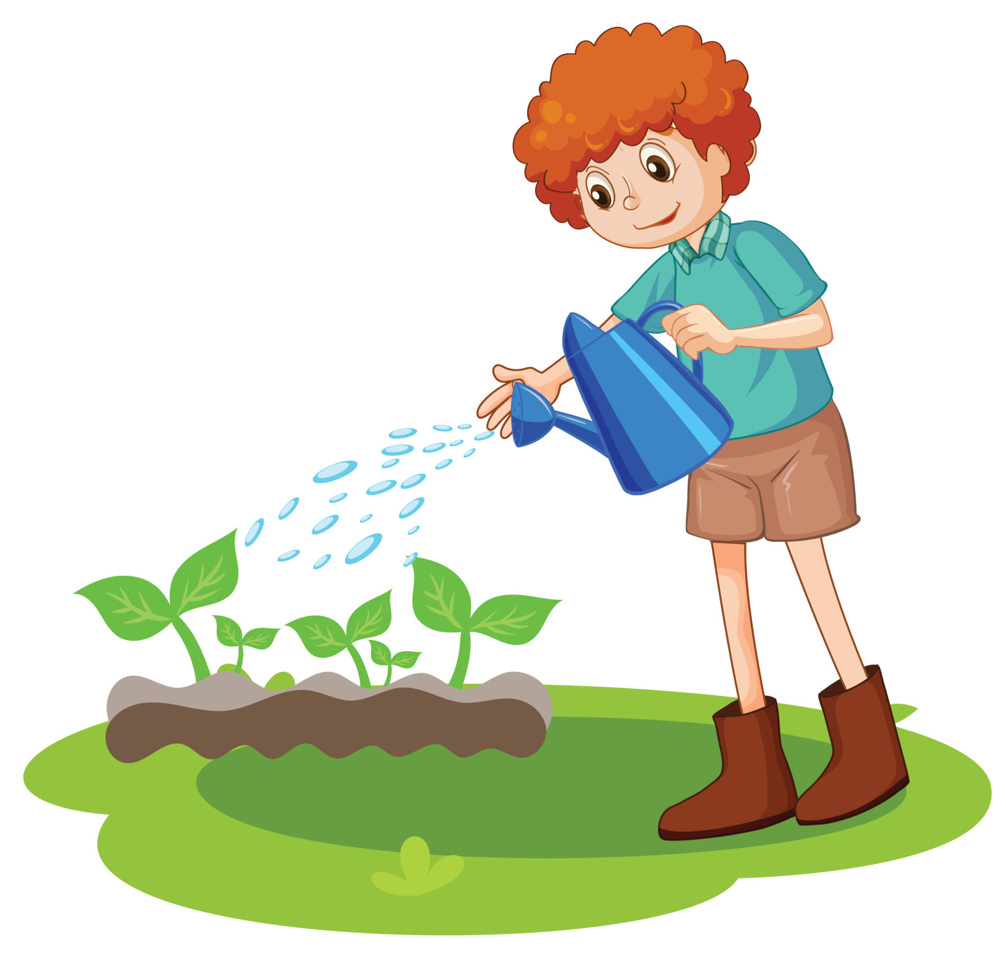
3
Write sentences using will (‘ll) or won’t and the words given.
1.
computer / do / housework
2.
robot / water / ﬂowers
3.
smart TV / cook / meal
4.
washing machine / iron / clothes
5.
smartphone / take care / children
Notes:
Câu 1 làm model, mỗi nhóm 1 câu, làm game, cho hs nói trc rồi hs khác nhận xét, mở đáp án

Slide 18



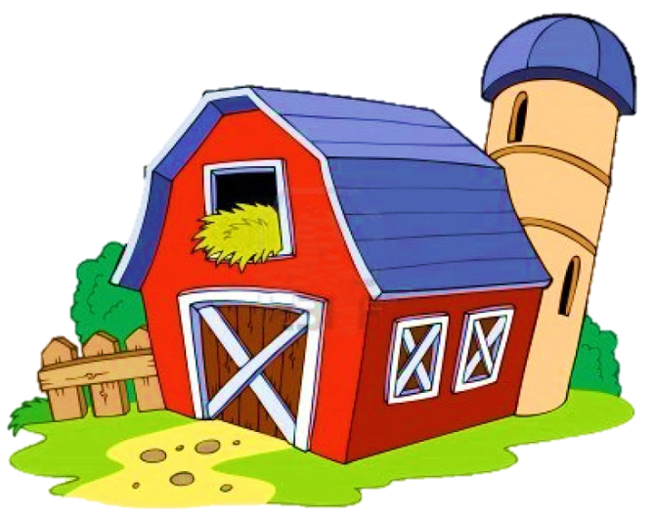

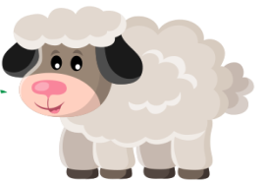



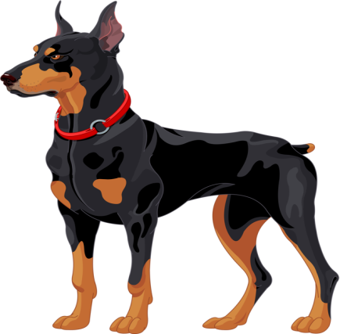
Lisa
John
Jenny
Peter
David

Slide 19

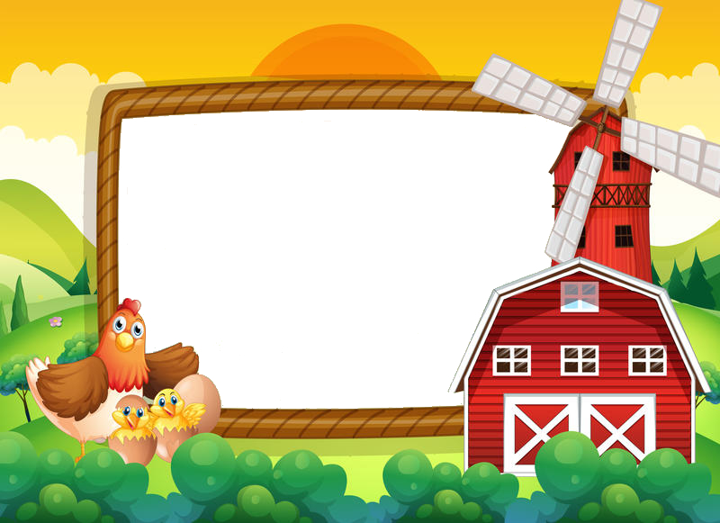

1. computer / do / housework
A computer will / won’t help me to do my housework.

Slide 20
2. robot / water / ﬂowers
A robot will help me to water the flowers.

Slide 21
3. smart TV / cook / meal
A smart TV won’t help me to cook meals.

Slide 22
4. washing machine / iron / clothes
A washing machine will / won’t help me to iron the clothes.

Slide 23
5. smartphone / take care / children
A smartphone won’t help me to take care of the children.

Slide 24
3
Write sentences using will (‘ll) or won’t and the words given.
1.
computer / do / housework
A computer will / won’t help me to do my housework.
2.
robot / water / ﬂowers
A robot will help me to water the flowers.
3.
smart TV / cook / meal
A smart TV won’t help me to cook meals.
4.
washing machine / iron / clothes
A washing machine will / won’t help me to iron the clothes.
5.
smartphone / take care / children
A smartphone won’t help me to take care of the children.
Notes:
Câu 1 làm model, mỗi nhóm 1 câu, làm game, cho hs nói trc rồi hs khác nhận xét, mở đáp án

Slide 25

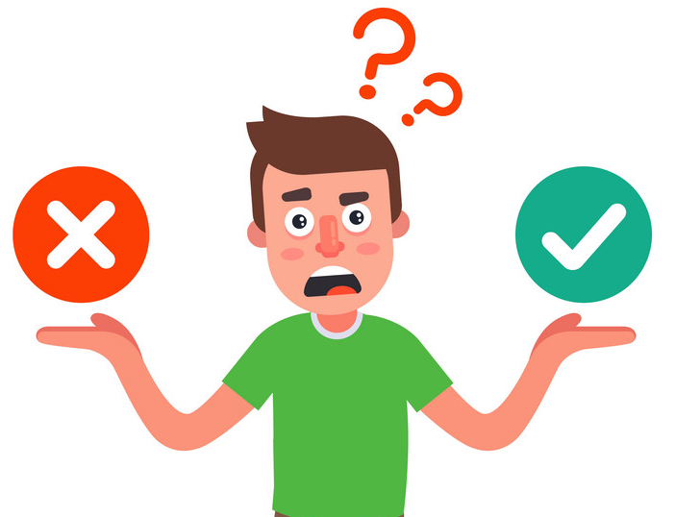
Will vs Might
Example:
might live
We (live) _________ in a UFO.
Uncertain → Might
Certain → Will
Notes:
Chia đobgj từ

Slide 26
MIGHT for future possibility
Affirmative (+)
We
might
live
in a UFO.
+
…
S
+
might
+
Vbare infinitive

Slide 27
MIGHT for future possibility
Negative (-)
We
might
not
travel
in cars.
S
+
+
+
+
…
might
not
Vbare infinitive

Slide 28
We use the future simple to talk about an action that happens in the future.
MIGHT for future possibility
*Usage:
We use “might + V” to talk about actions that are possible in the future (we are not sure if they will happen or not).
Example:
We might live in a UFO.
They might not travel in cars.
uncertain

Slide 29
Read two poems. Tick (✓) T (True) or F (False).
TASK 4

Slide 30

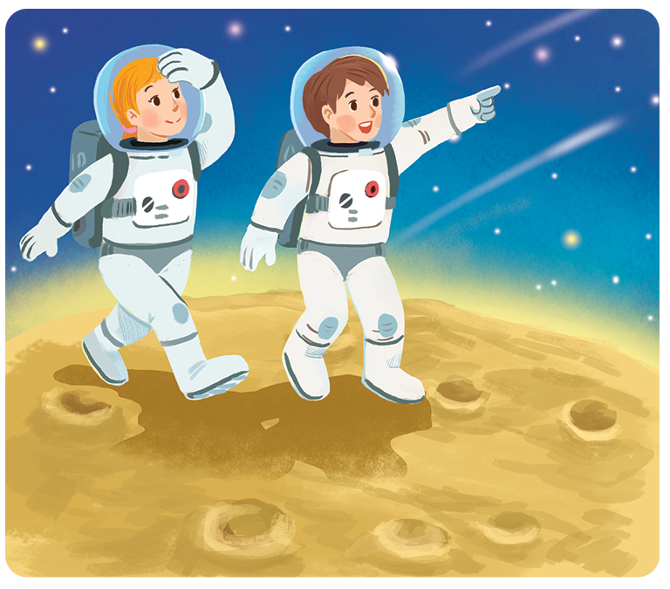
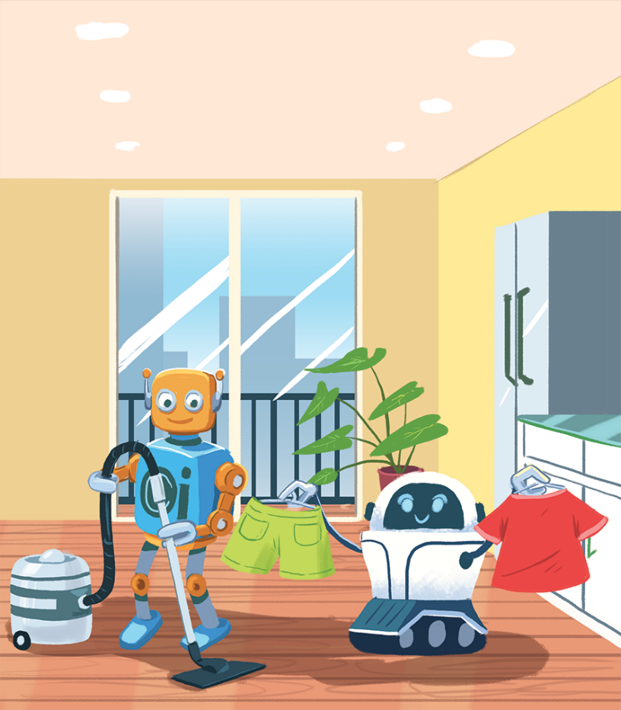
4
Read two poems. Tick (✓) T (True) or F (False).
In the future
We might live with robots.
They might clean our houses.
They might wash our clothes.
They might not talk to us.
In the future
Jenny, aged 12
We might go on holiday to the Moon.
We might stay there for a long time.
We might have a great time.
We might come home soon.
Henry, aged 11

Slide 31
 | True | False
1. Jenny thinks we might live with robots.
2. Henry thinks we might travel to the Moon.
3. Jenny thinks robots might not clean our houses.
4. Henry thinks we will stay on the Moon for a short time.
5. Jenny thinks robots might help us to do the housework.
6. Henry thinks we might not have a great time on the Moon.
We might go on holiday to the Moon.
We might stay there for a long time.
We might have a great time.
We might come home soon.
Henry, aged 11

We might live with robots.
They might clean our houses.
They might wash our clothes.
They might not talk to us.
Jenny, aged 12

We might live with robots.
They might clean our houses.
They might wash our clothes.
They might not talk to us.
Jenny, aged 12
We might go on holiday to the Moon.
We might stay there for a long time.
We might have a great time.
We might come home soon.
Henry, aged 11

We might go on holiday to the Moon.
We might stay there for a long time.
We might have a great time.
We might come home soon.
Henry, aged 11

We might live with robots.
They might clean our houses.
They might wash our clothes.
They might not talk to us.
Jenny, aged 12
for a long time.



Slide 32
Work in groups. Think about what you might do or have in the future. Share your ideas with your classmates.
TASK 5

Slide 33

Example:
I might have a smartphone to surf the internet.

Slide 34
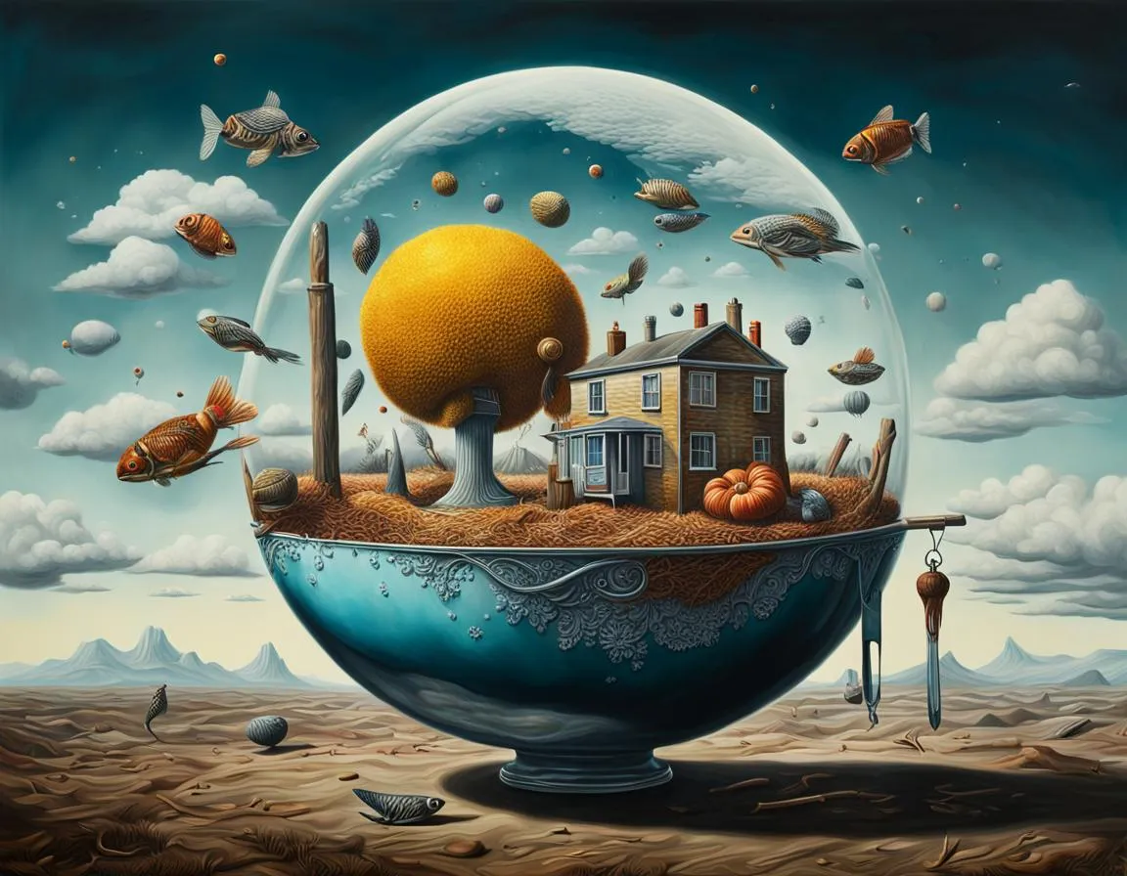
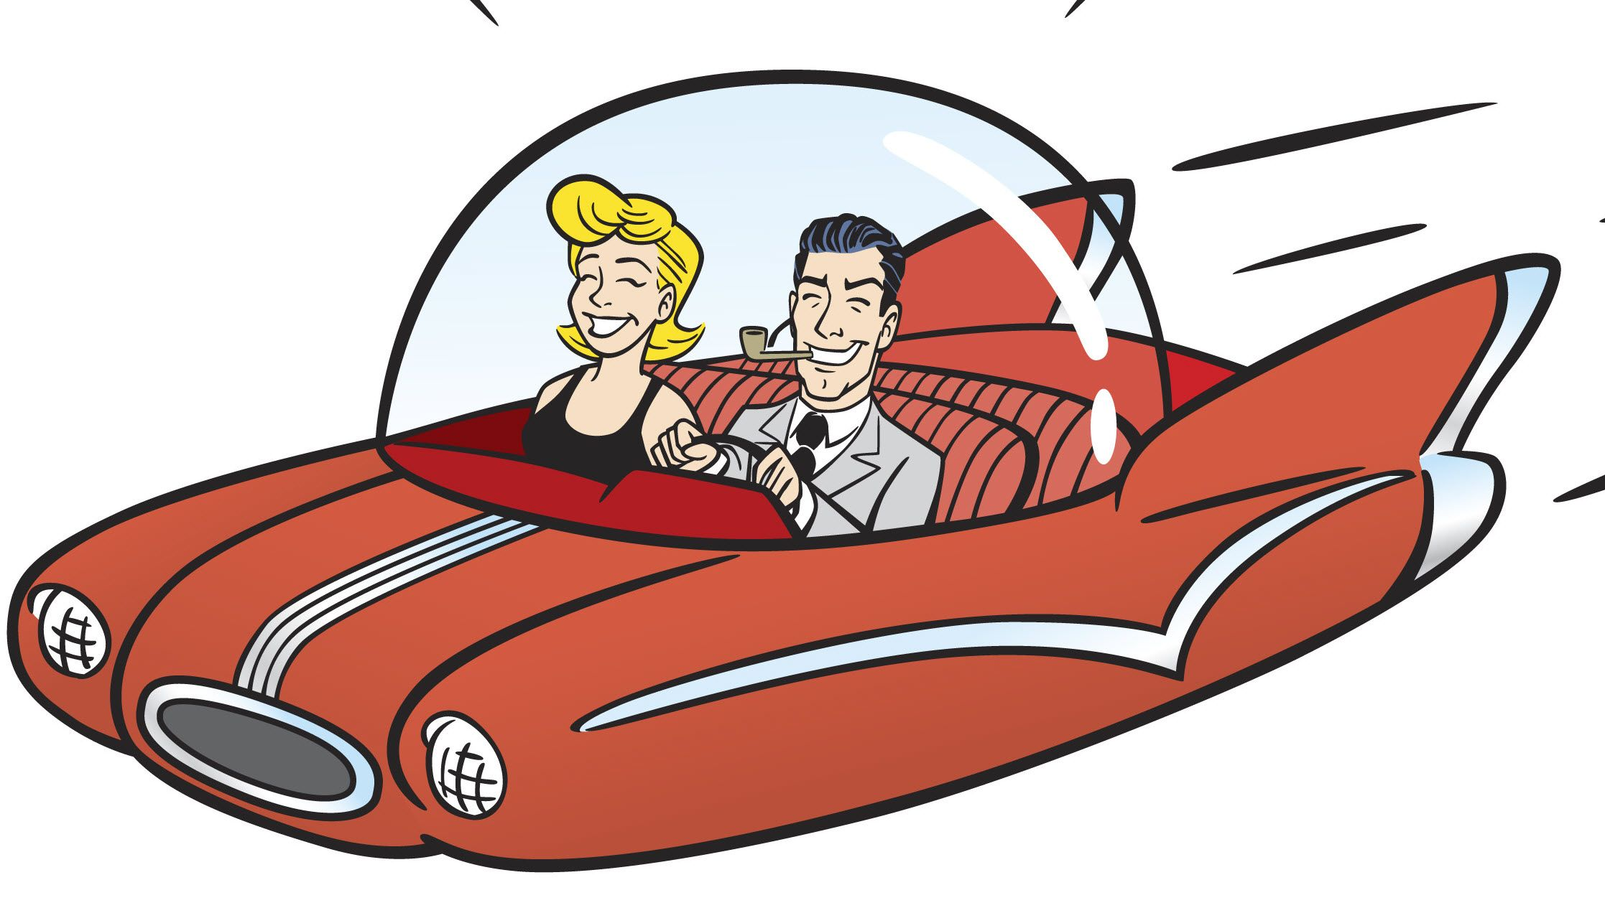
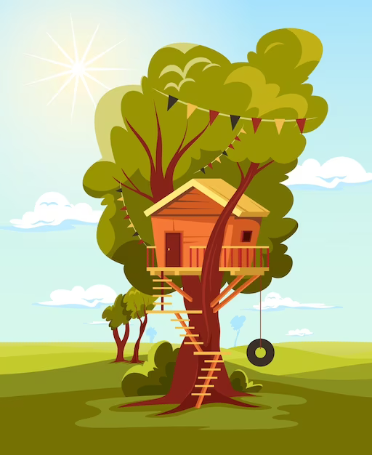
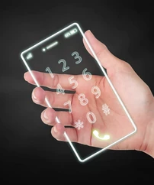
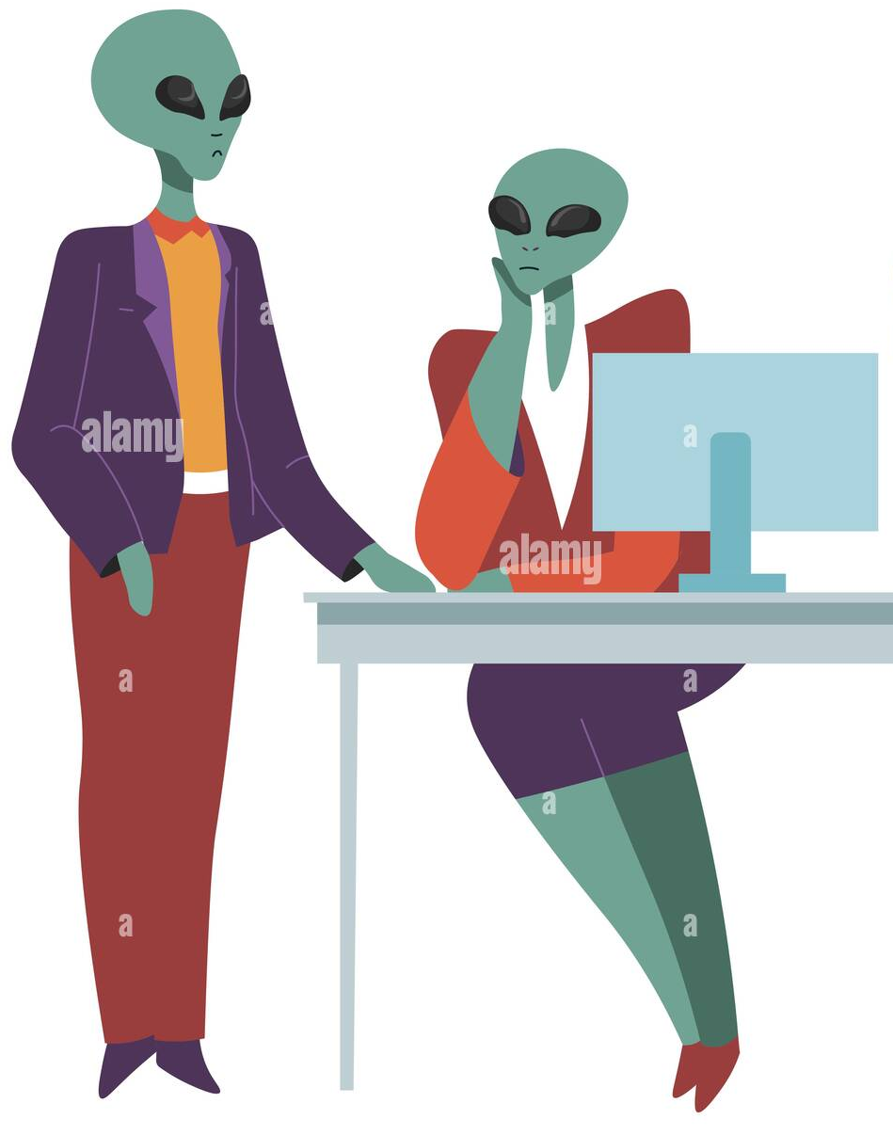
Draw one thing you want to have or do in the future

Slide 35

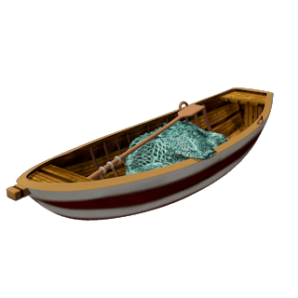
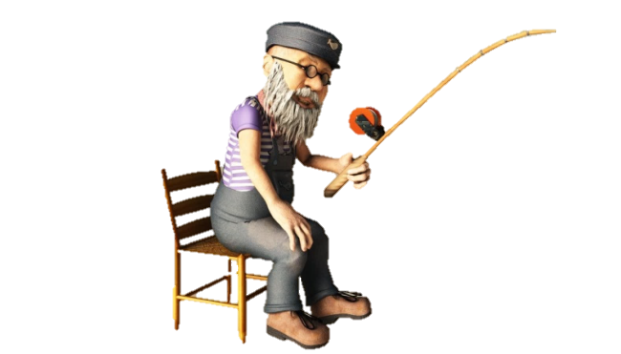






GOING

Slide 36
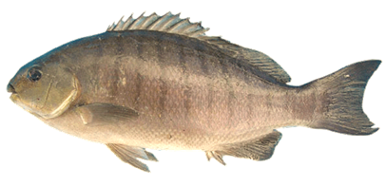

1._____ you be in Rome tonight?
GREAT!
Will
Do
Might
Will
Did

Slide 37
GREAT!
2. I am still not sure where to go for my holiday. I _____ go to Da Lat.
might
will
didn’t
doesn’t
might

Slide 38
3. We have enough food for dinner, so I ____ go shopping today.
GREAT!
won’t
won’t
might
doesn’t
will

Slide 39
4. One day people _____
find life on other planets.
GREAT!
might
do
might
will
won’t

Slide 40
5.They _____ find water on Mars.
GREAT!
might
will
might
don’t
did

Slide 41
THANKS FOR
YOUR ATTENTION

Slide 42




Slide 43
4
16
9
15
7
30
29
28
27
26
25
24
23
22
21
20
19
18
17
16
15
14
13
12
11
10
9
8
7
6
5
4
3
2
1
1
2
20
3
0
5
27
22
17
18
12
6
24
11
10
8
13
14
29
19
21
23
26
25
30
28

